Slide 1
How did we begin - Govind Narrative
Engaged Philanthropists | Stronger NGOs | Bigger Impact

Slide 2
SVP India:
Scale & Impact
SVP International Global Summit 2025
Austin, TX, USA | May 2025
Engaged Philanthropists | Stronger NGOs | Bigger Impact

Slide 3
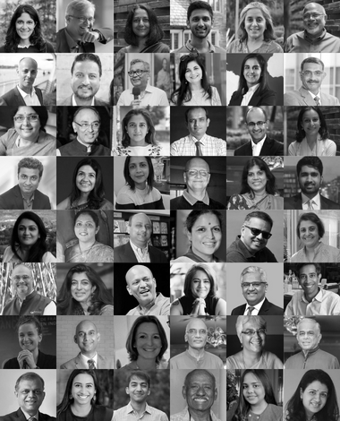
Content
The SVP India Story: Inception to Impact
One SVP / SVP As One (SAO)
Board
Management Council (MC)
Leadership Team (LT)
3. The SVP India Multiplier Effect & Impact
Partner Drive
Partner Diversity & Engagement
NGO Engagement
Retail Fundraising
Fast Pitch: An Ecosystem Enabler
Communications & Outreach
Engaged Philanthropists Stronger NGOs Bigger Impact

Slide 4
Our Vision
Building a community
of like-minded individuals
focused on engaging in philanthropy to become lifelong givers
Engaged Philanthropists | Stronger NGOs | Bigger Impact

Slide 5
The SVP India Story
Engaged Philanthropists | Stronger NGOs | Bigger Impact

Slide 6
SVP India’s footprint across the country
8 Cities
Pan India
736*
486*
123*
Delhi NCR
Partners
Partner Units
NFP
USD 5M grants disbursed by SVP Partners since inception
USD 8.5M funds enabled to our grantees since inception
90,000+ hours invested by SVP Partners since inception
Ahmedabad
Kolkata
Surat
Mumbai
Pune
Hyderabad
Bengaluru
*data as of Mar 31, 2025
Chennai
Registered nonprofit organization with all cities finances rolled up into one entity (SVP India)
Engaged Philanthropists | Stronger NGOs | Bigger Impact

Slide 7
Partner Diversity & Engagement
Key roles for partners in each affiliate:
Lead Partner
Grants Committee
Grants Review Committee
NFP Engagement Committee Partner
Partner Enrolment Committee
Partner Engagement Committee
Enabled Funding Committee
Profession
Age Profiles
Engaged Philanthropists | Stronger NGOs | Bigger Impact

Slide 8
SVP India’s Unique Model
REVIEW IMPACT
Through a review committee, NGO-Partner engagements are periodically reviewed to measure social impact.
This process creates deeply 'Engaged Philanthropists'
FUNDED /
NONFUNDED SUPPORT
Every NGO's capacity building needs are identified. Skilled partners are matched to support the NGOs. Partners use their wide networks to aid NGOs to scale
GRANTS TO NFPs
Partner donations (USD xx/year) are pooled together and invested in social ventures (NGOs)
PARTNER SIGN UP
Individuals and Corporates sign up as partners and get actively involved in philanthropy
Engaged Philanthropists | Stronger NGOs | Bigger Impact

Slide 9
Our Board and their Key Responsibility Areas
Currently, SVP India has 5 Board Members, each of whom hold key functions for the organization:
Prasad Baji - Finance
Ajit Rangnekar - Process & Tech
Amita Chauhan - Marketing & Communications
Rati Forbes - People
GOVIND IYER
AMITA CHAUHAN
All-India Chair
RATI FORBES
PRASAD BAJI
AJIT RANGNEKAR
Engaged Philanthropists | Stronger NGOs | Bigger Impact

Slide 10
Our Management Council (MC) - Bringing In Rich Philanthropic & Corporate Experience
GOVIND IYER
RATI FORBES
PRASAD BAJI
All-India Chair
All-India Board
All-India Board
& Mumbai Chapter Chair
SASHI RAJAMANI
AMITA CHAUHAN
Bengaluru Chapter Chair
AJIT RANGNEKAR
All India Borad
All-India Board
HARJEET KOHLI
PIYUSH BHANDARI
SAMIR SHAH
Delhi Chapter Chair
SUNITA CHERUKU &
SHOBU YARLAGADDA
Chennai Chapter Chair
Ahmedabad Chapter Chair
RIPPLE MIRCHANDANI
Hyderabad Chapter Chair & co-Chair
SUNIL BHANDARI
Pune Chapter Chair
Kolkata Chapter Chair
Engaged Philanthropists | Stronger NGOs | Bigger Impact

Slide 11
Our
Leadership
Team (LT)
Yogesh Ranganath, CEO
Shivani Gupta, Program Manager
Karishma Dixit, CEO
Parul Vaidya, CEO
Parvati Chandran, CEO
Priyanka Nighot, Program Manager
Bhagyashree Gade, Program Manager
Arpit Singh, Program Manager
Gauri Sharma, Program Manager
Priti Patel, Program Manager
Bengaluru
Mumbai
Pune
Delhi NCR
Snigdha Shah, CEO
Aamrapali Sharma, CEO
Anna Tulika Gomes, Program Manager
Angana Nanavaty, CEO
Gayathri Balan, CEO
Sherry Yezdani, Head - Strategic Partnerships
and Operations
Prachi Mishra, Program Manager
Falguni Pal, Program Associate
Sadhvi Surendhran, Program Associate
Hyderabad
Kolkata
Ahmedabad
Chennai
Manisha Dalal, Project Manager
India

Slide 12
Partner Drive: Growing Our Partner Base
Trust-based philanthropic approach through word-of-mouth prospective partner outreach
SVP India LinkedIn and website active sources attracting prospective partner leads too
900 prospective partner referrals since 2021 by SVP Partners with an approx. 40% conversion rate
Engaged Philanthropists | Stronger NGOs | Bigger Impact

Slide 13
Partner Growth Over the Last 7 years (FY18-19 to FY24-25)
 | 2018-19 | 2019-20 | 2020-21 | 2021-22 | 2022-23 | 2023-24 | 2024-25
All India Total PUs (End of Year) | 156 | 175 | 188 | 220 | 331 | 418 | 486
No. of Hours Engaged (@ 3 hrs per Partner Unit/month) | 5,616 | 6,300 | 6,768 | 7,920 | 11,916 | 15,048 | 17,496
+16.30%
+26.30%
+50.50%
+17.00%
+7.40%
+13.00%
+12.20%
Engaged Philanthropists | Stronger NGOs | Bigger Impact

Slide 14
SVP India Brand Film
Engaged Philanthropists | Stronger NGOs | Bigger Impact

Slide 15
Not-for-Profit Engagement
Systematic and robust Due diligence …on average we select 12% of all applications
Have a formal Financial DD done by a reputed Accounting Firm
Different affiliates have different thematic engagement basis local contextualisation
Focused programs for capacity and capability building
Many of our SVP Partners have joined our investee NFP advisory boards
All Alumni NFP have continue to grow beyond our engagement
Engaged Philanthropists | Stronger NGOs | Bigger Impact

Slide 16
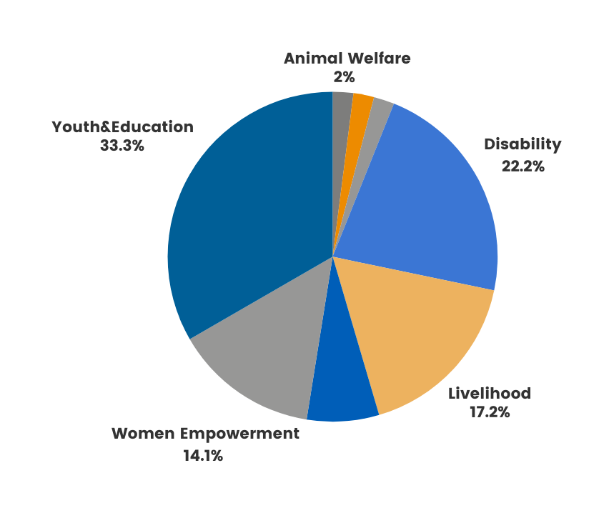
Impact Areas
Agriculture
2%
Urban Development
2%
33%
22%
Sectors Supported by
17%
14%
Sustainable
Environment
7%
Engaged Philanthropists | Stronger NGOs | Bigger Impact

Slide 17
NFP Growth Over the Last 7 years (FY18-19 to FY24-25)
Engaged Philanthropists | Stronger NGOs | Bigger Impact

Slide 18
Fast Pitch Program – an ecosystem enabler
SVP India’s marquee fundraising initiative has had 4 editions
Largest ever virtual event with live Fund raising
Wonderful opportunity for partner engagement – actively involved 200 SVP partners over the last 4 years
Raised USD 2.41 Mn over the last 4 years (excl. prize money)
Helped 46 Pan-India urban and rural NFP leaders in building lifelong communications pitching skills
Led to significant increase in brand visibility in the sector
Engaged Philanthropists | Stronger NGOs | Bigger Impact

Slide 19
Communications & Outreach
New SVP website
SVP India’s visibility and followership on LinkedIn grew from approx. 3,500 to 15,000 (5x growth) with 1.5 Mn impressions
Reached 1+ Bn readers/viewers through national and regional publications like The Times of India, The Economic Times, The Better India, The CSR Universe, etc.
Revamped style and storytelling format towards amplifying visibility of our NGOs, partners and SVP India.
Regular social media amplification of SVP India updates by team as well as user-generated content by enthusiastic SVP Partners and NGOs
Engaged Philanthropists | Stronger NGOs | Bigger Impact

Slide 20
The SVP Multiplier Effect & Impact
Partners
736+
Upto 6x growth
in impact at NFP
SVP India
has
enabled
Direct Grants
USD 5 M
Enabled Funding
USD 8.5 M
Beneficiary
outcomes
Time
90,000 hours
Engaged Philanthropists | Stronger NGOs | Bigger Impact

Slide 21
Communications & Outreach
Young Partners of SVP India
((2194) Embracing Engaged Philanthropy with Karan Kishorepuria – YouTube)
Engaged Philanthropists | Stronger NGOs | Bigger Impact

Slide 22
Enabled Fund Raising over past 2.5 years
No. of Events hosted:
No. of Invitees:
Funds Raised for NFPs: USD
Expenses: USD
Return on Investment:
No. of Partners who joined SVP:
Engaged Philanthropists | Stronger NGOs | Bigger Impact

Slide 23
EXTRA SLIDES
(FOR FUNDRAISING ROI)

Slide 24
SETU - Pune - 14 July 2023
SNAPSHOT
 | Partners | Enablers | Guests | CSR | Prospect | Total
Invites | 73 | 0 | 20 | 2 | 77 | 172
Attendance (No) | 67 | 0 | 16 | 1 | 48 | 132
Donations from (No) | 1 | 0 | 1 | 0 | 0 | 2
Donations Amt (Rs) | 3,62,000 | 0 | 1,25,000 | 0 | 0 | 4,87,000/-
SVP Partner onboarding donations | 12,00,000/-
Donations + conversions | 16,87,000/-
Event Expenses | 4,74,000/-
Net Expenses (net of event specific donations) | 4,74,000/-
Return On Event (RoE) | 3.5x
Partner ongoing conversion conversation | 6
PROSPECTS
Unique Individuals | 77
Partner Units | 48
Converted till March 31 | 4(10%)
Notes:
Donations from (No)
Aruna Katara – 77K to 7 NGOs
Sarika Mahashabde – 1.25L to Eklavya
19 partners contributed INR 15,000 each to create a corpus of INR 2,85,000/-
Converted till March 31
Padmini & Bharat Sundaram
Rupal Sancheti & Salil Bhargava
Rajiv & Mamta Batra
Sunil & Deepa Kunte
Partner ongoing conversion conversation
Sanjay Gandhi
Neeraj Sharma
Kailash Katkar
Ashish Bhandari
Rohit Goyal
Tata Autocomp Systems Ltd

Slide 25
SETU - Kolkata - Oct 6, 2023
SNAPSHOT
 | Partners | Enablers & Others | Other HNI | CSR | Prospect | Total
Attendance (No) | 49 | 20 | 45 | 6 | 6 | 130 (200+)
Donations from (No) | 18 | 3 | 7 | 4 | 5 | 37
Donations Amt (Rs) | 310L | 72L | 122L | 66L | 57L | 627L
PROSPECTS
Unique Individuals | 6
Partner Units | 2
Converted till March 31 | 2(100%)
SVP Partner onboarding donations | 6L
Donations + conversions | 633L
Event Expenses | 8.09L
Net Expenses (net of event specific donations) | -
Return On Event (RoE) | 78.2X

Slide 26
PITCH PERFECT – Pune – 2 Feb 2024
SNAPSHOT
 | Partners | Enablers | Guests | CSR | Prospect | Total
Invites | 69 | 1 | 41 | 89 | 70 | 187
Attendance (No) | 46 | 1 | 34 | 6 | 45 | 132
Donations from (No) | 51 | 0 | 12 | 3 | 0 | 66
Donations Amt (Rs) | 1.53,54,700 | 0 | 33,10,000 | 53,02,374 | 0 | 2,39,67,074
SVP Partner onboarding donations | 6,00,000/.-
Donations + conversions | 2,45,67,074
Event Expenses | 4,88,372/-
Net Expenses (net of event specific donations) | 4,88,372/-
Return On Event (RoE) | 50X
Partner ongoing conversion conversation | 5
PROSPECTS
Unique Individuals | 70
Partner Units | 45
Converted till March 31 | 2 (5%)
Notes:
CSR
Bajaj Finserv
TACO
Cummins India
Sandvik Asia
Forbes Marshall
Indigo Paints
Partner onboarding
1. Ashish Bhandari – June 24
2. Indu Jacob – July 24

Slide 27
SETU - Kolkata - Sept 26 - 2024
SNAPSHOT
 | Partners | Enablers, Others | Other HNI | CSR | Prospect | Total
Attendance (No) | 59 | 45 | 99 | 10 | 17 | 230 (350+)
Donations from (No) | 19 | 1 | 13 | 6 | 6 | 45
Donations Amt (Rs) | 349L | 37L | 142L | 50L | 52L | 630L
PROSPECTS
Unique Individuals | 12
Partner Units | 5
Converted till March 31 | 6(??)
SVP Partner onboarding donations | 18L
Donations + conversions | 648 L
Event Expenses | 15.65L
Net Expenses (net of event specific donations) | -
Return On Event (RoE) | 41X

Slide 28
SETU - Mumbai – Oct 18, 2024
SNAPSHOT
 | Partners | Enablers | Other HNI | CSR | Prospect | Total
Invites | 184 | 25 | 56 | 40 | 16 | 208
Attendance (No) | 81 | 14 | 23 | 18 | 16 | 152
Donations from (No) | 18 | 1 | 5 | 2 | 0 | 26
Donations Amt (Rs) | 5,660,000 | 20,000 | 775,000 | 1,100,000 | 0 | 7,555,000
PROSPECTS
Unique Individuals | 16
Partner Units | 12
Converted till March 31 | 3
SVP Partner onboarding donations | 900,000
Donations + conversions | 8,455,000
Event Expenses | 1,759,074
Net Expenses (net of event specific donations) | 659,074
Return On Event (RoE) | 5X
Partner ongoing conversion conversation | 6
Notes:
PARTNER ONGOING CONVERSATIONS
Anant Kasibatla
Charlotte Vaz + Don Vaz
Siddharth Gopalkrishnan
Priti Ambani
Rajesh Dahiya
Vijuraj Eranazhath

Slide 29
Daan Utsav – Hyd - Oct 2025
SNAPSHOT
 | Partners | Enablers | Other HNI | CSR | Prospect | Total
Invites | 106 |  |  | 23 | 30 | 159
Attendance (No) | 62 |  |  | 16 | 23 | 101
Donations from (No) | 32 |  |  | 4 | 11 | 47
Donations Amt (Rs) | 31,85,645 |  |  | 2,10,100 | 9,85,500 & Anonymous 67,000/- | 44,48,245
SVP Partner onboarding donations | 18,00,000
Donations + conversions | 62,48,245
Event Expenses | 4,60,000
Net Expenses (net of event specific donations) | 4,60,000
Return On Event (RoE) | 13.5x
Partner ongoing conversion conversation | 5
PROSPECTS
Unique Individuals | 14
Partner Units | 11
Converted till March 31 | 6 (55%)
Notes:
PARTNER ONGOING CONVERSATIONS
Anant Kasibatla
Charlotte Vaz + Don Vaz
Siddharth Gopalkrishnan
Priti Ambani
Rajesh Dahiya
Vijuraj Eranazhath

Slide 30
Setu – Bengaluru - Dec 7, 2024
SNAPSHOT
 | Partners | Enablers | Other HNI | CSR | Prospect | Total
Invites | 140 | 25 | 85 | 40 | 62 | 362
Attendance (No) | 68 | 15 | 56 | 27 | 44 | 210
Donations from (No) | 34 | 5 | 28 | 5 | 12 | 84
Donations Amt (Rs) | 269.82 | 12 | 77.65 | 40.5+67 (pre-commit) | 57.35 | 524.32
SVP Partner onboarding donations | 249
Donations + conversions | 530
Event Expenses | 12 lacs
Net Expenses (net of event specific donations)
Return On Event (RoE) | 44X
Partner ongoing conversion conversation | 5
PROSPECTS
Unique Individuals | 30
Partner Units | 12
Converted till March 31 | 2
Notes:
PARTNER ONGOING CONVERSATIONS
Anant Kasibatla
Charlotte Vaz + Don Vaz
Siddharth Gopalkrishnan
Priti Ambani
Rajesh Dahiya
Vijuraj Eranazhath

Slide 31
Prerna – Delhi NCR- April 2023
SNAPSHOT
 | Partners | Enablers/SVP All India & NCR NGOs | Other HNI | CSR | Prospect | Total
Invites | *
Attendance (No)
Donations from (No)
Donations Amt (Rs)
SVP Partner onboarding donations
Donations + conversions
Event Expenses
Net Expenses (net of event specific donations)
Return On Event (RoE)
Partner ongoing conversion conversation
PROSPECTS
Unique Individuals
Partner Units
Converted till March 31

Slide 32
Prerna – Delhi NCR- March 2024
SNAPSHOT
 | Partners | Enablers/SVP All India & NCR NGOs | Other HNI | CSR | Prospect | Total
Invites
Attendance (No)
Donations from (No)
Donations Amt (Rs)
SVP Partner onboarding donations
Donations + conversions
Event Expenses | 0
Net Expenses (net of event specific donations)
Return On Event (RoE)
Partner ongoing conversion conversation
PROSPECTS
Unique Individuals | 5
Partner Units | 3
Converted till March 31 | 3 PU

Slide 33
Prerna – Delhi NCR- August 2024
SNAPSHOT
 | Partners | Enablers | Other HNI | CSR | Prospect | Total
Invites |  | 1 |  | 1
Attendance (No) |  | 1 |  | 1
Donations from (No) | 17 (PU) 18 Partners |  | 32 | 1 |  | 50
Donations Amt (Rs) | 2387500 |  | 1573000 | 2,00,000 |  | 40,47,500
SVP Partner onboarding donations | NA
Donations + conversions | 40,47,500
Event Expenses | 4,16,000
Net Expenses (net of event specific donations) | 36,31,500
Return On Event (RoE) | 872.0%
Partner ongoing conversion conversation | NA
PROSPECTS
Unique Individuals | NA
Partner Units
Converted till March 31

Slide 34
Magnolias– Delhi NCR- March 2024
SNAPSHOT
 | Partners | Enablers/SVP All India & NCR NGOs | Other HNI | CSR | Prospect | Total
Invites | 10 |  |  |  | 82 | 92
Attendance (No) | 10 |  |  |  | 41 | 51
Donations from (No) | 1 |  |  |  |  | 1
Donations Amt (Rs) | 44250 |  |  |  |  | 44,250
SVP Partner onboarding donations (joined in April 2025) | 6,00,000
Donations + conversions | 6, 44, 250
Event Expenses | 66,246
Net Expenses (net of event specific donations) | −578,004
Return On Event (RoE) | 872.5%
Partner ongoing conversion conversation | 6
PROSPECTS
Unique Individuals | 7
Partner Units | 2
Converted till March 31 | 0

Slide 35
Prerna – Delhi NCR- April 2025
SNAPSHOT
 | Partners | Enablers/ SVP All India & NCR NGOs | Other HNI | CSR | Prospect | Total
Invites | 49 (PU) 80 Partner | 17+ 40 =57 |  | 80 | 205 | 422
Attendance (No) | 29 (PU) 34 Partners | 16 + 35 =51 |  | 12 | 91 | 188
Donations from (No) | 1 |  |  | 2 |  | 2
Donations Amt (Rs) | 3,00,000 |  |  | 10,00,000 |  | 10,00,000
SVP Partner onboarding donations | 0
Donations + conversions | 13,00,000
Event Expenses | 12,95,617
Net Expenses (net of event specific donations) | -4,383
Return On Event (RoE) | 0.34%
Partner ongoing conversion conversation | 23
PROSPECTS
Unique Individuals | 17
Partner Units | 6
Converted till March 31 | NA

