Slide 1
Field catalysts workshop
Discussion with Social Venture Partners International
May 30, 2025

Slide 2
Objectives for our time together
Introduce Bridgespan
Provide an overview of what we are learning about field building as an approach to equitable systems change and the critical role of field catalysts
Share examples of how field catalysts approach their work and some of the challenges they face
Start to answer any questions that this sparks for you

Slide 3

Overview of Bridgespan’s approach
3_84 14_85
overall_0_132267168483192369 columns_1_132267168483192369
Philanthropy
Consulting
Help donors invest big bets
for social change, improve grantee
performance, and work with those
that wish to align, expand,
or reorient their
philanthropy
The Bridgespan Group is a global nonprofit organization that works to build a better world by strengthening the ability of mission-driven organizations and philanthropists to achieve breakthrough results in addressing society's most important challenges and opportunities. We bring a rigorous approach, shared passion, and deep social sector experience.
Our experience has informed several elements of our approach:
Disciplined customization
Balancing values and motivations with data and analytics
Creating clarity without being overly prescriptive
An iterative and collaborative process
Since our founding in 2000, when incubated at Bain & Company, we have grown to have
Offices in Boston, Johannesburg, Mumbai,
New York, San Francisco, Singapore
400+ Staff
1,000+ client engagements
Nonprofit
Strategy
Consulting
  Collaborate with clients to
  create strategies for scaling
  impact, design for effectiveness,
  & provide implementation
  plans that achieve
  results
Leadership
Development
  Leading for Impact®,
  an innovative two-year
  consulting & capacity building,
  city-based, program
  for nonprofit executive
  teams
Developing
& Sharing Insights
  Leading publisher of
  social sector knowledge
  & best practice
  sharing

Slide 4


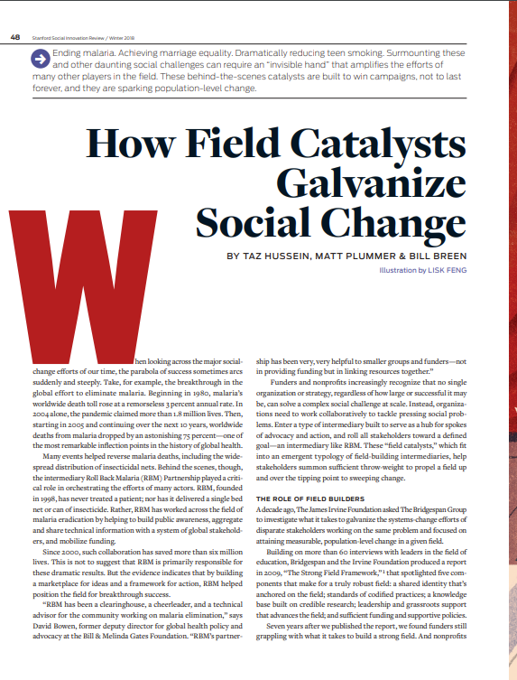
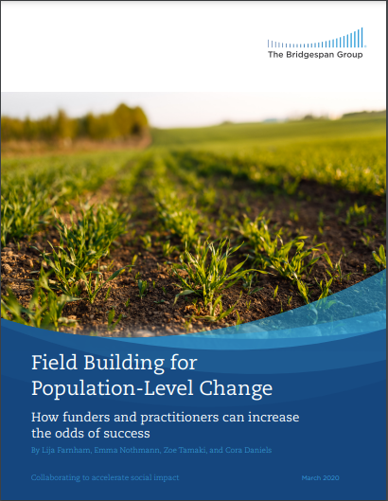
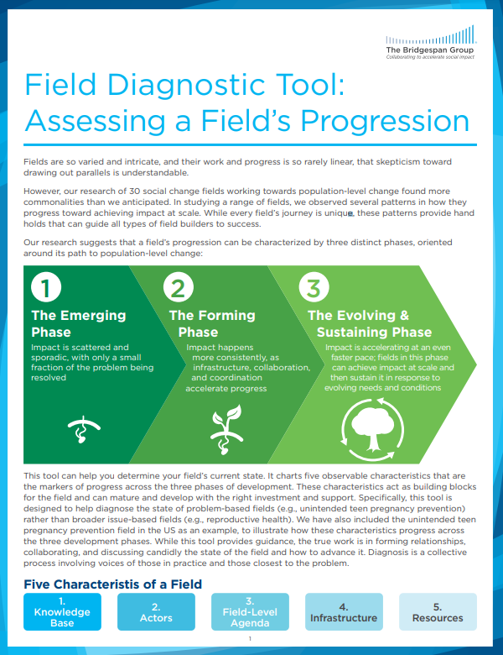
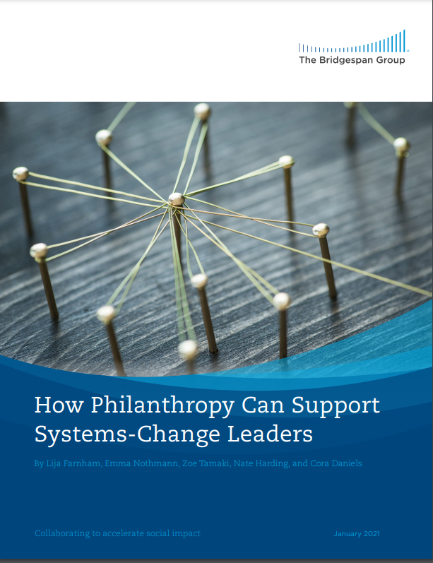
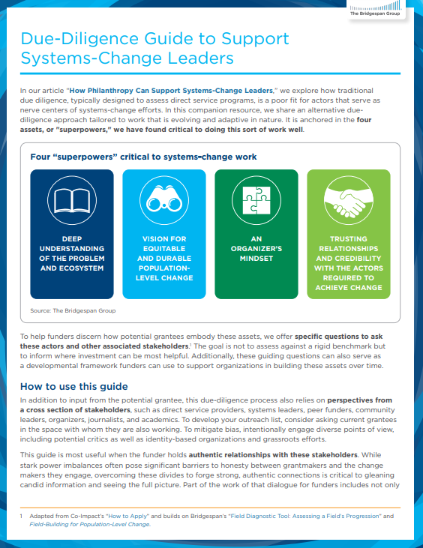
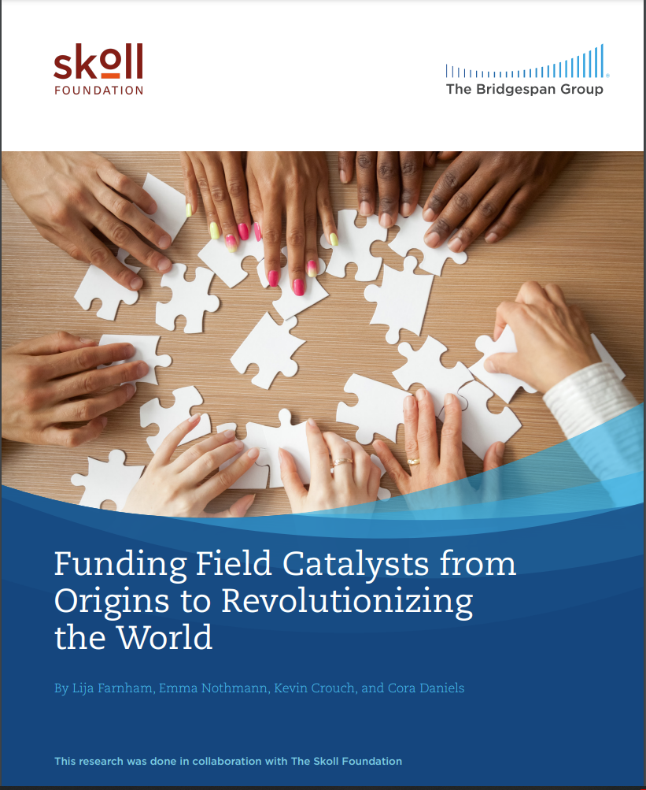
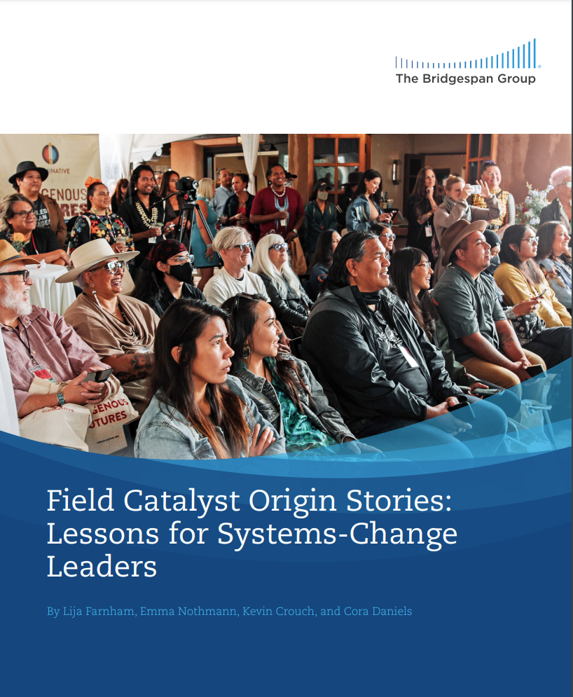
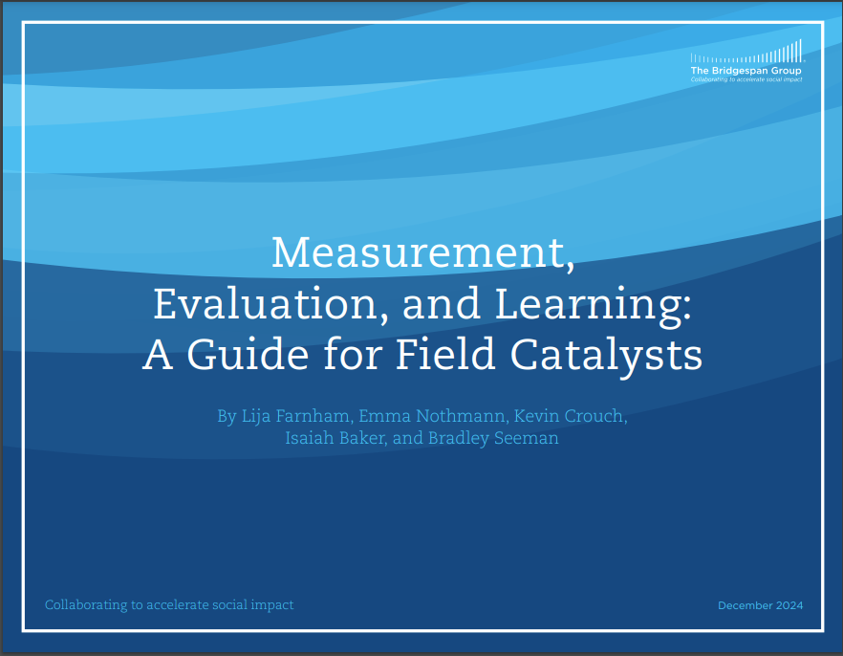
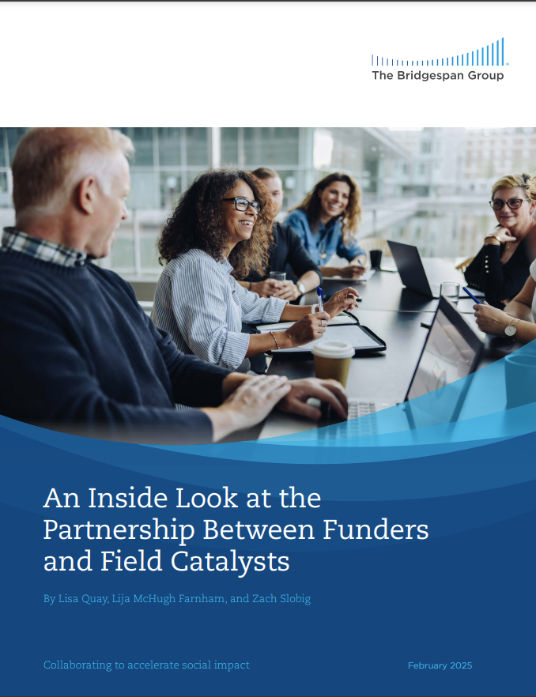
We seek to shine a light on field building and unlock capital needed for catalysts to achieve their equitable systems-change goals
Bridgespan’s Field Building for Equitable Systems Change Multi-Year Initiative seeks to achieve the following goals…
…through engagement with field catalysts, funders, and thought partners to advance the following activities:
1
Funders significantly increase their funding and support for field building for equitable systems change and the field catalysts who lead that work
Changing funder mindsets and practices through sector-wide thought leadership and dissemination and supporting peer learning
2
Field catalysts are fully funded and equipped to sustain effective, adaptive field building efforts to achieve equitable systems change
Amplifying field catalyst effectiveness and value proposition through facilitation of action learning communities and narrative-building around field catalysts as a critical ingredient in systems change
How Field Catalysts Galvanize Social Change
Winter 2018
Field Building for Population-Level Change
March 2020
Field Diagnostic Tool: Assessing a Field’s Progression
March 2020
How Philanthropy Can Support Systems-Change Leaders
January 2021
Due-Diligence Guide to Support Systems-Change Leaders
January 2021
Funding Field Catalysts from Origins to Revolutionizing the World
March 2023
Field Catalyst Origin Stories: Lessons for Systems-Change Leaders
March 2023
Measurement, Evaluation, and Learning: A Guide for Field Catalysts
December 2024
An Inside Look at the Partnership Between Funders and Field Catalysts
February 2025

Slide 5
Overview of field building
Overview of field progression and characteristics
The unique and critical work of field catalysts
Discussion

Slide 6



Field-building is one approach to equitable systems change, and field catalysts play critical roles leading the way to impact
Systems change
Systems change often requires a coordinated effort across many actors and the use of multiple levers (e.g., changing policies, shifting narratives) to address the root cause of social issues
Is supported by
field building efforts
A field is a set of individuals and organizations working to address a common social issue or problem
Field building is the activities and investments* that unlock a field’s progress towards systems change¹
SYSTEMS
CHANGE
Often led by field catalysts
Field catalysts are organizations that lead field-building work, organizing field actors and coordinating various levers of impact to strengthen the field’s work such that the “whole is greater than the sum of parts”
Source: How Field Catalysts Galvanize Social Change; How Philanthropy Can Support Systems-Change Leaders; Field Building for Population-Level Change

Slide 7
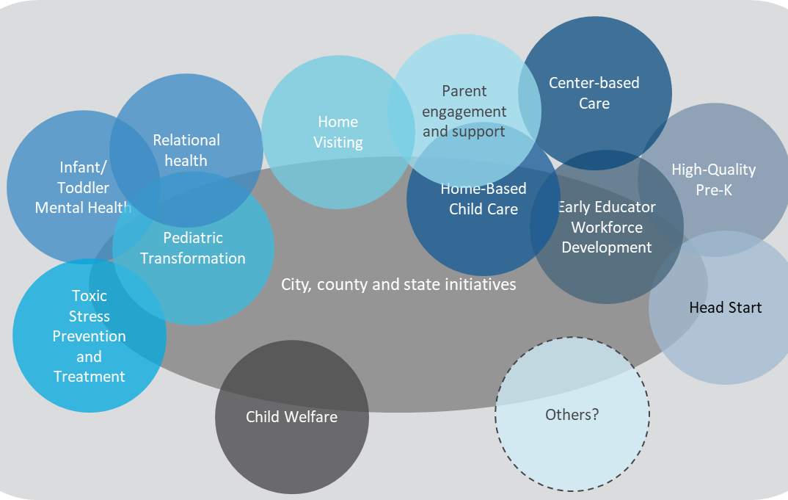
Field building: Two common field archetypes
overall_0_132078050744127240 columns_2_132078050731307556 4_1_132078050352229053 5_1_132078050513892829 15_1_132083914240053919 8_0_132176988410354469 12_1_132177149004290709
Problem-based fields
Issue-based fields
Problem-based fields often drive toward outwardly visible and measureable outcomes and solutions, and can be a valuable unit of change when pursuing impact at scale
Issue-based fields frequently operate beneath the surface but are powerful undercurrents enabling problem-based fields to overcome shared barriers, unlock resources, and draw powerful connections across fields
Illustrative examples
Bail Reform Field
Early Childhood Field
Problem:
Money bonds disproportionately penalize low-income individuals

Slide 8
Field building: We observe several factors dynamically affecting field definition
overall_0_132078050744127240 columns_2_132078050731307556 4_1_132078050352229053 5_1_132078050513892829 15_1_132083914240053919 8_0_132176988410354469 12_1_132177149004290709
Problem scope
More narrow problem statements are more concrete (including a clear measure of success), may require fewer actors to align; can be exclusive and miss broader opportunities/needs
Timeline
For some fields, the impact aspiration requires multi-generational work; for others, the population-level goal is visible within a shorter timeframe, and for still others, it may take years for field actors to even self-identify as working on a shared problem
Geography/place or altitude of the system
Many fields require change across multiple geographic areas and/or altitudes of the system; broadening necessitates including new sets of actors, figuring out the right balance to start with and how to grow/evolve over time
Present/Future
Field actors need to navigate the current actors and systems as they are today while simultaneously imagining the “future possible”, which may necessitate different field definition and bounding (and actors)
“Moments of ripeness”
New research, policy changes, or other events can create unique opportunities for subsets of actors to make progress around specific problem statements

Slide 9
Field building: Defining the field, assessing it, and aligning on an agenda are all interconnected components of field building
overall_0_132078050744127240 columns_2_132078050731307556 4_1_132078050352229053 5_1_132078050513892829 15_1_132083914240053919 8_0_132176988410354469 12_1_132177149004290709
Diagnosing and assessing the field
What is the state of the field today?
  Knowledge base
  Actors
  Infrastructure
  Agenda
  Resources
  Public sector systems
What progress has been achieved?
Defining the field
What do we seek to achieve?
What is our vision for what achieving it looks like?
Continuous learning and engagement with the field in service of systems change
  Note: While answering these questions is important, who gets to answer them and through what process are also critical to disrupting entrenched and historical power dynamics that can hinder equitable systems change
Field-level agenda
What are the shared priorities we will pursue to build the field and make progress toward our goal?

Slide 10
Overview of field building
Overview of field progression and characteristics
The unique and critical work of field catalysts
Discussion

Slide 11
Field progression: Common field progression towards population-level impact
Impact at Scale
75%
50%
25%
Emerging
Forming
Evolving & Sustaining
Impact is scattered and sporadic, with a small fraction of the problem being resolved
Impact is growing at a more rapid pace as infrastructure, collaboration, and coordination enable accelerated progress
Impact is accelerating at an even faster pace (often driven by equitable systems change); impact at scale can be achieved and then sustained in response to evolving needs and conditions
Source: Field Building for Population-level Change (The Bridgespan Group, March 2020).

Slide 12





Field progression: The six observable characteristics that together unlock a field’s progress towards impact
Robust knowledge base
The body of academic and practical research that helps actors better understand the issues at hand, and identifies and analyzes shared barriers
Heterogeneous yet complementary actors
The set of individuals and organizations that together help the field develop a sense of shared identity and common vision
The value proposition to and intersections with public sector systems, infrastructure, and resources
Adaptive infrastructure
The “connective tissue” that enables greater innovation, collaboration, and improvement among a field’s actors over time
Sustainable and sufficient resources
Financial and non-financial capital that supports the field’s actors and infrastructure
Clear field-level agenda
The combination of approaches field actors will pursue to address barriers and develop solutions to the field’s focal problem or issue
Source: Lija Farnham, Emma Nothmann, Zoe Tamaki, and Cora Daniels, Field Building for Population-level Change (The Bridgespan Group, March 2020; updated in 2024).

Slide 13
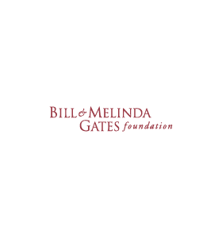








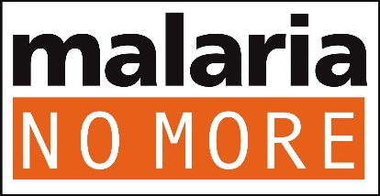
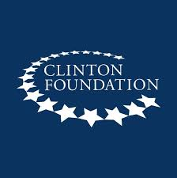
Field progression: Example of the malaria eradication field
overall_1_132156466139814654 columns_1_132156466139814654 12_1_132159058768343674
Emerging
(1980s-2005)
Forming
(2005-2015)
Evolving & Sustaining
(2015-Present)
Malaria deaths rose 3x through the 1980s and 1990s, peaking in 2004 at ~1m people (global malaria incidence rate of 70 per 1000 ppl at risk); RBM was founded in 1998 to galvanize a response, but its impact was not immediately felt as it focused on behind the scenes coordination, research, and advocacy | Increased public awareness, global coordination, and nearly $2 billion in new funding contributed to worldwide deaths from malaria dropping to ~400,000 people in 2015 and a global incidence rate of 59 per 1000 ppl at risk | Shifts and disruptions in public health infrastructure and services due to COVID and other events have created new challenges for the ecosystem to address (incidence rate rose 5%, deaths rose 12%); however, the partnership and dynamic response of the ecosystem prevented dramatically worse outcomes
Source: World Health Organization; National Institutes of Health

Slide 14
Overview of field building
Overview of field progression and characteristics
The unique and critical work of field catalysts
Discsussion

Slide 15


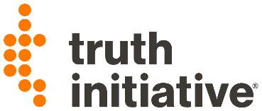



Field catalysts: They are a type of nonprofit intermediary that are critical to population-level outcomes in our sector
Historical examples of population-level change reveal a set of (often) unseen intermediaries critical to the work
Tobacco cessation
Marriage equality
Homelessness
These organizations amplify and harmonize the work of the field’s actors to achieve equitable systems change
Field catalysts have been crucial to population-level outcomes such as
  Decline in teen smoking rates from 37% in 1995 to 8% in 2018
  The U.S. Supreme Court ruling in favor of marriage equality nationwide
  Homelessness reaching “functional zero” in 14 U.S. communities
Source: How Field Catalysts Galvanize Social Change; How Philanthropy Can Support Systems-Change Leaders; Field Building for Population-Level Change;

Slide 16
Field catalysts: They mobilize and galvanize ecosystem actors toward a shared goal of durable population-level change
Core field catalyst roles:
Adaptive levers to fill critical gaps:
Diagnosing and assessing the field
Direct Service
Providing direct services as a complement to field building efforts, leveraging on the ground engagement with proximate communities and practitioners to bolster field and systems change capabilities
(E.g., Solutions Journalism Network, Transcend Education)
Connecting actors around a shared goal
Advocating or shining a spotlight on the issue
Regranting
Pooling funds and regranting by attracting resources into the field and deploying nimbly and equitably based on field needs, redistributing power from philanthropy and modeling new grantmaking approaches
(E.g., Liberation Ventures, Mosaic Momentum)
Filling critical gaps
Policy influence
Directly influencing policymakers and government officials by deploying advocacy capabilities such as policy and regulation advocacy and development, grassroots organizing, narrative change, etc. (501c4)
(E.g., Let's Grow Kids)
Source: How Field Catalysts Galvanize Social Change; How Philanthropy Can Support Systems-Change Leaders; Field Building for Population-Level Change

Slide 17




Additionally, these roles position field catalysts to act as systems learning engines
They engage in measurement and learning of the fields and systems they work in, to assess and further progress
The ways in which they capture and describe this “sense-making” work are variable and non-uniform
Practice
Field catalysts’ systems learning work manifests in a range of activities, from convenings to brokering relationships to driving alignment toward a shared agenda
Research
Policy/
Gov
Policies
Resource flows
Mental models
Private sector
Power dynamics
Practices
The approaches field catalysts take to advance progress vary across their different fields and issue areas, each with their own set of systems barriers and challenges
Civil society
Grassroots
Relationships and connections

Slide 18
Field catalysts: Our research revealed four distinctive assets that field catalysts bring to their roles
overall_1_131932672828009152 columns_1_131932672827833565
DEEP UNDERSTANDING OF THE PROBLEM AND ECOSYSTEM
VISION FOR EQUITABLE AND DURABLE POPULATION-LEVEL CHANGE
AN
ORGANIZER'S MINDSET
TRUSTING RELATIONSHIPS AND CREDIBILITY WITH THE ACTORS REQUIRED TO ACHIEVE CHANGE
Field catalysts frequently develop these assets through their lived and professional experience working proximate to the problem, working alongside other field actors, and using a systems lens to identify, understand, and address the root causes of the inequities they seek to address
Source: How Field Catalysts Galvanize Social Change; How Philanthropy Can Support Systems-Change Leaders; Field Building for Population-Level Change;

Slide 19



Field catalysts: Sample field catalysts at the heart of three high potential field building efforts “in the wild”
Child care in
Vermont
Reparations
Health equity
Field focused on ensuring equitable, affordable access to high-quality child care for all Vermont families
Field catalyst Let’s Grow Kids planning to sunset in 2025, focused on state level policy wins (achieved 2 out of 3 so far) by:
  Cultivating an ecosystem of diverse stakeholders and built their capacity
  Conducting research and analyzing data to make the case for ECE and care to Vermont’s business community
  Building a coalition to support key policy passage and movement to sustain progress
  Pursuing narrative change around the importance of equitable, accordable access to high-quality child care
  Regranting to support growth of quality child care programs across Vermont
Field focused on providing comprehensive, federal, financial and non-financial reparations program in the US
Field catalyst Liberation Ventures focused on building public will for reparations will by:
  Helping the field/ecosystem develop shared goals and brokering and supporting relationships to help actors collaborate on shared goals
  Translating academic or practical research for different audiences
  Raising philanthropic funding to regrant to other organizations in the field/ecosystem and provide technical assistance and capacity building to grantees
  Producing communications to pursue narrative change to shift historical narratives
  Tracking the field’s impact over time via public opinion polling
Field focused on building a health-based economy in the US that equitably invests public and private dollars in health
Field catalyst The Health Initiative focused on changing policies, practices, and mental models by:
  Conducting public opinion research around attitudes towards drivers of health
  Working with partners across the ecosystem to develop measures of success and data gathering approaches
  Building awareness of the opportunity to transform health care and activating stakeholders around moments of opportunity
  Working behind the scenes to change policy and policy implementation approaches to screen for and cover cost of drivers of health

Slide 20




Field catalyst leaders face four similar challenges and rely on their assets to achieve impact
FIELD CATALYST CHALLENGES
1: FUNDING
2: TALENT/CAPACITY
3: EXTERNAL ROADBLOCKS
4: LEARNING & MEASUREMENT

Slide 21
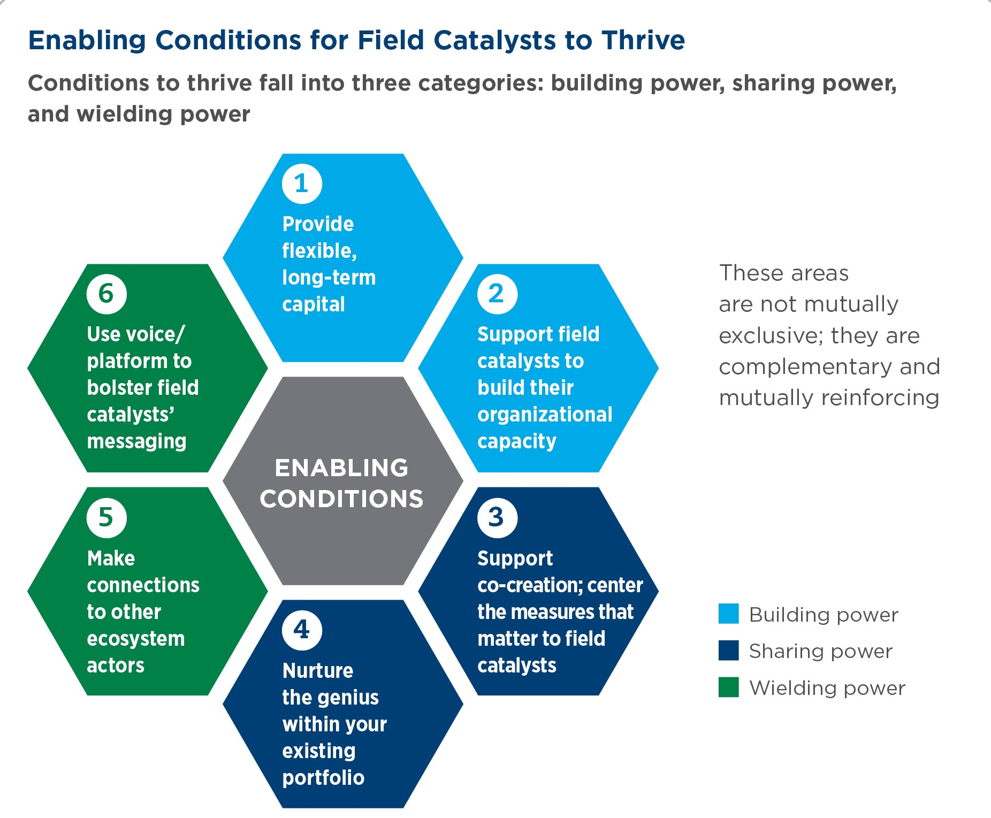
Field building funders can build, wield, and share power to create the enabling conditions for field catalysts to thrive
Source: National Committee for Responsive Philanthropy

Slide 22

overall_1_131895572491650234 columns_1_131895572491524862
Questions?

Slide 23

Group discussion: how do these ideas show up for you?
overall_1_131895570883209643 columns_6_131941137995275374 10_1_131895570883490903 11_1_131895570883558480
As I described the roles and assets of field catalysts, do any organizations that you know of come to mind? What made you think “Aha! A field catalyst!”?
What insights or questions from this conversation do you want to bring back to your ecosystem or your community to explore them more deeply?
What feels most powerful about this approach? What are some of the challenges of putting it into practice?

