Slide 1
A journey of innovation into philanthropy
Madhavi Hegde, SVP Bangalore Partner October 2016

Slide 2
Grants Committee, 2015 | Lead Partner, Prerak Trust, 2016 |
“Through SVP, I have got involved in varied projects – from organic farming to waste management to energy audits – which have helped me learn in different ways. Everyone in the network is so intensely passionate of doing it right and this high energy sparks off one another. I am beginning to discover the joy of philanthropy, and hope to help make SVP the harbinger of change.”
– Madhavi Hegde

Slide 3
SVP in Bangalore : Challenges
- Subject Matter Experts are required to understand the opportunities and challenges. For example, creating jobs in healthcare vs improving farmers’ incomes
- Need to foster a sense of intimacy within such a large partnership, and get partners to know and work with each other
- Grants Committee is centralized, fostered conservatism since budgets were not discussed at all meetings

Slide 4
Answer: Circles
MICRO ENTERPRISES
AGRI
LIVELIHOODS
CIVIC
SKILL
TRAINING
HEALTH
LIVELIHOODS
CORPORATE ENGAGEMENT
“There is a hunger among our SVP Partners to go deeper and understand the problems. This has led us to launch SVP Circles, that is helping us break down the livelihood problem for ourselves, vertically. It has received great traction so far.”
Akila Krishnakumar, Former Chair & Partner, SVP Bangalore

Slide 5
Civic Circle
SVP Bangalore's local theme - Solid Waste Management
Challenges:
Governance
Established "fraternity"

Slide 6
The Prerak Project: An Overview
Prerak (http://www.preraktrust.org) is a Not-for-Profit engaged in Water, Sanitation, Solid Waste Management and other community initiatives around Bangalore
The Proposal was to establish an integrated Solid Waste Management initiative at Hebbagodi – a town about 21 km (13 mi.) outside Bangalore with a population of 35,000
3 year engagement with the township
End-to-End solution vision - providing a comprehensive assessment and resolution of the issues around solid waste management collection, handling and disposal
The initial stage of the project was data oriented
Collection of information of “black spots” – where mixed garbage was disposed
Identification of systemic bottlenecks
Outlining a solution approach

Slide 7
The Prerak Project: An Overview
Prerak identified three major dimensions for providing a comprehensive solution
Institutional Strengthening
Studies
Implementation
Progress has been established in part in each of the above major dimensions from Feb, 2016 – Aug, 2016
A proposal to continue the engagement with Prerak is in discussion with the Grants Committee – Bangalore
We have been working with the Prerak team to ensure transparency, governance and communication objectives are adhered to

Slide 8
Some of the work done by Prerak
Before
After

Slide 9
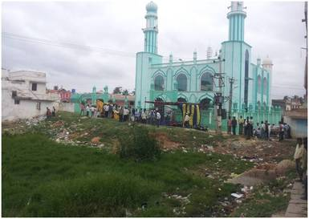
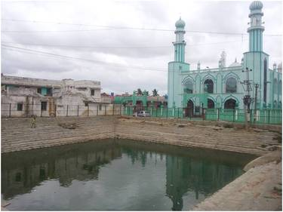
Some of the work done by Prerak
Before
After

Slide 10
Thank you!

