Slide 1
WELCOME
Strong nonprofits deliver better results.
So SVP goes beyond traditional philanthropy to build the capacity of nonprofits, givers, and the community. We help organizations and people do what they do, only better.
Notes:
I need to add more about SVP connect, updating profile, using the profile as contact update form for SVP ,etc
Thank you for coming.
We are thrilled to have all of you on-board. During this presentation I’ll be sharing the basics about who we are, what we do, where we’re headed and exciting new efforts. I’d also like to answer your questions and get to know you all better.

Slide 2
How we talk about SVP
SVP engages community members, givers, and nonprofits to work side-by-side strengthening our community.
Strengthen the core skills, practices, strategies, and systems of nonprofits so they are more effective
Engage and educate givers
Convene to create cross-sector solutions
We serve:
Nonprofits/organizations/social sector
Philanthropists/donors/givers/volunteers/people
Community members/board members/ concerned citizens
Notes:
Share business-sized message cards and business cards

Slide 3
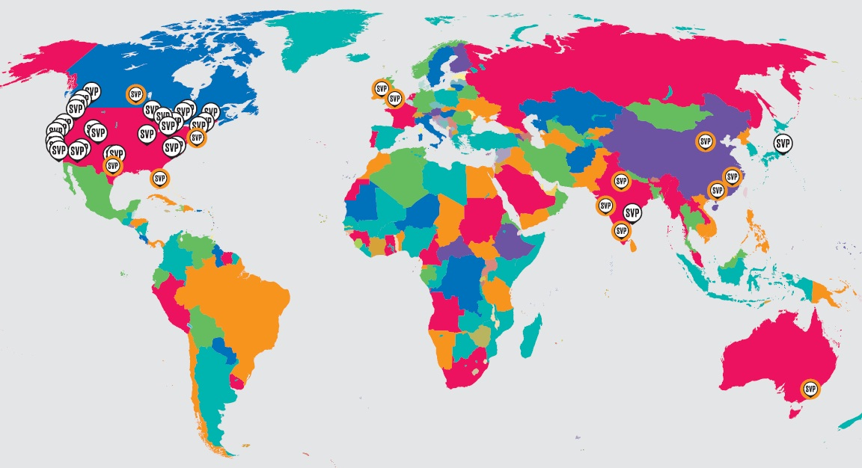
SVP Member Organizations
Notes:
The Social Venture Partners model was created in 1997, in Seattle, the inspiration and vision of Paul Brainerd and a small group of collaborators.
Their vision was a philanthropic community that borrowed from venture capital practices and made highly engaged investments of money, resources and business expertise in local non-profit organizations.
About 13 years ago the existing SVP’s created Social Venture Partner International – now the SVP Network Office to serve member organizations and spread our model. We now have 39 member organizations and more than 3,000 partners in the US., Canada, Japan, China, India, Australia, and the UK. More opening
We work very closely as a network sharing technology and best practices and working initiatives together.
Largest individual donor network in world

Slide 4
SVP Boulder County Investments
Cash Grants =$1,350,000 +
Consulting Services = $4,400,000
Total Impact = $5,750,000
The total impact of our investments through September 30,2015 based on a consulting rate of $200 an hour.

Slide 5
Notes:
Share one-page handout
The Board crafted a 2014-2017 strategic plan with a lot of input from partners, investees, and community stakeholders
It’s all about helping SVP Boulder County move from a smaller, reactive, internally-focused organization doing mostly deep work to
a local leader that is:
proactive in driving change,
engaging a lot of community members,
doing both deep and broad capacity building work,
and can convene others for social good.
We want to strengthen our capacity building, grow our impact, innovate, and collaborate to meet community needs.
We plan to do this through the attainment of five goals:
Becoming a community engagement leader,
Increasing awareness of SVP,
Building nonprofit capacity,
Building internal capacity
And better evaluating our work.

Slide 6
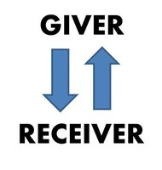
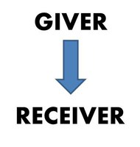
SVP Values & Culture
Engage & Learn
Inclusivity & Respect
Leverage & Strengthen
Risk & Grow
Connect & Collaborate
GIVER
RECEIVER
You can say:
Yes
Maybe
No
I have a counter-offer
we ASK
Notes:
Go through handout of values / Talk about change and Act-Align-Adjust
Traditionally, philanthropy is seen as a donor purchasing something (a service or program) on behalf of a beneficiary who can’t pay for that program.
That’s the transaction with which most of us are familiar, and is a very static model of philanthropy. The giver provides resources of time, money or connections to the receiver (e.g. a nonprofit organization) which in turn provides a service to the community.
Philanthropy as exchange posits that BOTH sides have something of value. That means giver can also receive, and receiver can also give. In this scenario the donor gives time, money, connections and the nonprofit gives back information, community impact, opportunities to engage and learn, and so forth.
One of the things I love about the exchange model is that it is inherently renewable. Instead of being based on a one-time transaction, it creates a virtuous cycle, where both sides have something of value to contribute to each other.
We work in a relationship with nonprofits. We both have a lot to bring to the table. We listen, provide our perspective and experience, share recommendations, but we do not tell.

Slide 7
How Partners Get Involved
Nonprofit Consulting Projects
Lead Partner
Coaching
Investee Gatherings
Investment Committee
Investee Impact
SVP Impact
Broader Community
Impact
YOU
Board of Directors
Sustainability
Finance
Partner Engagement
Task Forces
Educational Sessions
Host an event
And, more
Executive Coaching
Educational Workshops
Write a blog post
Coordinate a program
And, more
Notes:
Brian, talk for a few minutes about how you have gotten involved and what those experiences have meant to you.

Slide 8
Leadership Structure
Board of Directors
Staff
Committee Chairs
Lead Partners
Current Affiliations
SVP Network member
Impact HUB Boulder & Impact HUB Global
Colorado Nonprofit Association
Colorado Association of Funders
Colorado Funders for Inclusiveness and Equity
The Community Foundation
Boulder and Latino Chambers
And more
Notes:
Org chart
Partners are voted on by the partnership to serve terms on the Board of Directors.

Slide 9
SVP Programs
Investee Capacity Building
Pro bono consulting
Cash grants (in support of capacity building)
Partner Philanthropic Development
Volunteer engagement for nonprofits & SVP
Partner Bootcamp (educational series)
Expanding Networks
Execs Evolve – executive coaching for nonprofit leaders
Nonprofit Education
Boards with Brains
Strategic Partnerships & Collaborations
Invested EDs

Slide 10
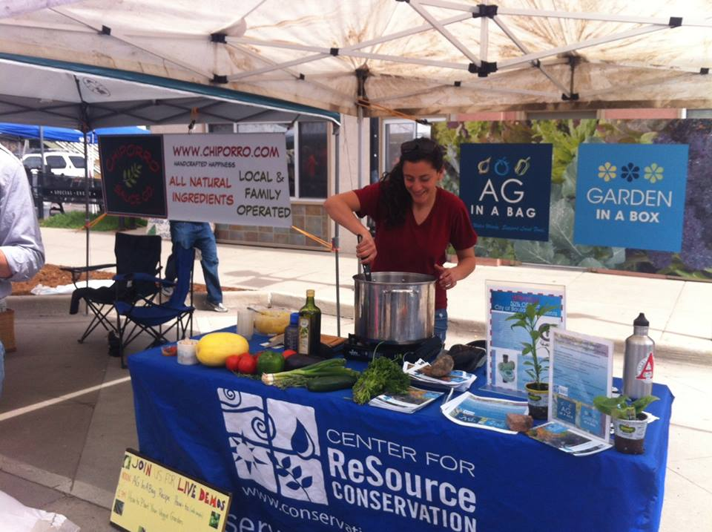
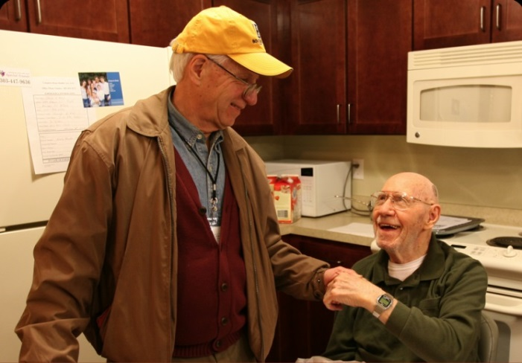
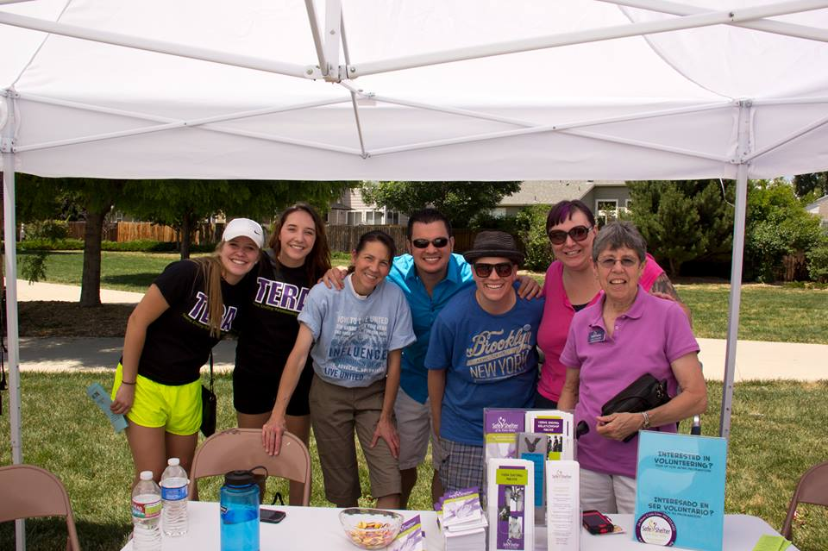
Strengthening Nonprofits
Current Investees
Attention Homes (June ‘15-present)
Center for ReSource Conservation (June ’13- present)
InReach (formerly Boulder Institute for Psychotherapy & Research) (June ‘14- present)
Safe Shelter of St Vrain Valley (June ‘13- present)
Voices for Children CASA (June ‘15-present)
Notes:
Current Investees: Boulder County Care Connect, Boulder Institute for Psychotherapy & Research, Safe Shelter of St Vrain Valley, Center for ReSource Conservation, and Veterans Helping Veterans Now. Just added Boulder Treasures and Intercambio
This year graduated: TLC Learning Center, Boulder Treasures, and Intercambio
Talk about investments in capacity building and grants in service of those investments

Slide 11
Get Involved
Volunteer
Low-Moderate-Higher level of engagement
To support SVP, investees, or education for nonprofits
Let’s talk about the volunteer opportunities handout
Educational, Social, and Investee Events
Some type of event every month, two business meetings
Flexible days and times
Topics – you decide

Slide 12
SVP Network
SVP Connect (intranet)
Network conference (Oct 22-24)
Collaborative efforts
Technology and marketing tools
Best Practices
Staff Support
Impact on the philanthropic sector
www.socialventurepartners.org
Notes:
SVP connect is very important – go over how to access, where partner list is, updating profile, using the profile as contact update form for SVP ,etc

Slide 13
About SVP
Website: www.svpbouldercounty.org
SVP Connect: https://connect.socialventurepartners.org
1877 Broadway, Ste 100, Boulder, CO 80302
Contact staff at 303.840.0165
Follow us on:
Facebook (Social Venture Partners Boulder County)
Twitter (@SVPBoulder)
LinkedIn (SVP Boulder County)
Jennie Arbogash, Executive Director., jennie@svpbouldercounty.org
Olga Heifets, Education & Communication Director, olga@svpbouldercounty.org
Shannon Sackmann, Membership Director, shannon@svpbouldercounty.org
Caitlin Plaza, Program Associate, admin@svpbouldercounty.org
Notes:
Fill out forms / Talk about next steps / Buddy / Volunteer / Etc
Handouts
Pwpt slides
Strategic plan overview, values, culture
Partner profile
SVP Connect instructions
Org chart
Involvement matrix
Confidentiality policy
IP policy
Gifts
Business cards
Message cards
Little sticker
Bumper sticker
Flash drive

