Slide 1
Strategic Plan
2016-2019

Slide 2
Strategic Context
Don Kendall

Slide 3
Partner Survey Results
Clare Hare
Jim Corgel

Slide 4
What We Learned
High level of Partner satisfaction:
100% Rate Partner experience as good or outstanding 96% Would recommend SVP-CT to others
96% Have become more confident investors
70% Have become more thoughtful philanthropists
100% Believe there are sufficient engagement opportunities
Top issue areas of interest:
Education (87%) Poverty/Workforce (71%) Environment (30%)
New product extensions:
Incubator (67%) Board Matching (56%) Fast Pitch (56%)
Notes:
55% of the partners responded; (24 out of 45 partners)

Slide 5
Opportunities for Improvement
Partner with other funders and organizations
Enhance our investment process (smaller grants, rolling application)
Explore new types of investments
Develop better outcome measurements
Systematize our consulting approach
Clarify our mission and strategy

Slide 6
SVP Network Review
Paula Argosh
Camille Guthrie
Lindsay Reimers

Slide 7
Survey of Selected Affiliates
Interviewed 12 SVP chapters
Austin
Boston
Boulder County
Chicago
Cleveland
Dallas
Los Angeles
Portland
San Diego
Seattle
SV2 Silicon Valley
Urban & metro areas of medium-sized cities
31 – 510 Partners (CT – 45)
2015 Revenue: $218k - $2.6M (CT - $256k)
Notes:
Completed 12 lengthy interviews with the ED’s affiliates of varied sizes and locations.
Partner # - 31/CHARLESTON - 510/SEATTLE, Global Network Stats: 40 Affiliates, 3500+ Partners have invested $55M+ in 700+ nonprofits,
Seattle founded 1998 --- NOW HAVE 40 chapters in 9 countries – San Antonio added few months ago, London was added last Fall.

Slide 8
Affiliate Investment Strategies
Focus: Varied
Seeking to solve a community problem
Investing more broadly
Concentrating on a specific issue/sector
New Approaches: Evolving
Fast Pitch Collective impact
Impact investing Time-only support
Convening Role: Beginning
Act as backbone of cross-sector partnerships
Notes:
SEEKING to Solve a Community Problem: CHICAGO - POVERTY Investing BROADLY: BOULDER COUNTY & CLEVELAND CONCENTRATED on Specific Issue: PORTLAND - EDUCATION
CONVENING ROLE: Portland, San Diego –Portland was “failing 1 success at a time w/o moving the needle”. Created 10 yr plan (currently in yr 5) to get every child in Portland ready for Pre-K. Supporting/focusing on collective action for orgs focused on infant-Pre-K . Local cross-sector partnerships: Bridgeport, Stamford, & Norwalk STRIVEs

Slide 9
Affiliate Success Strategies
Focus on expanding partnership demographics / skill set when recruiting
Diversify financial resources
Offer varied engagement roles & educational opportunities
Notes:
MEMBERSHIP– Seek to expand AGE RANGE, GEOGRAPHIC REACH, CAREER & CULTURAL BACKGROUNDS, PARTNER SKILL SETS
BUILD AWARENESS OF SVP– Have Partners speak at community events/orgs (Rotary, alumni club events, etc.) to offer insight into SVP / venture philanthropy
Opportunities for Partners: JEFFERSONIAN DINNER, LECTURES, HAPPY HOURS also PARTNER-LED COMMITTEES & ISSUE FOCUSED GROUPS on Ed & Workforce Dev

Slide 10
Community Landscape Analysis
Karen Brown

Slide 11
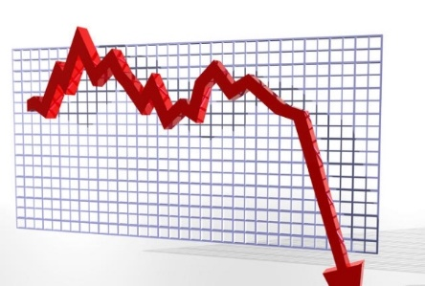
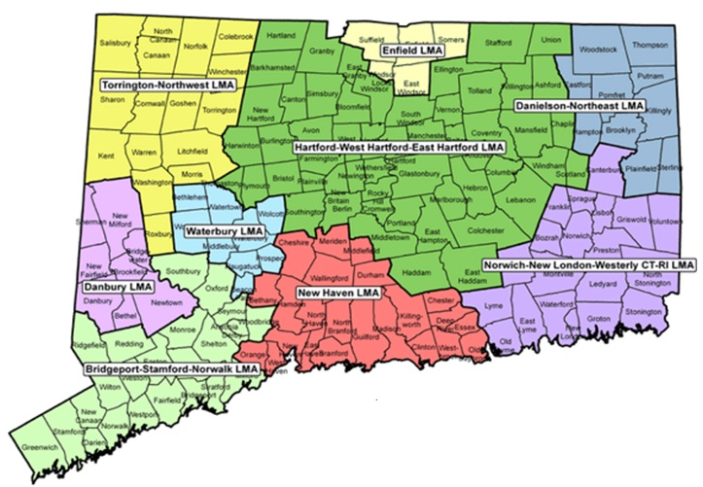
Key Findings
Biggest issue facing CT: Closing the opportunity gap
Poor CT economy: Stagnating job creation & economic growth
Hyper-localization: Fragmented political & financial systems make it difficult to scale social solutions
Significant demographic changes: young & educated are leaving, immigrant population growing
Notes:
No County Governments, 174 town governments, 194 school districts, 60% of towns can’t afford their infrastructure
GROWTH in immigration, particularly in state’s HISPANIC population.

Slide 12
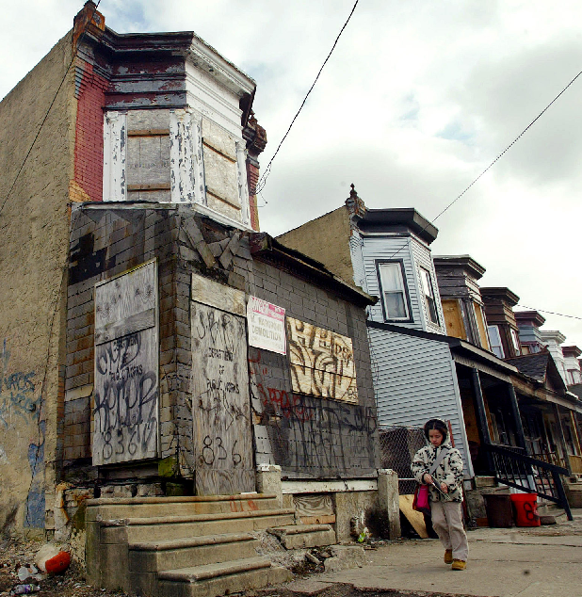
Key Findings
Disengaged corporate & business sector
Fragmented nonprofit sector
Revitalization needed in urban areas
Funders are adapting their strategies
Community engagement is key to achieving impact
Notes:
6. SILOED nonprofit sector -- DIFFICULT to develop & scale solutions.
9. Increased realization (among funders, government, some business) that community engagement is key

Slide 13
Mission, Vision, Key Imperatives
Mark Argosh

Slide 14
Our Research Led Us to Six Major Imperatives
Set a compelling vision and goal
Grow & diversify our partnership
Collaborate with funders & cross sector partners
Develop an innovative investment approach
Play a convening role
Enhance & extend SVP Partner capabilities
Notes:
Diversify our Partnership - to strengthen our organizational capacity & add new perspectives and expertise.

Slide 15
BROAD PARTNER & COMMUNITY CONSENSUS
The biggest problem facing Fairfield County and Connecticut is the
Opportunity Gap
WE HAVE A GOAL
We are dedicated to closing the Opportunity Gap
in Connecticut for all families

Slide 16
Our Mission
SVP Connecticut is an engaged community of Partners leveraging time, expertise, and resources for sustainable solutions to social problems, while becoming more strategic and effective in our personal giving.
Our Vision
As a community, it is our responsibility to close the opportunity gap in Connecticut.

Slide 17
Key Goals
To achieve our vision, we have three goals and a set of strategies to strengthen SVP Connecticut and take our impact to the next level:
GOALS
Grow our social impact through our work in closing the opportunity gap
2. Enable our Partners to grow as strategic philanthropists
3. Strengthen our organizational capacity to support our strategies
Notes:
Click to reveal each bullet point one by one

Slide 18
Strategies
Robert Smith
Don Kendall
Ted Yang
Jeff Mayer

Slide 19
Goal: Grow Our Impact
Strategy: Innovate Our Investment Process
Who
Previous Approaches
Proposed Approach
Social enterprise
Social enterprise preferred, but not required
Issue sector agnostic
Organizations closing the Opportunity Gap
SVP-CT Partners, FCCF and other community partners to identify organizations/sectors
Cohort Investment, Collective Action
Fast Pitch competition with target market

Slide 20
When
Previous Approach
Proposed Approaches
RFP once per year in the Spring
Missed opportunities; bad timing
RFP once per year in the fall >>> better timing
Proactively solicit Investees throughout the year
Actively engage SVP Partners throughout the year
Monthly meeting of Investment Committee (open)

Slide 21
How
Previous Approach
Subjective “feels right” approach with anecdotal post investment follow-up
Proposed Approach
Refined Investment criteria & rubric
Assessment
Initial 3 month time-only investment
Confirm scope
Ensure matching goals
Ensure right fit with SVP goals, skill set, interest, strategies
Investment
At conclusion of successful Assessment
Up to $25K per year, up to three years, SVP retains option
OR
Conclude engagement; provide brief with recommendations

Slide 22
Goal: Grow Our Impact
Strategy: Serve as a Convener and Catalyst for System Change
Take our community survey findings on the road
Share with funders, other orgs
Build network & framework for collaboration
Determine how we can help existing Collective Action Networks (e.g. Thrive by 25)

Slide 23
Goal: Grow Our Impact
Strategy: Enhance Consulting Services to Investees
Elevate quality of SVP services delivered by expanding Partner skills training/mentoring
Partner with FCCF Center for Nonprofit Excellence to augment our capacity building services
Develop corporate membership with SVP-coordinated employee
skills-based engagement
Increase time-only, short-duration engagements – expands SVP reach
Notes:
Partner Skills Training examples: (nonprofit 101, nonprofit financial management, building consensus)

Slide 24
Goal: Enable our Partners to Grow as Strategic Philanthropists
Strategies:
Offer varied education opportunities
Enhance Partner experiences
Provide hands-on engagement opportunities
Notes:
Click once to reveal 3 strategies under 2) Enable our Partners ….

Slide 25
Goal: Enable Our Partners to Grow as Philanthropists
Strategy: Offer Varied Education Opportunities
Speaker series featuring social sector thought leaders – Fall kick-off
SVP Network workshops (on-going) & annual conference (Oct / LA)
Nonprofit 101 boot camps on grant making and capacity building
Lunch & Learns and Entrepreneur breakfasts – resuming in Sept
FCCF / Center for Nonprofit Excellence events & resources
Strategy: Enhance Partner Experiences
Onboarding for new Partners, link with a “Partner Buddy”
Who are we? Learn about ourselves / spotlight on Partners
Partner-led education talks – we have philanthropists who want to share!
Social events
Notes:
September – Tour of Harbor Watch Lab & local LI Sound Oyster Farm

Slide 26
Goal: Enable Our Partners to Grow as Philanthropists
Strategy: Provide Hands-on Engagement Opportunities
Publicize clear roles/responsibilities for SVP committees & Investee project teams
Develop varied ways for Partners to get involved – there is a role for everyone!
Mentor Partners who want to “roll up their sleeves” to learn
Facilitate community leadership opportunities

Slide 27
Goal: Strengthen SVP’s Organizational Capacity
Strategy: Grow & Diversify our Partnership
Reach 100 Partners by June 2017
Solicit referrals from partnership – everyone is a SVP Ambassador!
Focus on millennials & expanding geographic reach, age-range, skill-sets
Update recruitment materials/website
Build community awareness of SVP
Geographic
Reach
Demographics
Professional
Experience
Capacity Building
Skills

Slide 28
Goal: Strengthen SVP’s Organizational Capacity
Strategy: Expand & diversity revenue sources
Strategy: Deepen our partnership with FCCF
Strategy: Define Partner & staff roles

Slide 29
Future Investment Focus: Workforce Development
Sylvia Shepard

Slide 30
Change Lever: Opportunity Youth
5.5 M opportunity youth (aged 16-24) are not in school and not employed
homeless youth young families
ex-incarcerated pregnant teens (mostly 16-19)
HS and CC drop-outs youth transitioning from HS and CC
Cost the U.S. $76.9 billion in lost income taxes
YET
40% of U.S. businesses report difficulty filling jobs
AND
88% say their future depends on finding the right talent
Engaging Opportunity Youth is Critical
Stats from LeadersUp website

Slide 31
Change Lever: Strengthen Career Pathways
SVP identifies and supports alternative career pathways to middle skill jobs, closely collaborating with FCCF’s Thrive By 25 in this effort.
Transition Supports
HS Higher Education
HS Job Training Programs
Technical HS Jobs or Higher Ed
Community College Jobs
Social Service Supports
Increase student completion rates, job access & career success
Advocacy, Program & Marketing Supports
HS Technical System
Advanced Manufacturing Technology Centers (AMTC)
E-House Program (train HS students in renewable energy fields)
Employer Supports
Increase # of jobs and internships for OY & link training programs to jobs

Slide 32
Change Lever: Catalyze Economic Development
Create trained labor force in high growth sectors
Health care services Medical technology
Advanced manufacturing technology Renewable energy
Revitalize Manufacturing Along the Route 8 Corridor – Bridgeport to Waterbury
Link people, training programs & biz through place-based development & collaboration
High unemployment provides labor
CC’s & technical HS’s provide training
Sikorsky & small manufacturers supply jobs
State provides transportation along RT 8
Grow Entrepreneurial Base
Create business incubators - stimulate entrepreneurial activity
Focus on manufacturing, draw companies to RT 8 Corridor
Market RT 8 Corridor as new hub of biotech, advanced manufacturing & green energy
Notes:
ROUTE 8 – Historically a KEY manufacturing corridor in CT
- Most of corridor designated “enterprise corridor zone”, offering tax advantages to new businesses

Slide 33
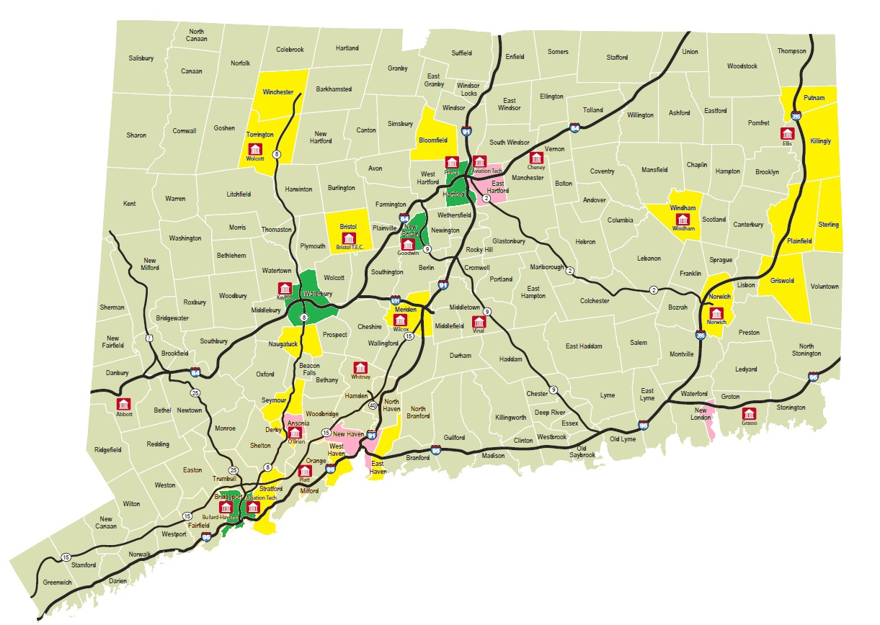
Targeted Investment Community
(Waterbury)
Naugatuck Valley Community College
(Waterbury)
Naugatuck Valley
Enterprise Corridor
W.F. Kaynor Technical HS
(Waterbury)
O’Brien Technical HS (Ansonia)
Targeted Investment Community
(Bridgeport)
Stratford HS For Aviation Maintenance Technicians
Bullard-Havens Technical HS
(Bridgeport)
Defense Plant Zone
(Stratford)
Housatonic Community College
(Bridgeport)
Unemployment
Over 8%
Over 7% Avg. 5.4%
Over 6%
CT Tech HS
Sikorsky
8500 employees

Slide 34
Future Investment Focus: Education
JP Hernandez
Rich Wenning

Slide 35
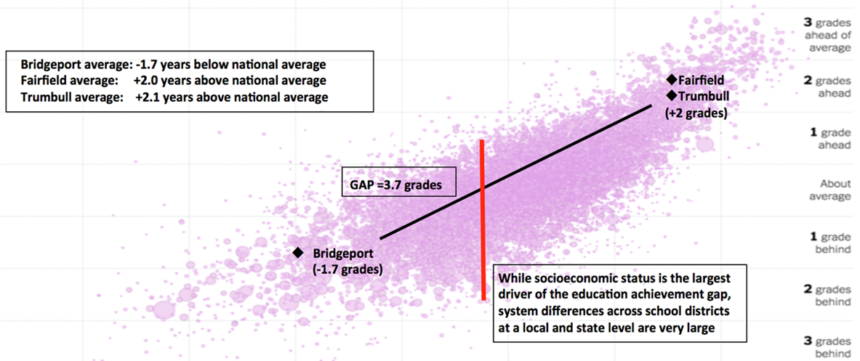
How Big is the Opportunity Gap?
Sixth Grade Achievement Gap by Each School District in the U.S.
Poorer Parents’ Socioeconomic Status Richer

Slide 36
Investment Priorities – Education
Expansion of high quality choices
Alternative options: career, & technical education
Extended hours: summer learning & after school
School financing reform
Parent engagement
Effective data infrastructure
Incentives to attract/retain high quality teachers
Early childhood education & child care orgs
Student mentoring programs
Notes:
EXPANSION OF CHOICES – Open choice (suburban slots), new school starts, investments in public school improvement efforts
PARENT ENGAGEMENT– Support community orgs to increase power of low income families to advocate for improved learning opportunities
EARLY CHILDHOOD - Scale high quality education & child care orgs EFFECTIVE DATA INFRASTRUCTURE – Collective Impact Initiatives

Slide 37
Closing Remarks
Don Kendall

Slide 38
Version 2.0
TODAY
45 Partners
Broad issue focus
One size fits all investment process
Working alone
Fewer Partner education events
Ad hoc consulting
2017
100 Partners
Targeted Focus on Education & Workforce Development
Innovative Investment Process:
Time-only engagement before committing financial support
More investments, smaller grants, year-round cycle
Collaboration with Other Funders
Broader Range of Educational Events
Higher Quality, More Consistent Grantee Support

Slide 39
Partner Engagement Opportunities
Join the Membership Committee
Participate on the Investment Committee
Become a Member of an Investee Consulting Project
Be a Lead Partner for an Investee
Plan Partner Education/Social Events
Attend Educational Events (e.g. Lunch & Learns)
Help with Fast Pitch
Join Strategy Teams
Education Sector Focus
Workforce Development
Convening and Collaboration
Advocacy

