Slide 1

Strategy Framework and
Business Plan
2016-2019

Slide 2

The Social Venture Partners Model
Grants & Investments
Partners pool capital to financially support high potential social ventures
Beyond the Dollars Support
Partners contribute time and expertise in service of grantees
Learning Opportunities
Offer workshops, speakers, and other ways for Partners to augment their learning and grow as strategic philanthropists
Notes:
Largest network of engaged donors in the world. 40 chapters in 9 countries (US, England, Australia, Korea, Japan, China, India, Brazil, Canada), 3500+ Partners
With their collective power, SVP Partners help individuals make a greater impact with their giving, fund and strengthen nonprofits, and equip our community to tackle our greatest social challenges. Dual Mission – to strengthen nonprofits and strengthen our Partners’ philanthropy.

Slide 3




SVP Connecticut History and Context for this Plan
SVP-CT was founded in October 2013 by a group of business leaders who partnered with the Fairfield County Community Foundation (FCCF) to create a new chapter of SVP. SVP was organized as a field of interest fund at the FCCF, and actively partners with the community foundation. Our initial business plan focused on social enterprises and earned income opportunities for nonprofits. In practice, we found a limited number social enterprises to invest in and shifted our focus to investing in nonprofits and providing them consulting support for capacity building, organizational development, and financial sustainability.
Over the past three years, SVP has invested $384,000 in four nonprofits, and 3200 volunteer hours in a total of 15 nonprofits. In this work, SVP has achieved significant outcomes and has received very positive feedback in grantee surveys. In addition, our partners have participated in a wide range of educational events, enabling partners to deepen their knowledge of philanthropy, while expanding their networks of partner and community relationships.
Past and current investments: International Institute of Connecticut
  Harbor Watch
  CT Pre-Engineering Program
  Horizons National
The SVP-CT Board of Directors decided to conduct a strategic review in order to plan for our future based upon a deeper understanding of partner interests and community needs. This document represents the product of a six-month strategic planning effort led by a team of 15 partners and board members. The comprehensive process included a landscape analysis of our community, a best practices review of our SVP network, and an analysis of our internal organization, including our Partner experiences, and our current operating and financial model. These activities and other external data have formed the basis for this strategic plan.

Slide 4
What We Learned from our Partner Survey and SVP Network Review
Partner Survey Results
SVP Network Review
High level of partner satisfaction
-100% rate the partner experience good or outstanding
-96% would recommend SVP to others
-96% more confident investors; 70% more thoughtful philanthropists
-100% believe there are sufficient partner engagement opportunities
Top issue areas of interest for partners are education (87%), poverty/workforce (71%) and environment (30%).
New Product interest: Incubator (67%), Board Matching (56%), Fast Pitch (56%. Create a big tent that includes new issue areas and programs that will attract other business minded donors.
Opportunities for improvement:
-Growing and diversifying the partnership
-Help “non-core” partners become more involved in the process
-Partnering with other funders and organizations
-Systematizing our consulting approach
-Clarifying our mission and strategy
Investment Process enhancements: smaller grant sizes, earlier engagement with potential grantees, rolling investments, better outcome measurement, exploration of new types of investments
Revenue management:
-Revenue/Partner: Average: $5,029 Best practice: $7194 (Portland)
-# of Partners: Typically 50-150 partners. Best practice: 510 partners (Seattle)
Program and Investment Focus:
-Investment focus: Chapters vary between solving a community problem,
concentrating on a specific issue, or investing more broadly
-New investment approaches: fast pitch, impact investing, collective impact
-Convening role: SVP chapters are increasingly bringing together cross sector
partners and serving as backbone
SVP organizational and capacity growth (Taking SVP to the next level)
-Expand and diversify membership, including younger partners who
bring new knowledge, skills, and energy
-Diversify and expand financial resources through funder partnerships
-Professional development of partners, mentoring for SVP leadership roles
-Codifying, scaling partner advisory support; utilizing strategic allies for grantees
-Speaker series, Jeffersonian dinners and other social events

Slide 5
Connecticut Landscape Analysis
SVP spent three months doing a landscape analysis of Fairfield County and Connecticut. This included 40 interviews and a review of numerous research studies done locally and nationally.
Key findings:
Closing the opportunity gap is the biggest issue facing Connecticut. This problem is challenging because it involves education, the economy, the vitality of our urban areas, and the high cost of living in many parts of our state. Many funders and organizations are focusing on aspects of this issue but lack a cohesive approach. Community foundations, as well as some national philanthropies are starting to concentrate on this problem.
CT economy is stagnating in job creation and economic growth resulting in less economic opportunity (McKinsey/BCFC study)
  Root causes:
  -Global and national economic forces have hurt CT’s traditional sectors like manufacturing
  -Unfavorable business climate due to state fiscal problems, inconsistent taxes and regulation, lack of public- private
  sector collaboration around business and infrastructure investment
  -Weak entrepreneurial environment hurts our ability to create new jobs
  -Lack of urban vitality causing a talent drain and hurting our attractiveness to employers
  Potential solutions:
  -Develop high growth sectors like Health Care and Advanced Manufacturing
  -Close our achievement gap, while training opportunity youth for middle skill jobs (skills and workforce development)
  -Stimulate greater public-private sector collaboration for growth
  -Fix long term state fiscal problems to restore business confidence (pension sustainability, budget stability)
  -Upgrade performance and investment in transportation and broadband infrastructure
  -Revitalize urban core areas to provide healthy environment for all families and to attract young talent
  -Stimulate greater entrepreneurship to increase the number of new jobs

Slide 6

Manufacturing has declined, while Finance and Insurance have stagnated
Connecticut industry mix, 1980-2014
% of GDP
30
25
Manufacturing
20
15
10
Interview with Paul Timpanelli, Bridgeport Regional Business Council:
1988: 15 manufacturers in Bridgeport >500 employees, 9 bank hq
2016: 0 manufacturers in Bridgeport >500 employees, 1 bank hq
5
Finance and Insurance
0
1980
1990
2000
2010
2014
SOURCE: Moody’s Analytics; US Bureau of Labor Statistics
|
12

Slide 7
Job creation by young companies has not returned to pre-recession levels and is among the lowest in the U.S.
0 to 5 > 5 years
50,000
Connecticut firms by age
Number of firms
Connecticut job creation by age of firm
Number of jobs
0 to 5
> 5 years
0 to 5
> 5 years
50,000
130,000
120,000
45,000
110,000
40,000
100,000
90,000
35,000
80,000
30,000
70,000
60,000
25,000
0
0
2006 2008 2010 2012 2014 2004 2006 2008
2004
2010
2012
2014
0-5 year old firms accounted for 33% of total firms and 54% of jobs created in 2013, ranking Connecticut 40th (lowest) in the U.S.
NOTE: Excludes data for companies where establishment data is unknown (~10-15% of total Connecticut firms)
SOURCE: U.S. Census Longitudinal Business Database
|
14

Slide 8
Connecticut Landscape Analysis
SVP spent three months doing a landscape analysis of Fairfield County and Connecticut. This included 40 interviews and a review of numerous research studies done locally and nationally.
Key findings:
Hyper-localization: CT’s fragmented political and financial system (174 town governments, 194 school districts) makes it difficult to scale social solutions
  60% of towns can’t afford their infrastructure without state assistance
  Subscale nonprofits operate inefficiently and generate duplication in each community (e.g. Fairfield County vs. Westchester County)
  State budget cuts causing pain for nonprofits
  Philanthropy is spread out supporting local organizations in individual geographies, with little ability to spread successes
Demographic Changes: CT is losing its young and highly educated population to other states, but seeing a growth in immigration and the state’s Hispanic population
  Stemming the talent drain is critical to the state’s ability to attract employers
  Supporting recent immigrants and the state’s Hispanic population are critical priorities
Businesses in Connecticut are relatively disengaged from community involvement due to a lack of locally owned businesses and the transient nature of corporate management
  Several models of employee engagement occur: a) organized corporate programs (e.g. Pitney Bowes); b) employee demand driven programs supported using third party platforms (e.g. Bridgewater); 3) adopt a nonprofit; and 4) owner/executive driven
  Businesses should provide internships for diverse students and to enable for them to gain valuable work experiences and build professional networks.
  SVP and FCCF should work with the business community to share their expertise with nonprofits. Opportunities exist to leverage Pitney Bowe’s learning and work with Bridgewater to build out Catch a Fire local platform

Slide 9

Top quartile Middle 50%
Bottom quartile
Finding #6: Most of our urban areas need significant revitalization to improve the quality of life for families and to attract younger families, which is a critical factor for job creation
Livability metrics by city, 2014
Quality of life measures are very weak for our biggest cities
CT overall
Bridgeport
Hartford
New Haven
Norwalk
Stamford
Waterbury
8.5% | 20.3% | 15.5% | 12.3% | 17.0% | 17.3% | 12.6%
- | 10,196 | 7,499 | 6,002 | 2,717 | 1,318 | 9,021
263 | 905 | 1,104 | 1,054 | 296 | 240 | 373
31.9% | 37.4% | 36.2% | 36.4% | 30.3% | 32.5% | 35.2%
0.13% | 0.30% | 0.57% | ND | 0.28% | 0.31% | 1.57%
7.9% | 14.6% | 19.4% | 11.2% | 8.5% | 9.3% | ND
Insurance coverage
% of population without health insurance
School ranking
Nationally of 13,506 school districts¹
Crime rates
Violent crime per 100k residents
Cost of living
Median gross rent/income ratio
Homelessness
Percent of total population
Unemployment %
NOTE: Quartiles are determined using cities >50,000 residents 1 School ranking calculated through surveys, health, safety, student culture, diversity and state test scores 2 Unemployment based on ACS 2014 one year survey estimate for purposes of comparison with city-level data
SOURCE: Social Science Research Council; FBI U.S. Crime Database,
US Department of Housing and Urban Development; ACS 2014, US Department of Education
|
20

Slide 10
Finding #7: Highly fragmented nonprofit sector makes it difficult to develop and scale social solutions. Some of the current nonprofits need to merge to more efficiently serve their populations. The lack of mid-sized nonprofits with strong entrepreneurs and scalable models makes it challenging to apply SVP’s traditional capacity building strategy
Mid-Sized$5-15MM
Mid-sized Agencies:
Family Centers, LifeBridge,
National Audubon Society,
Childcare Learning Centers,
CT Food Bank
Mega-funder: “There is no path to double our education funding in CT.”
Medium Sized Funder: “We’re giving 200k grants, because they don’t have the capacity to handle $1MM grants.”
DOMUS, Achievement First, Horizons National
Small Number of Emergent and Scalable Connecticut Nonprofits
Emerging: $1-5MM
Carver Center
ConnCan
International Institute of CT
All our Kin
ProBono Partnership
NeighborsLink
Smaller agencies
Habitat-Coastal FC
Connecticut’s fragmented social sector
Educators for Excellence
Citizens Schools
College Summit
Conect, Fund for Teachers
Future 5, CPEP
Harbor Watch, Intake
Faith Acts for Education
Hundreds of organizations
Traditional Agencies rely on state funding. Budget cuts will require more consolidation
Small: <$1MM
Organization Type
Institutional Agencies
Local Branch of National Organizations
Local Nonprofits
Social Entrepreneurial Scalable Nonprofits

Slide 11



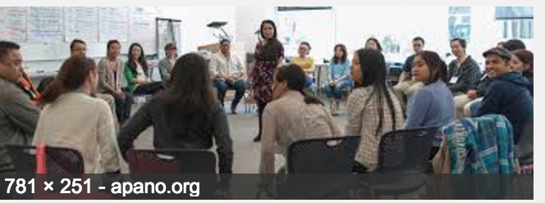
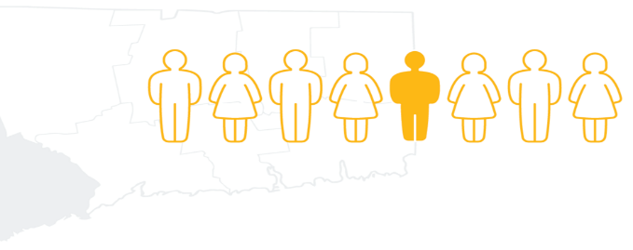

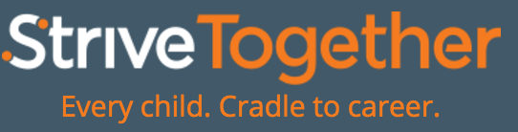
Finding #8: Funders are adapting their investment strategies to the needs of CT’s social environment:
-Incubator/cohort strategies with smaller nonprofits -Community organizing, policy advocacy, systems change
-Collective impact and cross sector partnerships -Shift from direct services to social impact investing and systems change
-Scaling investments for larger nonprofits -Recruiting nonprofits from other geographies
Organizing cross sector partnerships
Funding cohorts of smaller organizations
CT Early Childhood: Graustein
Memorial Fund
Perrin Foundation hired ED as program leader, funded 4 small organizations, provide training and organization development for the groups
Criminal Justice Reform: TOW Foundation
Zoom Foundation held competitive grant process for parent organizing, selected four groups, providing training and support
Thrive by 25: FCCF
Collective Impact:
Norwalk ACTS
Bridgeport Prosper
Stamford, Hartford, Waterbury
Newman’s Own Foundation funding cohorts in nutrition, social enterprises

Slide 12

Finding #9: A budding movement to create community voice: “People’s needs and poverty are more dire than ten years ago. It’s a story of two Connecticuts. It won’t change until we can mobilize Black and Brown communities to have real decision making power.” -Nonprofit ED-
Funders are supporting parent and community engagement organizations
Graustein Memorial Fund: 11 organizations in 6 communities doing parent organizing
-Make the Road, Connect (New Haven-Norwalk), Faith Acts for Education, PTPartners Bridgeport)
-Figure out to build the infrastructure for human capacity: engagement, leadership development, self agency
-Collaborating with other funders: Zoom, Perrin, Universal Health, Nellie Mae
Perrin Family Foundation: 4 organizations focused on youth organizing (youth led social change). Hired new, experienced program leader.
-Funding CT. Students for a Dream (FC), Hearing Youth Voices (New London), Grow Hartford (Food Justice), Youth Council for Justice (Norwalk)
-Organizations participate in retreats, technical training. Consulting and advocacy team of three people working with groups.
-Difficult to fund: lack of 501C3 status, small groups
-National network including The California Endowment that has put $5B into youth organizing
Zoom ran a competitive grant process for parent organizing
-Cohort of five organizations: NeighborsLink (Stamford), Make the Road (Bridgeport Latino Community), PT Partners Public Housing in Bridgeport), Faith Acts, Blue Hills
(Hartford)
-Zoom arranges training programs and technical assistance to cohort members
OO
Led by charismatic social entrepreneur Jemeliah Prince-Stewart
Harnessing the power of faith to build power to improve education in Bridgeport
25 churches, 181 members, led by Pastor McCullough.
TOC: by focusing on education, will have deep impact on poverty
Initial issues: school suspensions, special education, school funding. Successfully fought for four new charter schools.
Organizational
Profile: Faith Acts for Education

Slide 13




Our Community Research Identified Six Major Imperatives for SVP
Set a compelling vision and goal: There is a great opportunity to harness the wealth and talent of our area to improve the quality of life in our state. Our chances of tapping into this wealth and talent will increase as we become more intentional about setting a compelling vision and goal.
Grow and diversify our partnership to strengthen our organizational capacity and add new perspectives and expertise: SVP needs to grow its partnership in order to have the scale to achieve its vision. We will greatly benefit from reaching out to a more diverse set of partners, who can bring new knowledge, experiences, skills, and insights to invigorate SVP’s work.
Collaborate with other funders and cross sector partners: In order to address the most important problems facing our communities, we need to collaborate with other funders to create a more diversified financial model that matches our appetite for social impact. We should also get involved with cross sector partnerships that relate to our principal areas of focus in education and workforce development/economic growth.
Develop an innovative Investment approach: Given the fragmented nature of the Connecticut nonprofit sector, SVP should experiment with a number of new investment strategies, including:
-Work with issue oriented cohorts of smaller nonprofits with smaller grant sizes and smaller time investments
-Support systems change efforts with cross sector and collective impact partnerships
-Experiment with social and business incubators
-Import proven nonprofit operators from other geographies

Slide 14
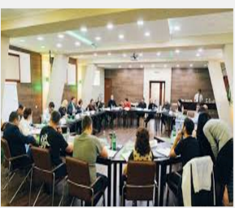

Our Community Research Identified Six Major Imperatives for SVP
Convening Role: Connecticut foundations tend to work alone in tackling social problems, except for funding collaboratives like the Early Childhood Collaborative that was highly successful. SVP is well positioned to play a role as a neutral broker and convener for funders. We can help bring together business and community leaders to tackle social problems.
Enhance and Extend Partner Capabilities: Prepare Partners with the training, resources, and support to engage effectively with the community and with SVP’s grantees. Nonprofits need consulting help in four key areas: TOC/Strategy, Leadership coaching/development, data analytics/performance management and fundraising. There are relatively few resources that nonprofits can afford that will provide these services. We can extend our consulting offerings by engaging other organizations, including the Center for Nonprofit Excellence to augment SVP partner experience to ensure that the right mix of capacity building and operational skills are available to investees.

Slide 15
SVP-CT’s Vision, Mission, Business Model

Slide 16
We have a goal: we are dedicated to closing the opportunity gap in Connecticut for all families
Connecticut has one of the largest economic and educational opportunity gaps in the country. Connecticut ranks 49th in its academic achievement gap, 50th in wealth inequality and 42nd in long-term inequality. Due to the high cost of living in Connecticut, a majority of families in Connecticut’s three largest cities have incomes below the working poverty level (Asset Limited Income Constrained-United Way report). Statewide, 35% of Connecticut households or 474,000 families live in this highly vulnerable state.
There was broad consensus in our community interviews that the opportunity gap is the biggest problem facing Fairfield County and Connecticut.
In our partner survey, the top two areas of interest are education (83%) and reducing poverty/job creation (71%). After extensive research, listening to the needs and wishes of our community, surveying the interests of our Partners and careful discernment of our path, we accepted a challenge to close the opportunity gap. Solving this problem requires audacious thinking, significant capacity building at an organization and systems level, adaptive leadership skills, collaboration with other organizations, and an orientation to getting results. This plan outlines our key strategies, programs, and ideas for achieving progress toward our goal.
Our Mission:
SVP Connecticut is an engaged community of partners leveraging time, expertise, and resources for sustainable solutions to social problems, while becoming more strategic and effective in our personal giving.
Our Vision:
As a community, it is our responsibility to close the opportunity gap in Connecticut.

Slide 17









We believe that there are significant resources and leadership in our community to address these problems but we lack efficient models for directing them to have the most impact. SVP is committed to identifying high potential solutions, measuring their impact, aligning resources around these solutions, and building cross sector partnerships to remove the bottlenecks to success. As a partnership, we will invest our time and resources to scale and proliferate the most effective organizations and systems practices. We will play an advocacy role in pushing for policy reforms and support the engagement and mobilization of families in developing sustainable solutions to these problems.
What SVP Does
1. Grants & Investments:
We pool our capital to financially support high
potential social ventures
Beyond the Dollars Support:
Many partners contribute time and expertise in
service of grantees
Learning Programs:
We offer workshops, speakers, and other ways for
partners to augment their learning and grow as
strategic philanthropists
Taking SVP to the Next Level
Explore and layer in new investment models
-Targeted and Partner Advised Investments
-Incubators, Fast Pitch, Cohorts of smaller groups
-Social ventures, impact investing
-Funding collective impact and networks
Equip our partners to provide more valuable
consulting support
3. Expand our convening role in philanthropy and
social change
Collaborate with FCCF and other funders to
mobilize resources for social impact
Grow and diversify our partnership
Advocate for public policy changes
3
SVP Role:
Business, Government,
Community
Resources
Children & Families who need us
Investing in Innovative Solutions
Increasing Systems Capacity
Aligning Resources/Breaking Bottlenecks
Advocacy for Public Policy Changes
Community Engagement/Developing Self Agency

Slide 18
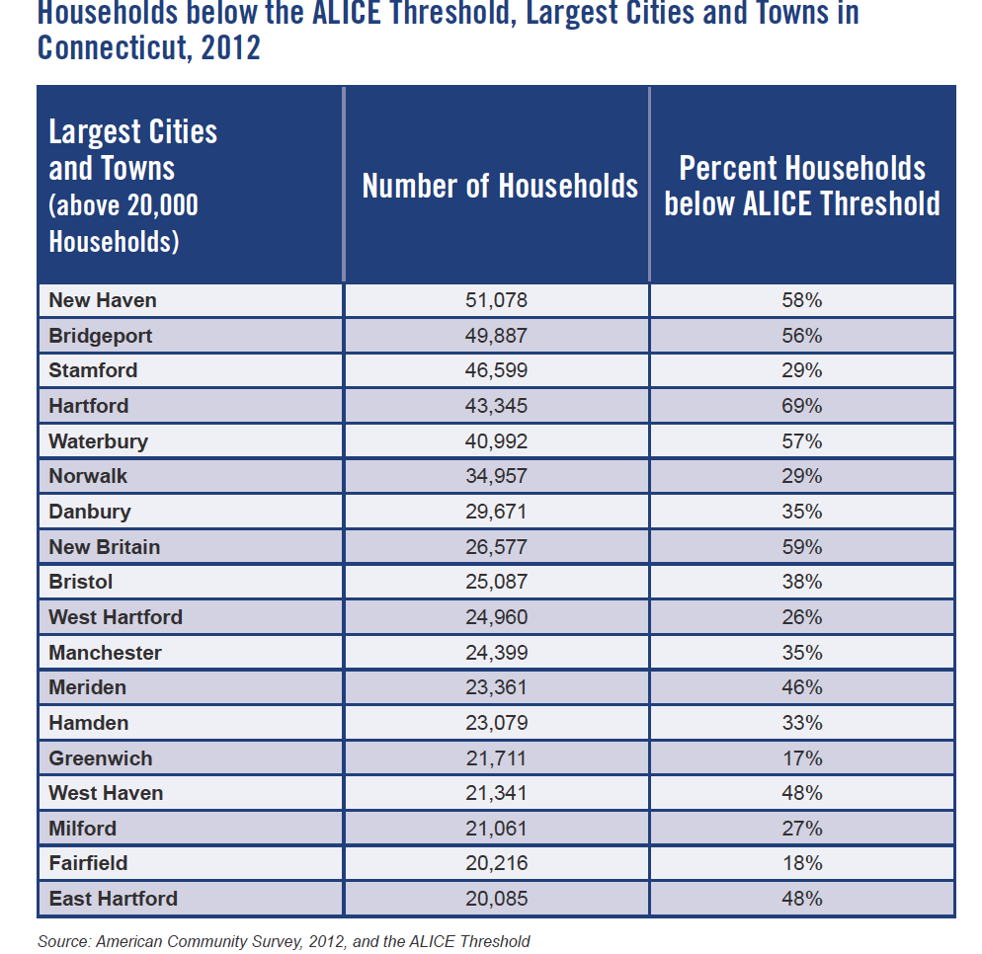
A majority of families in Bridgeport, New Haven, and Hartford have incomes below the working poverty level
Why are we focusing on the opportunity gap?
One of the most fundamental beliefs in our country is the principle of equality of opportunity. About 95% of Americans believe that everyone in America should have an equal opportunity to get ahead. Yet, over the past 30 years, the opportunity gap has widened in Connecticut and in our country. This gap is reflected in unequal educational and work opportunities resulting in fewer opportunities for upward mobility for lower income children. This lack of social mobility is economically wasteful, destabilizing for our democracy, and morally unjust. Community leaders told us that the problems of poverty, unemployment, homelessness, gun violence, and failing schools have worsened over the last ten years in our urban areas. They believe that Connecticut is rapidly becoming a tale of two states, one rich and one poor. We believe that it is our responsibility as citizens and philanthropists to restore greater opportunity for all.
Economic Costs of “Opportunity Youth”
 | Taxpayer Burden | Societal Burden
Annual (per youth) | $13,900 | $37,450
Adult lifetime (per youth) | $170,740 | $529,030
Aggregate for current cohort of opportunity youth | $1.59 trillion | $4.75 trillion

Slide 19
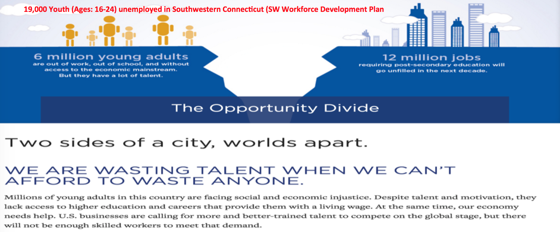
What are the root causes of the opportunity gap?
Many factors have contributed to the opportunity gap, not the least of which are the tectonic shifts in our economy, schools, family structure, increasing numbers of families in poverty, and the practices and funding constraints that silo our education and workforce systems. These changes occurred gradually over several decades and will require significant investment and cross sector collaboration to reverse. We believe that the two most powerful levers are growing Connecticut’s economy and workforce and improving our urban educational systems.
Economic Root Causes: The industries in the past that provided a reliable path to the middle class have been displaced. In Connecticut, our manufacturing base has declined, while the finance and insurance industries have stagnated. The result: those with less education and fewer skills have been left behind. Some key problems that need to be addressed are:
-Breakdown of our workforce training and apprenticeship systems
-Unfavorable business climate due to state fiscal problems, inconsistent taxes and regulation
-Lack of public-private sector collaboration and investment in infrastructure and growth
-Weak entrepreneurial environment that hurts our ability to create new jobs
-Lack of urban vitality is causing a talent drain and hurting our attractiveness to employers

Slide 20
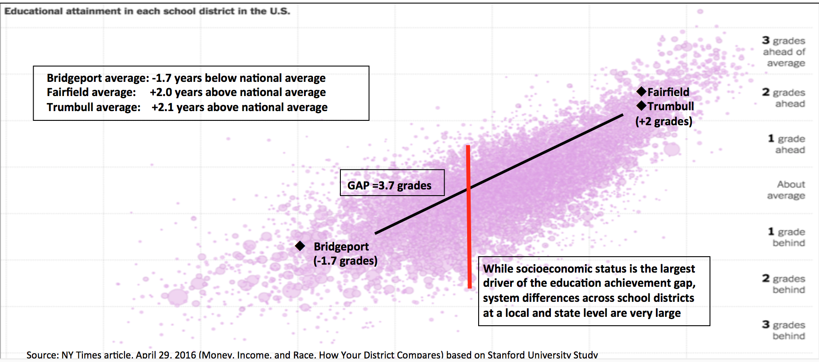
What are the root causes of the opportunity gap?
Education: Connecticut has one of the largest achievement gaps in the country on an absolute and relative basis. Our urban school districts have a higher concentration of low income students and are more racially segregated than many other large cities, due to the patterns of residential segregation in Connecticut. In addition, these school systems are under-resourced due to Connecticut’s antiquated school finance system. This makes it extremely challenging for urban school districts to create an effective learning environment, for students, given the host of social issues faced by under-resourced families.
The achievement gap starts in early childhood, as low income children tend to have less educational exposure before kindergarten due to their family circumstances and the lack of affordable high quality child care and early childhood education. As a result, they arrive at school with a gap in their readiness to learn. As poor kids move through the school systems, they are more likely to face social problems, that public chools are ill equipped to deal with. These schools also tend to attract a less experienced and lower quality mix of teachers and principals due to the lack of incentives for teachers to accept a more challenging teaching environment. By sixth grade in Bridgeport, there is a 3.7 grade gap versus kids in neighboring Fairfield and Trumbull.

Slide 21
What are the root causes of the opportunity gap?
Educational Achievement Gap Drivers: There are a number of key factors that are widening the achievement gap in Connecticut. Some of the key drivers are:
-Lack of affordable early childhood education programs and lack of affordable high quality child care
-Under-funding of urban school systems due to Connecticut’s antiquated school funding formulas and property tax system
-Lack of high quality school seats for poor kids, due to the lack of high quality district schools and the limited number of choice options in many geographies like Bridgeport
-Inability to leverage the substantial resources of suburban school systems (statewide: only 3,000 out of 60,000 students in our three largest cities get to attend suburban schools)
-Lack of incentives for attracting high quality teachers into urban school systems ($2,000 per year has attracted top quality teachers to high poverty schools in other states)
-Limited options for extended time and mentoring for low income kids (after school, summer)
-Lack of connectedness of K-12 schools to college, careers, and internships/apprenticeship opportunities
-Need for better alignment of employers with vocational education and community college programs
-Lack of accountability for school results, due to poor data infrastructure
-Need for a safer, healthier environment for learning
-Lack of parent involvement in their children’s education
How should we define our desired outcomes?
Key Metrics:
1. Opportunity Youth: Increase the number of opportunity youth that receive job training and get placed into jobs with livable wages
2. Economic Growth: Adopt public-private sector plan to invest in our highest potential business sectors
3. Economic Growth: Increase the number of jobs created by entrepreneurial companies
4. Education: Increase the learning velocity rate for low income students in Connecticut
-Establish a student learning velocity measure for evaluating alternative education investments
-Scale the most effective organizations and programs that increase student learning velocity
5. Education: Increase the number of students attending well resourced schools with an effective learning environment that prepares kids for gainful employment or higher education
6. Education: Increase the percentage of low income students that have completed college or have entered into meaningful careers

Slide 22
What can we do to address the opportunity gap?
Closing the opportunity gap will require a collaborative approach. The challenges that Connecticut’s urban areas face are too big and complex for the public sector to solve on its own or for nonprofits to pick up the slack where government resources fall short. Businesses and philanthropists need to be involved, and they need to think differently about how they contribute. SVP is committed to working together with all sectors to develop practical solutions and help mobilize resources to address these problems.
Fortunately, a number of private, public, and nonprofit organizations are targeting this problem. The Community Foundation Opportunity Network is launching a national initiative to address the opportunity gap. In Connecticut several community foundations (Hartford, New Haven, and Fairfield County) are making progress in addressing the education and job problems faced by opportunity youth. In the education sector, a number of local and national foundations are heavily investing to close the achievement gap. And at a national and local level, there are a number of promising evidence based solutions that can be adapted to the needs in Connecticut.
While we have some hunches about where our investments should be focused, we intend to work collaboratively as a partnership and work with other funders and cross sector players to “co-create” our investment strategies in education and the economy. At the same time, we need to help build system capacity to collect, share, and utilize a common set of program outcomes data to help prioritize organization and system-wide investments. By taking a data driven approach to investing, we will increase our speed of learning and direct resources to those organizations and solutions with the highest potential to achieve the desired outcomes.
Possible investment focuses:
Workforce and Economic Growth
Job training programs for opportunity youth that are matched with employers in high demand sectors and community colleges.
Target vulnerable groups, like the homeless or the ex-incarcerated with a comprehensive strategy around jobs, housing, and social services
Assist community colleges to increase their student completion and job placement rates
Work with employers to increase the number of internships for opportunity youth
Catalyze economic development in high growth sectors like health care services and advanced manufacturing
Growing our entrepreneurial base: Collaborate with a university like Babson to create business incubators to stimulate entrepreneurial activity
Advocacy: support solutions to the state’s fiscal problems (unfunded pension liabilities), increased investment in transportation and communications infrastructure, and streamlined state regulation
Support neighborhood revitalization efforts for our urban areas, while addressing the issue of housing affordability

Slide 23
Possible investment focuses:
Education
Growing the number of high quality seats for low income students: expand open choice (suburban slots), add new charters and magnet schools, support district school improvement efforts
Extended hours: Scale high quality summer learning and after school programs for low income students.
Advocacy: support school financing reform to provide greater funding for high poverty schools
Parent engagement: Support community organizations to increase the power of low income families to advocate for improved learning opportunities
Attracting/Supporting high quality teachers: Create incentives for attracting high quality teachers into urban school systems ($2,000 per year has attracted top quality teachers to high poverty schools in other states)
Early childhood education: Scale high quality early childhood education and child care organizations
Connect K-12 schools to college, careers, and internships/apprenticeship opportunities. Fix vocational school system in Connecticut.
Work with collective impact initiatives, school districts to build effective data infrastructure for schools
Scale student mentoring programs

Slide 24
Key Objectives and Strategies
To achieve our vision, we have three goals and a set of strategies that will strengthen SVP Connecticut and take our impact to the next level:
Grow our social impact through our work in closing the achievement gap
2. Enable our partners to grow as strategic philanthropists
3. Strengthen our organizational capacity to support these focuses

Slide 25
Key Strategies
Grow our social impact through our work in closing the achievement gap
  Strategy 1: Innovate our investment process to support our vision
    -Focus our investments on education and economic/workforce solutions
    -Explore new forms of investing including: collective impact initiatives and networks, business incubators, cohorts of smaller
    nonprofits, fast pitch, social impact investing
    -Encourage targeted and partner advised investments
    -Engage earlier with grantees on consulting projects to ensure investment suitability
    -Reduce our average investment size (up to $25,000 per year for up to three years)
  Strategy 2: Serve as a convener and catalyst for systems change around closing the opportunity gap
    -Build strong partnerships with the key players including parents, nonprofits, businesses, educational institutions, government, funders
    -Align the players around collective impact practices and a data led process to drive system and funding alignment
    -Build system capability to collect, share, and utilize common program outcomes data. Establish key performance metrics at an
    organization and systems level including inputs, outputs, and outcomes
    -Carefully monitor progress, identify challenges and opportunities and work with partners to identify potential solutions
    -Strengthen the key players: Align funding and resources against the highest impact, highest reach programs.
  Strategy 3: Enhance services to grantees through improved beyond the dollars consulting support
  -Prepare Partners with the training, resources, and support to engage effectively with the community and with SVP’s grantees.
  -Build out consulting capabilities in four key areas: TOC/Strategy, Leadership coaching/development, data analytics/performance
  management and fundraising.
  -Partner with the Center for Nonprofit Excellence to augment our capacity building services
  -Provide additional consulting services through strategic allies
  -Develop college internship program to support entrepreneurial social ventures

Slide 26
Key Strategies
Enable our partners to grow as strategic philanthropists
  Strategy 1: Provide educational programs to deepen partners’ knowledge of the social sector and philanthropy
    -Speaker series featuring social sector thought leaders
    -Strategic reviews with nonprofit leadership teams
    -Offer access to external workshops and conferences on philanthropy
    -Training workshops for skills development such as a grant making boot camp and capacity building series
  Strategy 2: Enhance the experience of new Partners
  -Expand new partner on-boarding program including orientation, engagement, and mentoring with seasoned partners
  -Plan for the needs, scheduling and experiences of a greater variety of partners, including busy professionals and younger partners in the
  variety and design of our program offerings
  Strategy 3: Provide hands-on engagement opportunities for partners to work with social sector organizations and SVP
    -Review and update expectations and core capacities desired for Partners serving on SVP committees, grantee teams, and corporate and
    community liaison roles
    -Improve process to promote and connect Partners with engagement opportunities
    -Mentor Partners to take on leadership roles within SVP
    -Support Partners in taking on community leadership roles

Slide 27
Key Strategies
3. Strengthen our organizational capacity
  Strategy 1: Grow and Diversify our Partnership
    -Engage the full partnership in cultivating new partner prospects (six touches to convert prospects to partners)
    -Double the size of our partnership over the next 12 months
    -Attract a more diverse partnership (geographically and demographically). Recruit younger partners to build the pipeline of future leaders
    and bring in new ideas, perspectives, expertise
    -Explore new categories of corporate and nonprofit partners. Work with corporations to engage their employees in philanthropy and social
    change.
  Strategy 2: Expand and diversify SVP's sources of revenue to expand SVP's social impact and help ensure its financial sustainability.
  -Cultivate strategic alliances with funders to scale our capabilities, impact, and influence
  -Program related co-investing for specific organizations or initiatives
-Explore opportunities to deliver capacity building activities to the broader community for foundations, other entities
-Investigate securing resources beyond Partner dues, such as planned gifts, permanent endowments, multiple partnership levels
-Develop deep partnerships with corporations including employee engagement programs and corporate sponsorship of members
  Strategy 3: Deepen our partnership with FCCF
  -Collaborate on developing a comprehensive community engagement strategy around addressing the opportunity gap
  -Partner with the Thrive by 25 initiative around workforce development opportunities
  -Work with the Center for Nonprofit excellence to provide a broad set of consulting and training services to nonprofits
  -Engage FCCF leadership in helping to carry out this business plan
  -SVP Partners get more involved with FCCF committees and board, leveraging our business skills
  -SVP and FCCF help each other diversify their revenue sources
  Strategy 4: Define partner and staff roles that align with SVP’s goals for increased social impact, growth, and sustainability

