Slide 1
SVP Global Conference
“Rethinking Recruiting”
October 21, 2016

Slide 2
SVP Arizona
Pipeline
All partners are ambassadors
Being intentional
Make it fun (or as fun as possible)
Program
Recruitment campaign—Game On!
Stewardship
Multiple staff and partners

Slide 3
SVP Tokyo
Out line
Partner : 110 units / 116 individuals
Annual fee : 1000$/year
Young and active community (over 60% partner are active)
Large Potential Partners in Tokyo
Population is 13M
Social Innovation movement is Booming
SVP Tokyo need to balance of community
Keep the balance of graduate and new comer (-10 / +20)
Have to keep atmosphere, culture and passion.
Notes:
Let me intro duce outline of our partner community.
Firstly, SVP Tokyo has 116 individual Partners which is 110 units.
And Annual fee is 1000$ per year and partner are easy to entry our community.
Consequently , community become young and active.
Also society is don

Slide 4
Recruitment root
External
Internal
External Event ,
Speach
Introducing
By partner
NWM
説明会
241
24
On site
MBA Classes
By CEO
Interview
Bｙ parter
Media
（Papers, magazines, websites）
SNS
(Facebook, twiter)
Official Account
(Facebook , Twitter)
Mailing
List
Registration
Payment
17
On line
578
Blog/
Web media
Official Website and
Account
orientation

Slide 5
Image
Knows SVP
Interesting / likes SVP
SNS follower
Alumni
Mailing-list members
SVP Tokyo
Community
Event participants
Partners
Investees
Support organizations

Slide 6
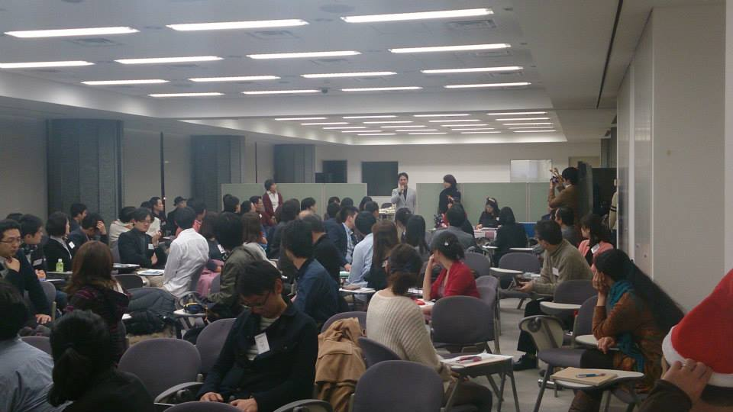
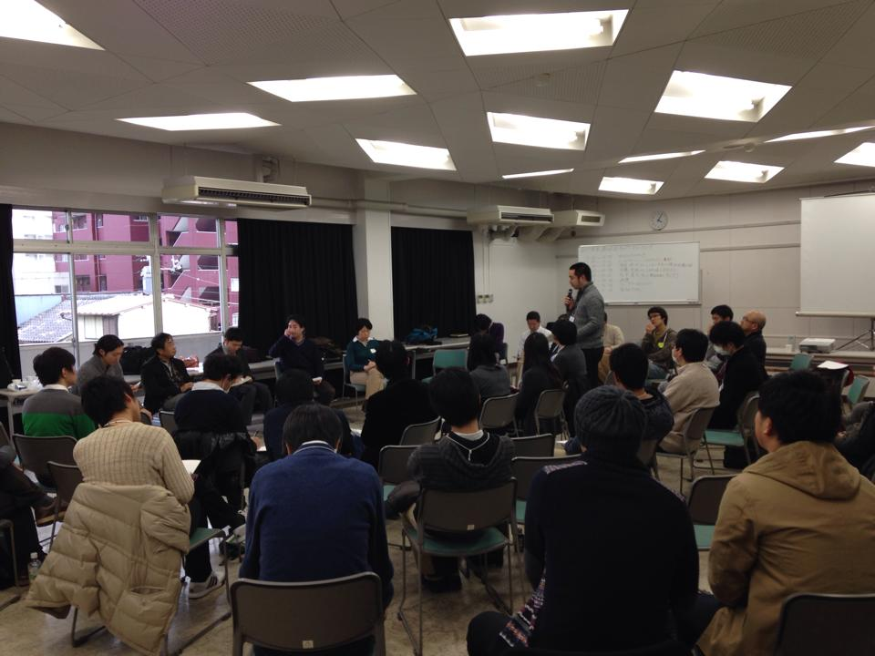
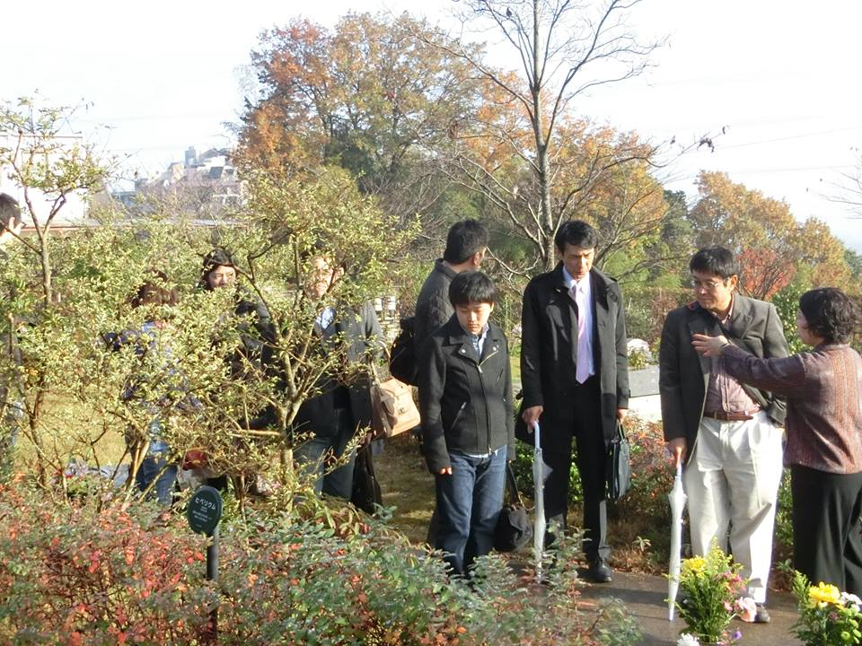
Network meeting

Slide 7
SVP Charlotte
Pipeline
Leverage relationships of Partners
Fast-pitch & Investees
Program
Annual event
Its all about the stories!
Keep the social in SVP alive
Stewardship
Timeliness of follow-up
Make the ask – keep inviting
Salesforce

Slide 8
SVP Seattle
Pipeline
All partners are ambassadors
Make it easy, acknowledge
Community events
Program
Prospective Partner Receptions
One on one meetings
Stewardship
Multiple staff and partners

Slide 9
SVP San Diego
Listen and Probe
Talk Less, Smile More
Get Answers to Questions Beforehand
Translate Features To Benefits (e.g. so that, which means, which gives you)
Objections
Write Out Common Objections and Responses
Use Feel, Felt Found to Respond to Objections
Closing
Develop Closes that Work for Your SVP

