Slide 1
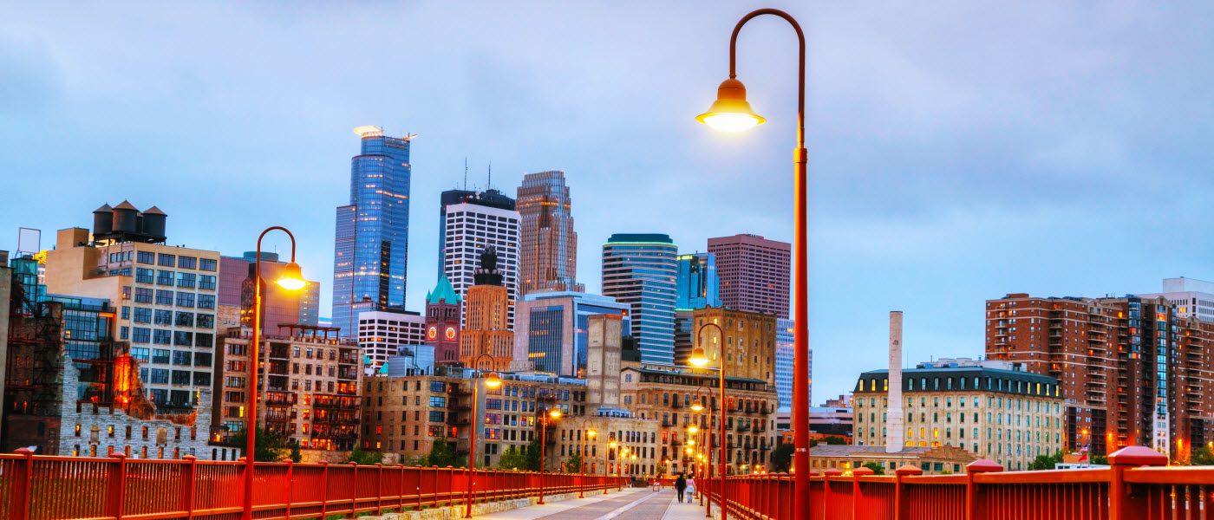
Due Diligence Team – the Process
Powerful Relationships. Thriving Communities. Engaged Philanthropy.
Notes:
Hello, I am Ann Herzog-Olson and I am the Executive Director of Social Venture Partners Minnesota.
We are one of 40 SVP affiliates from around the globe.
We are a nonprofit that uses the venture capital model to help other nonprofits scale.
SVP was launched in Seattle in 1997 and in Minnesota in 2002.
Our model has always focused on two things:
help social entrepreneurs in the Twin Cities build capacity, and
2. educate our partners on how to become engaged philanthropists using the VC model.

Slide 2
Who is on the Team
Jeff Parker
Due Diligence Team Leader
parksinep60@gmail.com
612-859-9946
Jeff Arnesen
jeffreyaarnesen@gmail.com
651-271-8025
Rhoda Beaird
rbeaird@luriellp.com
Kate Berman
kateberman1@me.com
612-802-2710
Nancy Chang
nmchang@mmm.com
Rebecca Duvick, ex officio
Chair of Investment Committee
rduvick@comcast.net
763-280-2295
Brian Garshelis
bgarshelis@newsector.org
612-437-1985
Todd Hauschildt
toddhauschildt@me.com
612-803-3694
Josh Heinrich
jhenrich@luriellp.com
Ross Johnson
rossj@riverbridge.com
612-904-6208
Julie Krieger
julie.krieger@evercore.com
612-222-9537
Matt Ladhoff
mladhoff@mmm.com
Alexandra Marston
alexandrakmarston@me.com
612- 386-0198
Adam McGrane
adamm@riverbridge.com
612-904-6208
Trevor McKinnon
trmckinnon@mmm.com
Drew Moss
drewmoss17@gmail.com
952-334-7823
Holly Parker
jphp@aol.com
612-819-5059
Brian Peterson
brian.peterson.c@gmail.com
612-968-5757
Vicki Raport
vicki.raport@gmail.com
612-817-8841
Louis-Paul Ricard
louis_ricard@cargill.com
612-812-7311
Tracy Skar
atskar@juno.com
952-807-6479
Kirk Smith
ksmith9@mmm.com
Emily Soltvedt
emilys@riverbridge.com
612-904-6208
Andrea Stark
andreas@riverbridge.com
612-904-6208
Mary Beth Steiner
marybeths@riverbridge.com
612-904-6208
Charles Talbert
ctalbert@luriellp.com
Thanh Tu
tttu@mmm.com
Amy Jo Van Culin
amyjovan@lubetech.com
763-417-1360
Staff
Ann Herzog-Olson
aherzog@svpmn.org
(m) 952-807-7232
(o) 952-933-5560
Esther Goldberg-Davis
egoldbergdavis@svpmn.org
(m) 612-508-5443
(o) 952-933-5560

Slide 3
Objectives of Team
Identify the most scalable nonprofits using our model of engaged philanthropy
Provide a portfolio of up to 4 nonprofits who will make a case at Pitch Night

Slide 4
Point of Inflection
Notes:
Timing is everything.
Finding orgs at the right time for expansion is part of the art of VC work.
We seek strategically timed investments for our grants and to build capacity.
We look for collaboration to attain sustainable long term success.
It’s all about building capacity for organizations at the point of inflection.
We help them be
financially stable,
retain key staff,
develop strong boards,
be adaptive to change and committed to results.

Slide 5
Our Investees
To educate and engage youth to learn, work, and thrive as responsible global citizens in the 21st century.
Empowers youth through action-oriented labs focused on sustainability and entrepreneurship by integrating interdisciplinary curriculum with hands-on agriculture systems.
To use food as a tool for building health, wealth and social change.
To prevent crime and violence by creating pathways to success for 16-21 year old gang-clique youth living in four North Minneapolis neighborhoods where homicide rates are high and poverty is concentrated.
Prepares under-resourced students for college success and cultivates the next generation of educators.
Notes:
We typically have 4-6 investees at any given time.
All of these organizations:
serve at-risk teens
in the 7-county metro area and
we are helping them scale.
In 2017, two will “retire” including BTC and Emerge

Slide 6
Grant Investment Process
Investment Committee
Due Diligence Team
Pitch Night
New Investee
Review LOIs
Eliminate nonprofits that do not fit guidelines
Send RFPs
Review RFPs
Select semi-finalists
Deep dive research including financial review
Site visits
Narrow to finalists
Provide coaching for Pitch Night
Finalists present 5 minute pitch
15 minutes Q&A
Partners vote on new investee
Board approves new investee
Lead Partner(s) determined
Partners build consulting team
Investee completes Organizational Capacity Assessment Tool (OCAT)
Create Capacity Building Plan together
Notes:
How we select investees

Slide 7
Fall 2016-Winter 2017 Due Diligence Process
Select semi-finalists
12/2/16
Due Diligence Team
Before the meeting:
Review updated applications, websites, public info, personal contacts
Score applicants using the rubric, post to shared doc
At the meeting:
Determine semi-finalists
Identify questions & concerns to explore further

Slide 8
Fall 2016-Winter 2017 Due Diligence Process
Select semi-finalists
12/2/16
Site visits
1/9-2/9/17
Due Diligence Team
Before the meeting:
Review updated applications, websites, public info, personal contacts
Score applicants using the rubric, post to shared doc
At the meeting:
Determine semi-finalists
Identify questions & concerns to explore further
Due Diligence Team
Sub-teams do site visits & meet with semi-finalists’ nonprofit mgmt to explore questions & concerns
Each sub-team writes up a report on its visit, which is circulated to the full Due Diligence Team on 2/10/17

Slide 9
Fall 2016-Winter 2017 Due Diligence Process
Select semi-finalists
12/2/16
Select finalists
2/15/17
Site visits
1/9-2/9/17
Due Diligence Team
Before the meeting:
Review updated applications, websites, public info, personal contacts
Score applicants using the rubric, post to shared doc
At the meeting:
Determine semi-finalists
Identify questions & concerns to explore further
Due Diligence Team
Sub-teams do site visits & meet with semi-finalists’ nonprofit mgmt to explore questions & concerns
Each sub-team writes up a report on its visit, which is circulated to the full Due Diligence Team on 2/10/17
Due Diligence Team
Before the meeting:
Read site visit reports
Conduct other research
At the meeting:
Determine finalists
Identify team members who will coach finalists for Pitch Night
Identify team members who will write briefing sheets about each finalist for Pitch Night

Slide 10
Fall 2016-Winter 2017 Due Diligence Process
Select semi-finalists
12/2/16
Select finalists
2/15/17
Site visits
1/9-2/9/17
Prep for
Pitch Night
2/20-3/24/17
Due Diligence Team
Before the meeting:
Review updated applications, websites, public info, personal contacts
Score applicants using the rubric, post to shared doc
At the meeting:
Determine semi-finalists
Identify questions & concerns to explore further
Due Diligence Team
Sub-teams do site visits & meet with semi-finalists’ nonprofit mgmt to explore questions & concerns
Each sub-team writes up a report on its visit, which is circulated to the full Due Diligence Team on 2/10/17
Due Diligence Team
Before the meeting:
Read site visit reports
Conduct other research
At the meeting:
Determine finalists
Identify team members who will coach finalists for Pitch Night
Identify team members who will write briefing sheets about each finalist for Pitch Night
Due Diligence Team
Sub-teams coach finalists on how to pitch themselves to SVP partners
Sub-teams put together briefing sheets on each of the finalists

Slide 11
Fall 2016-Winter 2017 Due Diligence Process
Select semi-finalists
12/2/16
Select finalists
2/15/17
Pitch Night!
Vote for investee
4/6/17
Site visits
1/9-2/9/17
Prep for
Pitch Night
2/20-3/24/17
Due Diligence Team
Before the meeting:
Review updated applications, websites, public info, personal contacts
Score applicants using the rubric, post to shared doc
At the meeting:
Determine semi-finalists
Identify questions & concerns to explore further
Due Diligence Team
Sub-teams do site visits & meet with semi-finalists’ nonprofit mgmt to explore questions & concerns
Each sub-team writes up a report on its visit, which is circulated to the full Due Diligence Team on 2/10/17
Due Diligence Team
Before the meeting:
Read site visit reports
Conduct other research
At the meeting:
Determine finalists
Identify team members who will coach finalists for Pitch Night
Identify team members who will write briefing sheets about each finalist for Pitch Night
Due Diligence Team
Sub-teams coach finalists on how to pitch themselves to SVP partners
Sub-teams put together briefing sheets on each of the finalists
SVP-MN Membership
Before Pitch Night!:
Briefing sheets are circulated to the full SVP-MN membership
At Pitch Night!:
Finalists do 5 minute pitches
Finalists take Q&A
SVP-MN members vote for investee
SVP-MN members volunteer to work with investee

Slide 12
Grant Investment Cycle
Develop plan & begin capacity building
Year-end Review &
Re-grant
Continue capacity building
Mid-year Review

Slide 13
Rubric Tool
Add visual (?) of the rubric (one section)

Slide 14
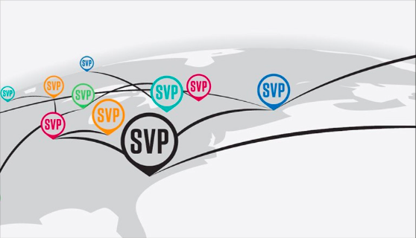
SVP Connect
View materials for Due Diligence Team
Portal for all 40 affiliates with dedicated space for SVP MN
Create your own profile
Access Partner roster
Access shared resources and best practices from the network
All We See is Potential.

Slide 15
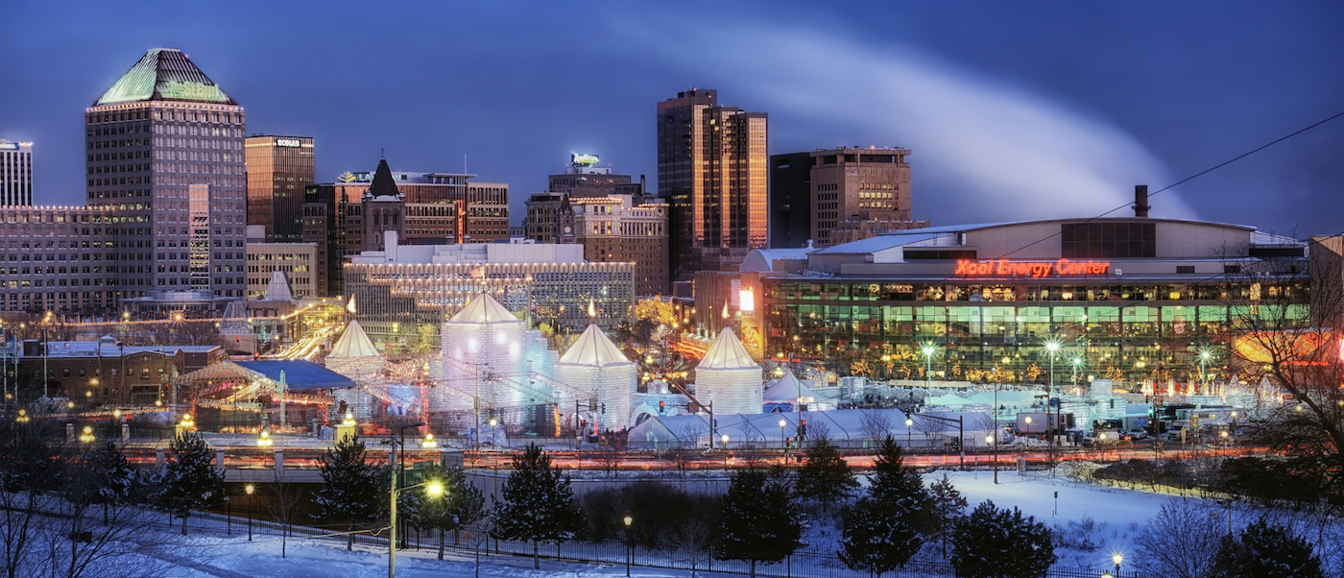
Questions?
Thank You

