Slide 1
SVP Revenue Model
Conference Session

Slide 2
SVP Revenue Model
Presenters & Agenda:
Fee for Services from SVP Affiliate
  Jennie Arbogash, SVP Boulder County
Personally Significant Giving Model
  Hilary Sparks-Roberts, SVP Cleveland
Seeking Support from Major Foundations
  Mark Holloway, SVP Portland
Event Sponsorship
  Jason Hirschton, Full Circle Fund
Corporate Partnerships
  Takuya Okamoto, SVP Tokyo

Slide 3
Fee for Services from SVP Affiliate
Jennie Arbogash, SVP Boulder

Slide 4
SVP Revenue Model
About SVP Boulder
This FY Income Budget: $399,400
This FY Earned Income Budget: $13,600
Next FY Earned Income Budget: ~$68,000
Employees: 2.7 FTE (1 FT, 3 PT)
Members: 63 people (53 households/businesses)
Programs: 5 in education, leadership development, and consulting (2 more coming in 2017)
Notes:
Boulder County has a population of ~ 300,000 people
Technically, ~1400 nonprofits, 400-600 are truly active
A handful of foundations and umbrella organizations
This FY Income Budget: $399,400
This FY Earned Income Budget: $13,600
Next FY Earned Income Budget: ~$68,000
Employees: 2.7 FTE (1 FT, 3 PT)
Members: 63 people (53 households/businesses)
Programs: 5 in education, leadership development, and consulting (2 more coming in 2017)
A brief overview of one way her/his organization has diversified income and why the organization chose this specific income source:
Completed a sustainability planning process in 2014 to craft a three-year plan that would help us meet our strategic plan goals to significantly change our organization. (Combined program planning with fund development and social enterprise planning.)
After conducting stakeholder input and research, determined a set of new programs to add and decided to make all of them socent/earned income (our investments are still true to the traditional model). Research shows charging for a service leads to greater participation, buy-in, and commitment. Had that experience with Boards with Brains educational programming….
Believed that having new programs pay for themselves would allow us to do more without adding a lot of fundraising capacity.
We have a special interest in helping local nonprofits develop social enterprises, so we also wanted to walk our talk.
An explanation of the successes and challenges experienced:
Successes:
Added very popular programs that we could not have otherwise funded. Met a diverse array of strategic and mission goals with the new programs.
Created a pipeline of relationships for potential new investments.
By and large, nonprofits do not have a problem with the concept of paying for our services.
Engaged Partners in crafting and providing the earned income programs, giving them new learning and engagement opportunities.
Challenges:
Convincing long-term Partners that it’s okay for to charge nonprofits for services, newer Partners are fine with it.
What nonprofits think is reasonable to pay is an issue.
Accessing seed funding to get the program up and running before income begins.
What lessons were learned:
Provide support to prospective clients that will help them convince their leadership/Board to invest $ in the program.
Should have expected a longer lag time until the programs paid for themselves.
Invest in marketing.
Make sure there is a staff person who understands the program AND can do business development.
Clearly communicate the value of the service you’re providing and what it costs you to provide the service so, if you do charge a sliding-scale fee, clients understand the value they are getting. Ie. BWB charge $40 but spend $100 to provide
Set up structure for income and make sure have enough admin support.

Slide 5
Personally Significant Giving Model
Hilary Sparks-Roberts, SVP Cleveland

Slide 6
SVP Revenue Model
About SVP Cleveland
Annual Budget: $282,664
Employees: 3
Members: 78
Grant Cycle: January-May (Call for Apps in Nov)
Total Giving/Year: $52,500 (Investees and Fast Pitch)
Grant Amounts: $15,000/Investee/Year

Slide 7
SVP Revenue Model
Personally Significant Giving Model
Partner Contributions: Historical Snapshot
 | 2011 Pre-Model Change | 2015 Post- Model Change
Individual Giving Levels
$5,000 and above | 48.5% | 16.4%
$2,501 to $4,999 | 0.0% | 20.3%
$2,500 even | 50.7% | 11.4%
$1,001 to $2,499 | 0.0% | 16.5%
$1,000 even | 0.0% | 20.3%
Scholarships & Fellowships | 0.8% | 15.2%
Total Partner Contributions | $ 123,596 | $ 215,668
Average contribution per individual in 2015: $2,730

Slide 8

Partner Ages -- 2012
Partner Ages -- 2015

Slide 9
Seeking Support from Major Foundations
Simone Wren, SVP Portland

Slide 10
SVP Revenue Model
About SVP Portland
Annual Budget: $1,619,000
Employees: 10
Members: 132 Partner units
Grant Cycle: Jan-Dec
Grant Amounts: $10,000- $100,000

Slide 11
SVP Revenue Model
Seeking Support from Major Foundations
Ready for Kindergarten Goal
“To ensure that all children in the Portland metro area enter kindergarten with the foundation for learning and life success. We focus on priority populations with the greatest need and the greatest disparities in educational outcomes: children living in poverty, children of color, and children who are English language learners.”

Slide 12
SVP Revenue Model
Seeking Support from Major Foundations
2010
  Partner Additional – $63,982
  Grants Received – $45,000
2015
  Partner Additional – $267,300
  Grants Received – $195,500
  Leveraged Funding for Investees – $200,000

Slide 14
Event Sponsorship
Jason Hirschton, Full Circle Fund

Slide 15
About Full Circle Fund
We are an active network of professionals who leverage our time, talent and resources to help advance high impact nonprofit organizations.
Members identify and advance proven solutions to challenges by vetting organizations in our four core issue areas – Health, Economic Opportunity, Environment and Energy, and Education.
We partner with 10 -15 nonprofits annually. Our grant partnerships include an unrestricted financial grant and a Member-led team partnering with each Grant Partner for seven months.
Our Impact Since 2000:

Slide 16

Our Model For Accelerating Change In The Bay Area

Slide 17
SVP Revenue Model
Event Sponsorship
Gala History
  $350,000
Switch to Demo Day
  $200,000 revenue Goal
  Fundraising with a mission
  Program Outline
  Sponsorship Opportunities
  Accelerator Fund

Slide 18
Corporate Partnerships
Takuya Okamoto, SVP Tokyo

Slide 19

About SVP Tokyo
Name: Social Venture Partners Tokyo
Form of organization: Non-Profit-Organization (501c)
Affiliate organization: Social Venture Partners Network
Established: 2003
Representative: Takuya Okamoto
Number of Partners: 114 (as of Oct 2016)
Corporate Partner: UBS Group, Accenture, Mitsubishi UFJ research
Staff: 3
Number of Investees: 40 (32 completed, 8 on-going)
Grants : Max. JPY 1 million (USD 10k) a year per investee

Slide 20
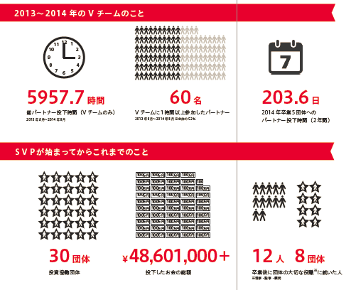
Track Records
Year to Year 2013-2014
Partners' volunteering hours
# of partners
who supported investees
Partners' volunteering Days
To date
40
$ 656,010
14
9
# of Investees
Total Grant made
# of Partners who joined investees' boards

Slide 21




Our budget
40% of budget is from corporate partners.
Staff roll:
- Coordinator for corporate sponsor.
- Engaging philanthropist.
- Catalyst of “business to social.”
Financially sound.
(Because of Various sources of income )

Slide 22
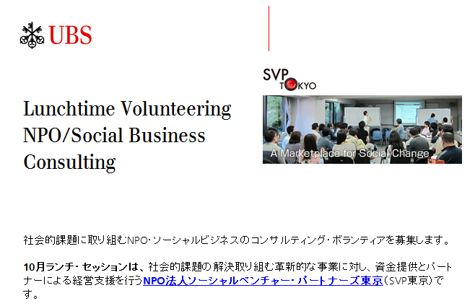
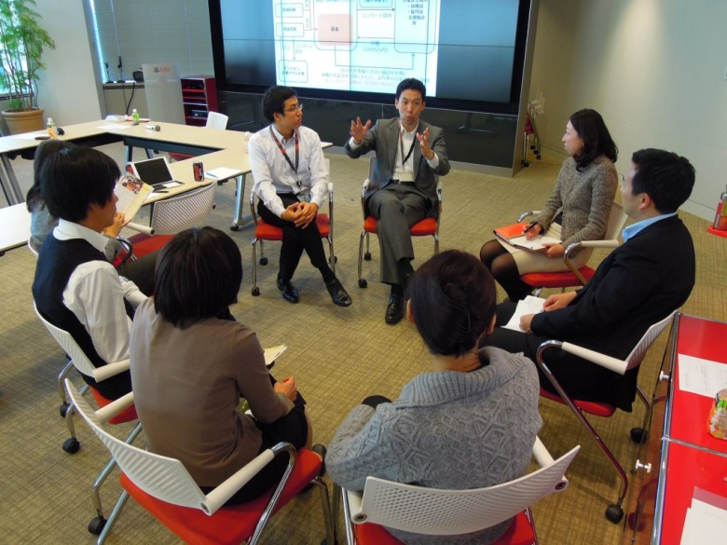
Corporate Partnership with UBS (case)
Consulting Sessions with UBS employee
Objectives
- Additional value for the SVP Tokyo to support our investees
- Skill-based volunteering opportunities for UBS employees
Formats
- Monthly, 90 minutes structured sessions at UBS Office Tokyo
- Focus on generating innovative ideas, compassionate but critical views
- Different investee in each session, repeats in 6-12 months
- Targeted employees of highly professional talents in private & investment bankers, legal, HR, Comms. to provide quality inputs

Slide 23
Take Away – achievements & challenges
Sharing a common mission
- accelerating social entrepreneurships in Japan
- catalyst for transforming individuals to be a "change makers"
Benefits to all stakeholders
- SVP Tokyo : capacity building, especially revenue contribution
- SVP Tokyo investees : consulting, networks in addition to SVPT partners
- SVP Tokyo individual partners: collaboration with corporate employees
- Corporate employees : social issue awareness,
expand networks with clients/colleagues
Future Challenges
- establishing roles in the increasingly competitive market
- analyzing / visualizing the impact (of the program & the organization)
- developing (larger) social impact investment

