Slide 1
Organizational Capacity Assessment
Methods
October 16, 2019
8 am PT

Slide 2
Presenters
Colleen Scrivner
Director of Engagement & Communications, SVP Chicago
Lauren LaCerda Merten
Executive Director, SVP Cincinnati
Spencer Downing
Program + Volunteer Officer, SVP Boulder County

Slide 3
Agenda
Welcome Emily
Introductions all
SVP Chicago Colleen
SVP Boulder County Spencer
SVP Cincinnati Lauren
Q&A all

Slide 4
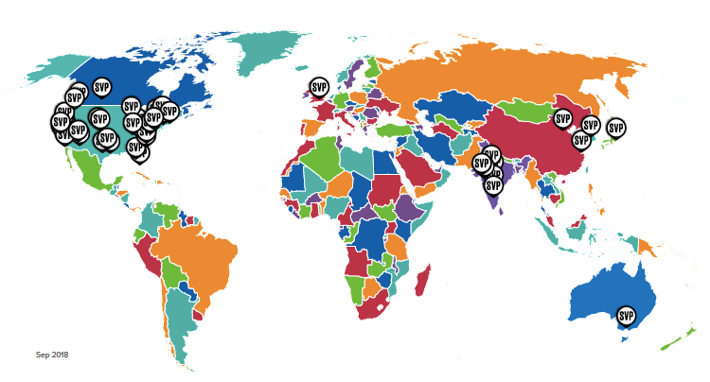
43 affiliates | 3,400+ Partners

Slide 5
Member Webinar Series
Keeping affiliates connected, sharing best practices, and learning together.
OCAT Solutions
October 15
Building a Coaching Program at Your Affiliate
November 4
Notes:
We’ll be launching a Member Webinar Series for you to stay connected to the work happening at affiliates around the network. These webinars will focus on best practice sharing and peer learning, and based on relevant and timely topics. Like the SVPI webinar series, we’ll be launching with two webinars this fall and will announce 2020 dates in the coming months.
On October 9th, we’ll hear from SVP Chicago, SVP Boulder County, and SVP Cincinnati about how they adopted the OCAT methodology for their needs.
On November 4th, we’ll learning about SVP Tucson’s Coaching program which has contributed to the impact of both their capacity building and philanthropic development programs.

Slide 6
SVPI Webinar Series
Keeping affiliates connected with the tools and resources available from SVPI.
Streamlining Engagement with Salesforce
October 17 and 21
Notes:
In order to keep the network more connected with SVPI tools and resources that we offer or make available, we’re launching a regular SVPI Webinar Series with two webinars this fall, including this one and an additional webinar about the recently released SVP Salesforce Managed Package. This webinar will be relevant for affiliates who have participated in this Salesforce migration but also for staff from affiliates who are wondering if their affiliate should be using Salesforce.
We’ll be offering SVPI webinars at two times in an effort to span all time zones and we’ll also be recording them for those who cannot attend.
Tools: instrument, document, and/or device that helps an affiliate perform a particular function(s) and is produced and offered by SVPI (e.g. Philanthropy Curriculum, Network Surveys & Reports, SVP Website, OCAT, Partner Recruitment Manual, etc.)
Resources: source of informational, educational, and/or expert materials produced and offered by SVPI (e.g. SVP Resource Center & Resource Map, SVPI Newsletters, etc.)

Slide 7
Leadership Cohorts
Connecting leaders across the SVP network through peer-coaching and consulting.
Executive Director and CEO Cohorts
Re-launch this fall, bi-monthly thereafter
Notes:
In 2017 we launched an ED cohort which has largely been dormant for the last year. We’ll be reaching out soon to invite network leaders for their participation in this program, which will kick off before the end of the year with bi-monthly meetings thereafter.
TRANSITION
This fall we’ll also be working to finalize our 2020 programs and event calendar, informed in large part by the continued dialogue with you… that Cathy will share a bit more about now.

Slide 8
SVP Chicago

Slide 9
Evolution from OCAT to OCAS
Original OCAT was used during year 1
Interest in incorporating into investment cycle
SurveyMonkey: Simplified, more user-friendly
OCAS:
Provided to finalists
Basis of year 1 with new investee
Intended to be used during final year

Slide 10
SurveyMonkey
Three variations – main folder SVPI account
SVP Chicago Organizational Capacity Assessment Survey
CEO/ED/COO
Board
Staff

Slide 11
Summary
Answers to graded questions were on a scale from 5 (most positive) to 1 (most negative), with 3 being neutral. The average score from all respondents is shown below.
Breakthrough is viewed as having many strengths, including:
Clear sense of mission
Diversified funding
Good senior leadership team
Strong brand
Key areas for work include:
Senior leadership succession (the single most significant issue)
Human resources development across multiple areas
Board development, particularly around engagement
Donor management

Slide 12
Mission, Vision, and Strategy
Our organization has a clear mission that is broadly held by the members of the team.
Our organization has a compelling vision of what we aspire to be and / or achieve for those we serve.
Our organization has a documented strategic plan with both short-term and long-term goals
In our organization, we are clear on our most important short-term goals and how they connect to the larger vision.
In our organization, we hold one another accountable for achieving short and longer-term goals.
We have a set of well understood metrics by which we measure the performance of our organization.
Weighted average for section | 3.94
Staff average | 3.58
Board average | 4.43
CEO / ED / COO average | 3.73
87%
n = 15
87%
n = 15
86%
n = 14
73%
n = 15
73%
n = 15
60%
n = 15
Strongly Disagree
Disagree
Neutral
Agree
Strongly Agree
< 40% favorable
41-69% Favorable
>70% Favorable

Slide 13
Mission, Vision, and Strategy
Open ended question:
Is there anything else you would like to comment
on regarding this organization’s mission, vision and strategy?
Responses from the Board:
During the budget process, Breakthrough executives are deliberate about communicating to the Board of Directors what their strategic goals and vision is for the upcoming year.
I believe the mission, vision, and strategy for the organization is clear. There was a recent 5-year plan developed that I don't believe received enough input from the board. I also could potentially not have been on the committee that focused on this.
Responses from Staff:
In terms of the mission and vision; I believe that there needs to be two different mission and vision statements for both the Youth Network and the Adult Network.
Performance accountability could improve
Responses from CEO / COO / ED:
Since the development of our strategic plan, and the support of retired Deloitte executive there has been an increase in the communication, strategies, and execution of our short and long term goals. A measure of accountability has been through the management of these goals through SLT (staff leadership team.) We haven't "arrived" so to speak, but have made great strides.
I think we could use help in identifying our key metrics and establishing a better way to represent them and compare to external data

Slide 14
SVP Cincinnati

Slide 15
SVP Cincinnati – OCAT Use
Comprehensive but cumbersome
One-time use at the start of Investee relationship
Not used for selection, evaluation or impact assessment
Late 2015, looked to network for other options

Slide 16
SVP Cincinnati – Rubric Development
Subjective measure of nonprofit sustainability
All partners would become familiar and comfortable using it
Used in all phases of Investee life cycle:
Site visit
Selection
Relationship planning
Partner skillset alignment
Annual evaluation/renewal
Impact assessment at end of relationship and afterwards
SVP Cincinnati internal uses:
Recruiting/retention
Education and Innovation
Self-assessment
Flexible enough to add criteria as needed (ex. focus area)

Slide 17
SVP Cincinnati - Rubric
Capacities to be evaluated:
Mission, Vision and Strategic Plan
Board Leadership
Staff Depth
Program Development and Evaluation
Funding, Fundraising and Finances
Communications and Marketing
Technology, Human Relations and Infrastructure Support Systems

Slide 18
SVP Cincinnati - Rubric
Capacities identified as Emerging, Stable or Sustainable
Descriptions of each capacity and classification
Additional capacities to be evaluated as High, Medium or Low:
Social Innovation
Equity
SVP Fit

Slide 19
SVP Cincinnati – Our Journey
Developed in 2016
First used with 2017 Investee and used for each one since
Used it on ourselves in 2018
Use it in our Investee yearly evaluation process to track progress
Ask Investees to use it on themselves as well and compare to our assessments
All partners are familiar with it and know how to use it
Has helped us evaluate partner competencies
Moving to make the process digital in the future but have incorporate Survey Monkey for Investee input
Notes:
In 2017 we launched an ED cohort which has largely been dormant for the last year. We’ll be reaching out soon to invite network leaders for their participation in this program, which will kick off before the end of the year with bi-monthly meetings thereafter.
TRANSITION
This fall we’ll also be working to finalize our 2020 programs and event calendar, informed in large part by the continued dialogue with you… that Cathy will share a bit more about now.

Slide 20
SVP Boulder County

Slide 21
SVP Boulder County’s OCAT Practice
SVP BC’s OCAT
Some questions modified to account for DEI and social enterprise
Administered via Google Form; data compiled and presented via Microsoft Excel

Slide 22
SVP Boulder County’s OCAT Practice
Investment Process – “Catapult” (3.5 yrs)
3 Finalists go through OCAT process including “consensus conversation”
OCAT results used to make investment decision
SVP work plans build on OCAT data
Investee uses OCAT and SVP-facilitated consensus conversation for yearly check-ins

Slide 23
SVP Boulder County’s OCAT Practice
Stand-alone Services (Resource Teams)
Organizational Assessment Resource Team does full OCAT; facilitated consensus; final report
Board Development Resource Team does board-related sections; final report; proposes further board dev projects

Slide 24
Questions?

Slide 25
Thank you!

