Slide 1
Using Principles-Focused Evaluation to Embed Justice in Our Social Change Work
Chris Corrigan and Meagan Sutton

Slide 2
Today we will:
Look at how to use a complexity informed evaluation approach to build a justice focus into social change initiatives.
Practice applying a new tool to existing projects.

Slide 3
“Philanthropy is commendable,” said Martin Luther King, “but it must not cause the philanthropist to overlook the circumstances of economic injustice, which make philanthropy necessary.”
Martin Luther King, Jr. quoted in Burton and Barnes “Shifting Philanthropy from Charity to Justice”

Slide 4
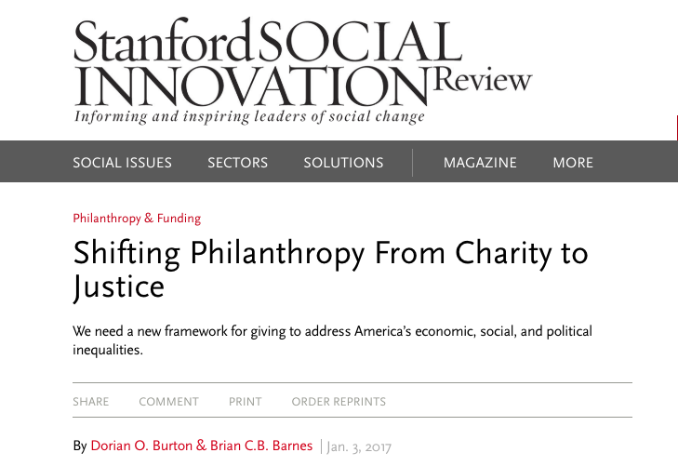
https://ssir.org/articles/entry/shifting_philanthropy_from_charity_to_justice

Slide 5
Assumptions
Sustainable social impact flows from changing the systems that maintain marginalization. These systems have a history that matters.
Changing these patterns means addressing injustice
Social justice is complex and needs complexity informed approaches.

Slide 6
“Complexity IS a theory of change”
Michael Quinn Patton, developmental evaluator
(and it requires different tools and approaches to address it)

Slide 7
WORKING WITH ORDERED AND COMPLEX PROBLEMS | Ordered problems | Complex problems
Characteristics | Predictable, knowable, stable. | Unpredictable, unknowable, adaptive and emergent
Planning/Strategy | Data has answers, experts solve problems, best practices, set targets, goals and objectives | Start with what is, shift patterns together, choose your intentional direction towards “good.”
Action | Resource programs, project manage to targets. | Shift conditions to change patterns, experiment and learn, manage within coherence with your intention.
Evaluation | Evaluate results against goals, measure merit and worth, and compliance summative. | Monitor, seek more stories like this, learn and pivot, rapid feedback, stabilize if possible.
Complexity

Slide 8
Leading others in complexity
Start by understanding the system as it is and understand the direction you want to go in: choose journeys not destinations
Notice patterns which create stability, patterns which create change
Notice what constraints seem to keep those patterns in place, and see what you can change about those constraints
Evaluate the effectiveness of principles that guide action

Slide 9
Principles focused evaluation
Michael Quinn Patton created principles focused evaluation to help organizations choose principles that can influence patterns and evaluate their success in doing so. Built into the program design, evaluation can be helpful in embedding a justice and equity focus in social change programming

Slide 10
GUIDE
High quality principles are:
GUIDING
USEFUL
INSPIRING
DEVELOPMENTAL
EVALUABLE

Slide 11
GUIDING
Prescriptive—provides advice and guidance
Directional—specifies direction and informs priorities
Effectiveness-oriented (active verb wording)— “Do this . . . ” to be effective
Distinctive from its opposite or alternative
Notes:
A principle is prescriptive. It provides advice and guidance on what to do, how to think, what to value, and how to act to be effective. It offers direction. The wording is imperative: Do this. The guid- ance is sufficiently distinct that it can be distinguished from contrary or alterna- tive guidance.

Slide 12
USEFUL
Points toward desired results
Describes how to be effective
Supports making choices and decisions
Utility resides in being interpretable, doable, feasible, and actionable
Notes:
A high-quality principle is useful in in- forming choices and decisions. Its utility resides in being actionable, interpretable, feasible, and pointing the way toward desired results for any relevant situation. The principle provides guidance for translating knowledge into action.

Slide 13
INSPIRING
Values-based, ethically grounded
Meaningful
Is important, evokes a sense of purpose
Notes:
Principles are values based, incorporating and expressing ethical premises, which
is what makes them meaningful. They articulate what matters, both in how to proceed and the desired result. They articulate how to do things right (effec- tively) and the right thing to do (express the values basis for action). That should be inspirational.

Slide 14
DEVELOPMENTAL
Context sensitive
Complexity adaptable
Enduring (not time-bound)
Notes:
The principle exhibits adaptability and applicability to diverse contexts and over time. A principle is thus both context sensitive and adaptable to real-world dynamics, providing a way to navigate the turbulence of complexity and uncertainty. In being applicable over time, it is enduring (not time-bound) in support of ongoing development and adaptation in an ever-changing world.

Slide 15
EVALUABLE
Can document and judge whether it is followed
Can document and judge what results
Can determine if it takes you where you want to go
Notes:
A high-quality principle must be evaluable. This means it is possible
to document and judge whether it is actually being followed, and document and judge what results from following

Slide 16
The tool
We used GUIDE to created principles based on questions in the paper “From Charity to Justice.”
Developed a rubric that demonstrates a scale of adherence to each principle
Scored projects and noticed differences

Slide 17
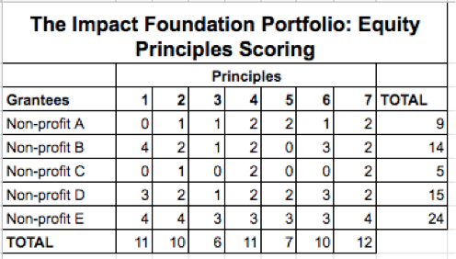
Sample Portfolio
Notes:
Here, I have created a case study that is based on organizations I’ve worked with in my past but the details have been adjusted and anonymized. The point is to show how we can look at our portfolio of investees or grantees and identify opportunities to align our relationships more closely with these equity principles.
If we look at the portfolio as a whole, we can also see that we aren’t necessarily consistently selecting organizations that are strong across all of these principles- and that is OK. It is an opportunity for conversation and reflection. What is important is that all parties are interested in working towards greater alignment with these equity principles.
We also have an opportunity to pair up organizations to mentor one another and help them learn from one another about how to align more closely with these principles. Take Non-profit A and B for example…

Slide 18
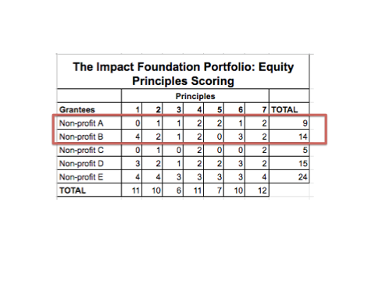
Sample Portfolio
Notes:
Non-profits A and B are similar in that they both provide after-school tutoring with an emphasis on math, but they have some interesting differences when it comes to equity principles.
Non-profit A has a mission of tutoring as many children in math as possible, and is present in over 200 schools in the region with volunteers providing tutoring assistance. The program was designed by a group of people still friends from college who are passionate about math and believe it is one of the most important ways to help kids be successful in the future. Non-profit A receives financial and capacity-building support from its funder, and its funder has worked with non-profit A to identify areas for growth, learning, and testing to ensure that the model is as effective as possible. At the end of the grant, non-profit A worked with the funder to identify key learnings and shared this in a report available on their webpage. The non-profit doesn’t partner with other organizations and is not aware of other leaders and change agents working in the same community on the same problems. Non-profit A leadership assessed itself using the Equity Principles scoring rubric, and realized that they were missing an opportunity by not looking into the community in which they serve to identify individuals who are taking a lead on helping children struggling with math, including the children themselves. They held a brainstorming session as a result and identified alumni children from their program who are excited about math who could be a strong asset to the program, as well as a well-known enthusiastic math teacher with her own YouTube channel with whom they could partner.
Non-profit B is a comprehensive after-school program that introduces math to kids via engaging and relatable activities. These activities were designed by a steering committee of kids, parents, artists, and math enthusiasts from the community, some of whom are also on the organization’s board of directors. The organization is well-networked and partners with a variety of organizations in order to enhance their reach and their impact. However, the organization has not had the time to set up learning outcomes or a way by which to assess how they are doing against such outcomes. They would like some help in doing this.
In this rubric, we can see an opportunity to pair up A and B so they can learn from one another. Non-profit B can work with Non-profit A to learn how they’ve set up their learning outcomes so that they can continue to improve, adapt and iterate their programs to meet the needs of their community. A can learn quite a bit from B’s ability to solicit feedback, input, and ideas from its target community using local leadership as an asset to the program.

Slide 19
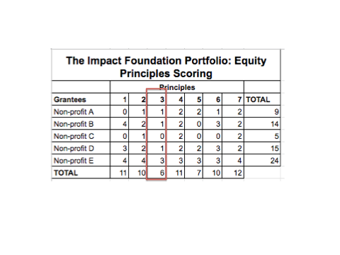
Notes:
Now, let’s take a look at what else we as the funder can do better to support our portfolio in aligning with these principles.
With the exception of non-profit E, most organizations in the portfolio struggle with principle 3- “the investment is based on a historical understanding of the patterns that caused the problem”. In this case as the funder, we can take this opportunity to reflect on what it would mean for us to design investments that are based on a historical understanding of the patterns that caused the problem of, say, child poverty. This would require some in-depth work to understand these patterns better first, and then to create investments that speak to this. A successful example is an organization called XXX (Meagan to enter example here).

Slide 20
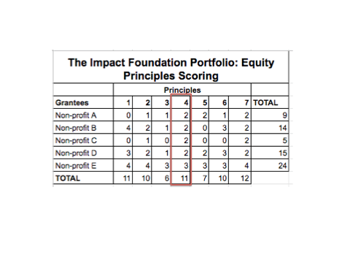
Notes:
Let’s try one more: If we look at principle 4, “the investor is in close and frequent physical relationship with the recipient, defined by listening, learning, and partnering with leadership”, we see that we are mostly 2’s across the board- we work with the recipient on the program. We can then use this opportunity to ask ourselves- what can we do to take us closer to aligning with this equity principle? What would it take to be a 4 – for us to work closely with our recipient in mutual partnership? (add in: Native Voices Rising example)
This is just a taste of what we can explore by using this rubric as a tool- as a jumping off point for discussion and conversation.

Slide 21
Your turn
Think of a project you are involved in. Take a few moments to honestly apply the rubric. Total your score.

Slide 22
Dialogue
Assemble into triads with folks who have different scores and discuss where you are strong and where you are weak. Compare and brainstorm ways you could increase your weak scores.

Slide 23
What can we do with this
Some uses for this tools include:
Invite people with different scores together to inspire each other towards more justice focused.
Use the rubric in conversation with investees to design projects that have an explicit justice focus.
Offer a workshop using this tool for prospective investees as part of the application process.
Use the tool to assess equity and justice across a funder’s portfolio.
What else can you think of?

