Slide 1
Welcome
Liberatory Workplaces

Slide 2
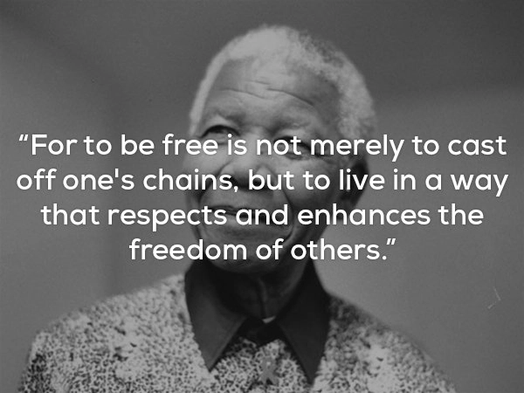

Slide 3
Grounding

Slide 4
Group Agreements
We show up fully present
Balance of self & community care
We assume good intent & reflect on impact
We open ourselves to learning, mistakes, connection
Where we begin is not where we end
Double confidentiality
Step Forward / Step Back

Slide 5
What’s a Liberatory Workplace?
Tend to Culture: Policies, structures, values, norms foster appreciation, trust, community, and wellness for all team members
Invite Wholeness: Team members know they can bring their full selves to work without negative repercussions
Enable Genius: Team members are positioned to do their best work, work that brings them joy and creates tremendous impact

Slide 6
Agenda
Welcome & Grounding
Context Setting
Tend to Culture
BREAK
Invite Wholeness
Enable Genius
Closing Reflections

Slide 7
Tend to Culture

Slide 8
What Creates Organizational Culture?
Policies
Practices & Norms
Structures
Values & Beliefs

Slide 9
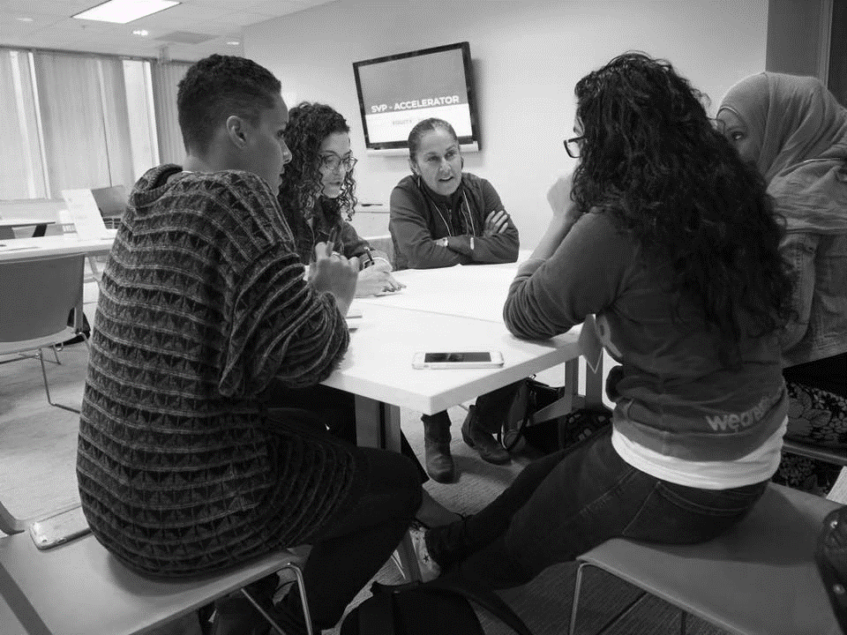
Reflection Question
Share a policy, practice, norm, structure, or value that has felt oppressive in your past or present workplace.
Share a policy, practice, norm, structure, or value that has felt liberatory in your past or present workplace.

Slide 10
White Dominant Culture
& Something Different
Competition Collaboration
Paternalism Partnership
Individualism Collectivism
Transactional Transformational
Written Word All Communication
Progress is Bigger Progress is Sustainability
Overworking Self/Community Care
Perfectionism Appreciation
Emotions Left at Door Full Selves

Slide 11
Small Group Exercise
Identify one norm you’d like to see your local SVP or the network shift.
What is one concrete way we could create something different?

Slide 12
Group Reflections

Slide 13
Break Time

Slide 14
Invite Wholeness

Slide 15
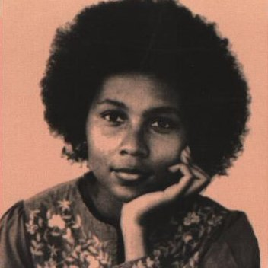
“The moment we choose to love we begin to move towards freedom, to act in ways that liberate ourselves and others.”
bell hooks

Slide 16
Personal Experience Panel

Slide 17
Turn & Talk
What shifts could you make in your workplace to create more space for team members to show up fully?

Slide 18
Enable Genius

Slide 20
Genius Teams

Slide 21
GENIUS
My unique skills.
I love doing these things.
Time flies.
The outcome is outstanding.

Slide 22
What might we create if we functioned in genius teams – where each team member felt joy in their work and created outstanding results?

Slide 23
Genius
What is my unique ability?
What do I most love to do?
What produces the highest ratio of abundance/impact per time spent?
What do I do that doesn’t seem like work?
Notes:
acknowledge privilege in even asking these questions.

Slide 24
Zone of Excellence
What do I persist in doing that I can do better than most other people?
Notes:
Popcorn out

Slide 25
Zone of Competence
What do I persist in doing that others can do just as well?
Notes:
Popcorn out

Slide 26
Zone of Incompetence
What do I persist in doing that others can do better?
That I do not enjoy?
That I’m not good at?
Notes:
Why this matters

Slide 27
Hey Girl...
What’s your genius?
(Interview time)

Slide 28
Genius Tools
Genius Worksheet
Appreciation to Genius
Kolbe-A, Strengths Finder
Genius Tracker
Notes:
Why this matters

Slide 29
Genius tracker
Notes:
One hour to here

Slide 30
Hiring for Genius
Notes:
Why this matters

Slide 31
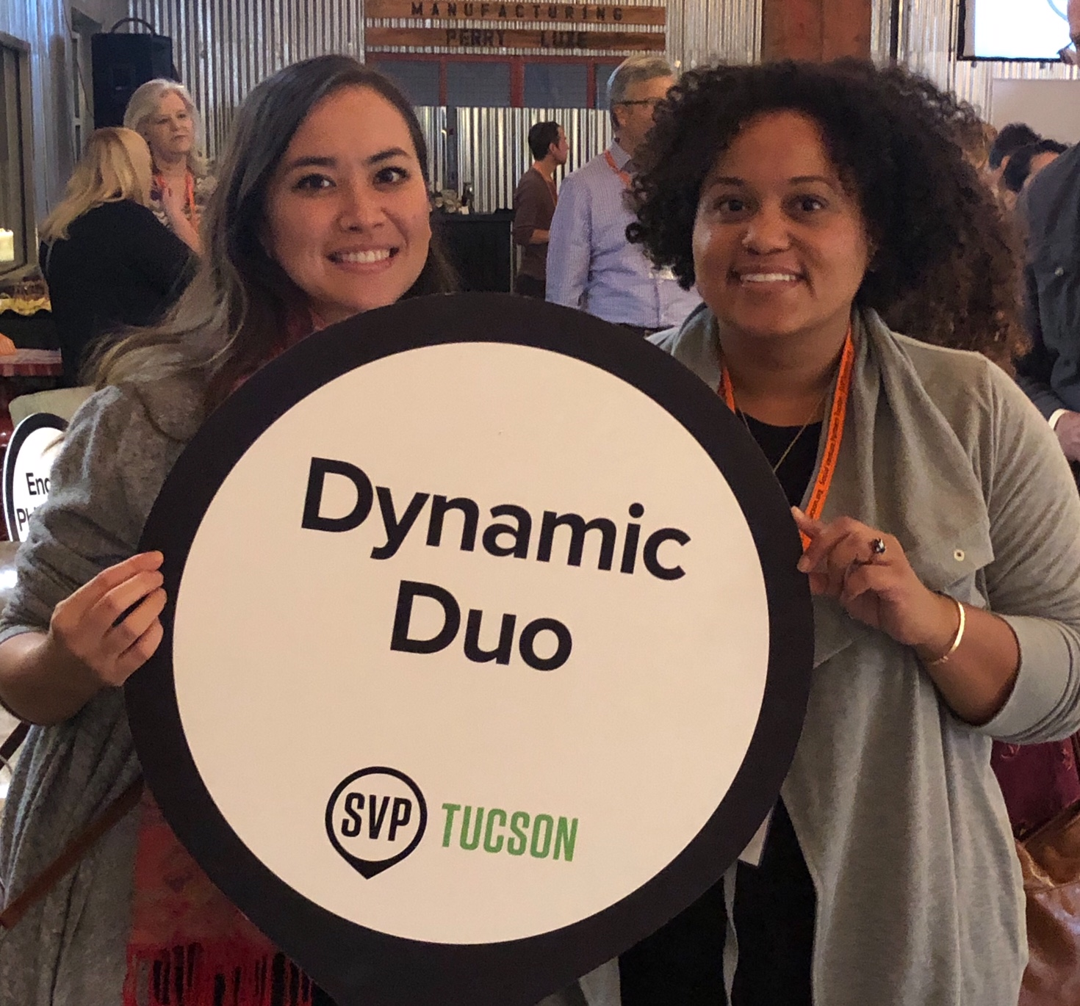

Slide 32
Hiring for Genius
What might you ask to identify genius?
What might you look for in the interview?
Kolbe for hiring
Notes:
Why this matters

Slide 33
Great Genius Swap
What’s one thing you’d pay someone else to do so you NEVER have to do it again?

Slide 34
Genius Tools Summary
Genius Worksheet
Appreciation Leads to Genius
Kolbe / Strengths Finder
Hiring for Genius
Great Genius Swap
Notes:
Why this matters

Slide 35
Journal
What is one thing you want to embrace as genius in your role?
What is one thing you’d like to let go of?
What is one action you want to take to cultivate a genius team?
Notes:
1 minute of silence, turn and talk;

Slide 36
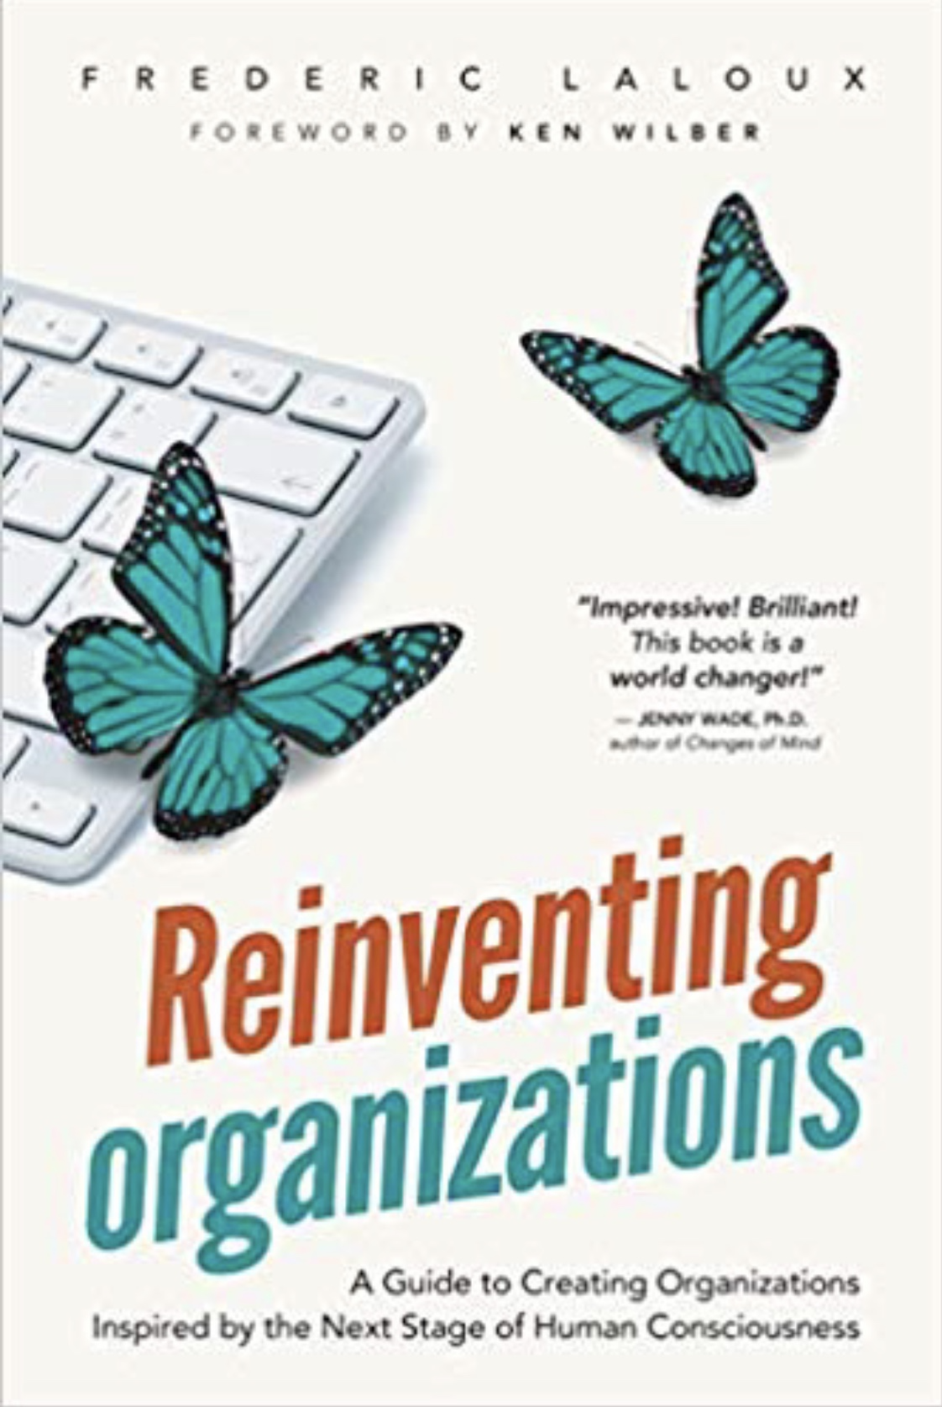

Slide 37
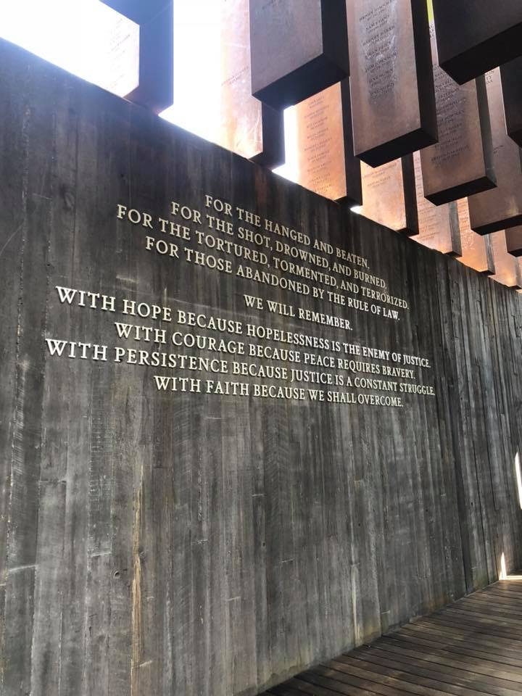
July 17-19 SVP trip to Montgomery, AL National Memorial for Peace & Justice

Slide 38
Closing
“I used to think…,
Now I think…”

