Slide 1
Loyola University Water Tower Campus
Impact Investing: Alternative Financing for Impact
John Thornborrow, Board Chair, Mission Capital
Madge Vásquez, CEO Mission Capital
Mark Newhouse, SVP Denver
www.svpglobalsummit.org

Slide 2
Who we are
For nearly 20 years, Mission Capital has worked in Austin & the Central Texas Region tackling complex issues and creating lasting social change. With tools and guidance, we combine human, financial, intellectual, social and political capital to fuel the work of mission-driven people and organizations.
Vision
Complex community problems get solved.
Mission
We multiply the impact of mission-driven people and organizations.
MissionCapital.org @Mission_Capital

Slide 3
Opening Activity
Introduce yourself to people at your table, include your organization and what you do there, and share your answer to this question:
What does your organization do best?
MissionCapital.org @Mission_Capital

Slide 4
NONPROFIT EFFECTIVESS FRAMEWORK
Clarity of Purpose
Sustainable Business Model
The Right Leadership
Smart Operations
Implementation & Improvement
Strategic Collaborations
MissionCapital.org @Mission_Capital
Notes:
You can learn more about the Mission Capital Effectiveness Framework on our web site at: https://missioncapital.org/what-we-do/
Clarity of Purpose
How you define and align your work and impact
Sustainable Business Model
How you develop resources and position your organization for success
The Right Leadership
How staff and board leaders steer and steward organizational effort
Smart Operations
How you manage and marshal organizational resources
Implementation & Improvement
How you use information to adapt and improve
Strategic Collaborations
How you leverage the community for greater impact
Last year Mission Capital conducted research on the state of the nonprofit sector in Central Texas- On the Verge.
Detailed size and scope of our sector, economic impact, challenges and strengths nonprofits are facing.
As part of this research we also wanted to learn more how organizations and groups across the country define what it means to be an effective/high performing nonprofit. Looked at more than 15 different frameworks; learned that while there is not a single, universal definition of what it means to be an effective, high performing nonprofit, there were nevertheless many similarities among the frameworks.
Some of the frameworks we reviewed seemed to focus on very large nonprofit organizations- over a million or even 5 million plus in size
We know from our research of the sector that most nonprofits are smaller- nearly three quarters are less than $100,000. Wanted to ensure a framework that could be applied to organizations of any size or mission area
We took what we learned- and based on Mission Capital’s years of experience working with nonprofits and our knowledge of nonprofit best practices- and built out a framework of the key elements that we believe are essential for an organizational to truly thrive and create meaningful results in the community.

Slide 5
Core competencies
Financial Viability
Value Proposition
Budgeting
Culture of Philanthropy
Development Plan
Stable Funding
MissionCapital.org @Mission_Capital

Slide 6
Financial Viability
Our programs are financially viable and incorporate earned revenue opportunities where possible.
MissionCapital.org @Mission_Capital
Notes:
Do you have a clear revenue strategy or are you flying by the seat of your pants?
Most new NPOs fly by the seat of their pants when getting started
Why would you want to transition to a clear revenue strategy?
Do you have at least some earned revenue?
Examples: fee for service, product sales (Girl Scout cookies), experience sales (tour of El Salvador), facility rental (SFC, churches)
How else do you earn money off of kids? (College Forward)

Slide 7
Beyond the grant background
MissionCapital.org @Mission_Capital

Slide 8
Beyond the grant background
Will help nonprofits and funders alike understand alternative financing strategies focusing on:
Why – the value proposition for alternative funding strategies
What – what are the various financial tools and resources that can be unlocked
When – when a nonprofit or funder might find a particular tool to be a good match
How – how to overcome barriers to successfully securing or deploying this financing
MissionCapital.org @Mission_Capital

Slide 9
Beyond the Grant: Why
MissionCapital.org @Mission_Capital

Slide 10
Why? Because we have to
Crowded and Fragmented nonprofit sector: Limited number of funders spread their dollars across many organizations
Funding gap: Currently not enough local capital to solve big problems in CTX
Shiny Objects: Emergence of for-profit social enterprise models attracting new funding to sector
*Findings from On the Verge (2015)
MissionCapital.org @Mission_Capital

Slide 11
Beyond the grant: what
MissionCapital.org @Mission_Capital

Slide 12
One solution: Alternative financing
Defined
Utilizing financial resources and tools in new ways to reduce the external funding gap in for social impact organizations
For nonprofits, this typically refers to low-cost loans or capacity building grants (venture philanthropy)

Slide 13
MissionCapital.org @Mission_Capital

Slide 14
Funding Tools
MissionCapital.org @Mission_Capital

Slide 15
Many nonprofits you know are social enterprises! Nonprofit organizations can be considered social enterprises if they generate a meaningful amount of earned revenue within a program or for an organization as a whole
Notes:
Social Enterprise Defined:
An organization founded with the intention of generating positive community, social, and/or environmental impact, utilizing business principles to deliver that impact
AND many non-profits you know ARE social enterprises.

Slide 16
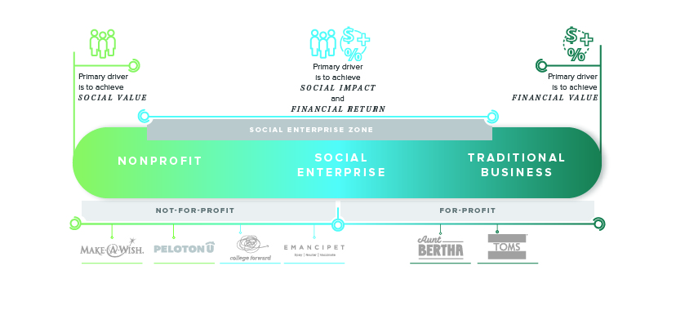
MissionCapital.org @Mission_Capital

Slide 17
Case studies
MissionCapital.org @Mission_Capital

Slide 18
Case 1: PelOtonU
Year Founded | 2012
Size of Organization | 4 staff, $380K Budget
Mission Area | College completion / workforce development
Type of Funding | Venture Philanthropy
Year of Alt Funding (for case) | 2016
Funders | Individual donors, family foundations, mid-sized foundations
Amount | $300,000
Terms | Grant funding, no repayment
IMPACT: Currently enrolls 70 Students and is on track to enroll 200 by 2019. Leading to degree attainment & higher living wages for working adults.
MissionCapital.org @Mission_Capital
Notes:
Social Impact:
Currently enrolls 70 Students and is on track to enroll 200 by 2019
Ultimately, leading to college degrees which provide higher income opportunities to working adults.
Business/Financial Impact:
Reach their fundraising goal with hopes that it would bridge to sustainability
Because of lower enrollment and higher than expected costs to support students on nights and weekends, they continue to fundraise.

Slide 19
Case 2: Emancipet
Year Founded | 1999
Size of Organization | 59 staff, $3.9M Revenue
Mission Area | Animal Welfare
Type of Funding | Impact investment, Social impact loan
Year of Alt Funding (for case) | 2013
Funders | ASPCA
Amount | $95,000
Terms | 5-year payback tied to revenue
IMPACT: Serves over 38,000 pets and the PRI is nearly paid off. Provides affordable healthy pet services for underserved families.
MissionCapital.org @Mission_Capital
Notes:
Social Impact:
The clinic has been open for four years, serving over 38,0000 pets and the PRI is nearly paid off.
The clinic is open four days per week, and now serves about 80 - 100 patients per day for spay/neuter services and healthy pet care such as vaccines, heartworm testing and prevention, and other preventive care services.
Business/Financial Impact:
Allowed for quick expansion to meet the needs of an underserved community.
Loan was affordable, with a rate of 2.2%, allowing them to reinvest more earned revenue into other clinics and programs.
The payback terms that were in line with the path to sustainability with the clinic, had a grace period for payback that allowed the new clinic to reach a point of revenue.

Slide 20
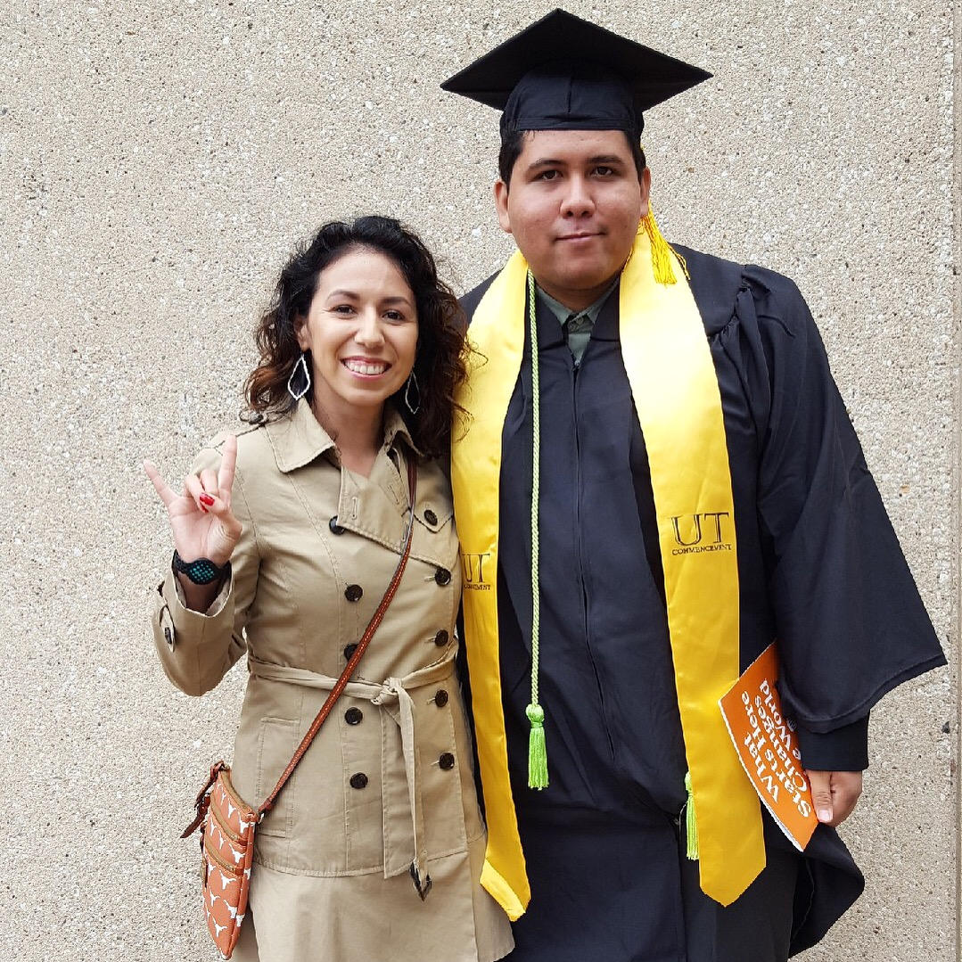
College forward
Year Founded | 2003
Size of Organization | 25 staff,100 AmeriCorps, $4.4M Budget
Mission Area | College completion / Educational equity
Type of Funding | Impact investment, Social impact loan
Year of Alt Funding (for case) | 2017
Funders | 6 local investors
Amount | $200,000
Terms | 4-year payback tied to revenue
IMPACT: Increasing college completion for over 300,000 1st generation & low-income students nationwide through 101 new partners.
MissionCapital.org @Mission_Capital
Notes:
Improve outcomes for 300,000 additional low-income students nationwide through 101 new partners
Reduce grant reliance for College Forward college success programs, aimed at increasing college completion for low-income and first-generation students
Business/Financial Impact:
Expand CoPilot team to steward new partners
Acquire a total of 101 new CoPilot customers by end of four-year loan period.
Generate cumulative incremental revenue of approximately $3.8 million

Slide 21
Beyond the grant: When
MissionCapital.org @Mission_Capital

Slide 22
Consider alternative funding when:
Experimenting with new service or product delivery options
Scaling up a proven model
OR -
Purchasing high-cost assets, like equipment or property
MissionCapital.org @Mission_Capital

Slide 23
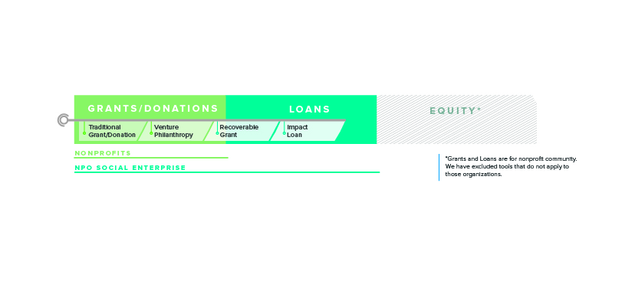
Capital continuum
MissionCapital.org @Mission_Capital
Notes:
Trying new programs, expanding proven ones, or big asset investments – which of these has your organization tried in the last year?

Slide 24
Beyond the grant: How
MissionCapital.org @Mission_Capital

Slide 25
Tools For nonprofits
Capacity Building (Venture Philanthropy Grants)
Impact Loans
MissionCapital.org @Mission_Capital

Slide 26
is your organization ready?
Questions to Consider:
What does my budget look like after this infusion of capital?
Where does the money come from to pay back a loan?
MissionCapital.org @Mission_Capital
Notes:
We are helping NPOs consider their readiness.

Slide 27
Investor ready checklist
What investors will look for:
Clear ability to articulate purpose, mission, and vision
Entrepreneurial leadership present in management team and the board
Solid understanding of operating model, and how different types of funding help support both the earned revenue components of your organization and the organization as a whole
Ability to articulate the problem you are solving for your customer (which may differ from that of your beneficiary) and how you intend to solve it
Ability to articulate your Unique Value Proposition (UVP), including an understanding of the broader market (who else does what you do) and how you differ from others offering similar services (competition)
Clarity about the resources you need to grow, and how you plan to get them
MissionCapital.org @Mission_Capital

Slide 28
Mission Capital 2018: Financial viability support
Earned Revenue Activities
“Is Earned Revenue Right for Me?” Mission Meet-up
NEW IN SPRING: Earned Revenue Lab
Beyond the Grant Activities
Self-assessment – is my organization ready to move beyond the grant?
Customized assistance for organizations ready to move
MissionCapital.org @Mission_Capital

Slide 29
Closing reflection
Share with the room:
What is one idea you’ll take back to your SVP Chapter & partners today?
MissionCapital.org @Mission_Capital

Slide 30
Questions?
MissionCapital.org @Mission_Capital

Slide 31
Mark your calendars for the next…
Impact Investing
Community of Practice Call
Thursday, June 7th
5 pm Pacific
Look for registration e-mail soon!
STRETCH | CONNECTION | EQUITY | ACCOUNTABILITY

