Slide 1
Loyola University Water Tower Campus
Impact Investing: An Opportunity for SVP
Impact Investing Track: Session A
April 27, 2018
www.svpglobalsummit.org

Slide 2
Definition
An investment approach intentionally seeking to create both financial return and social impact that is actively measured.
- World Economic Forum

Slide 3
Motivation
Investing
$40T
Philanthropy
$390B

Slide 4
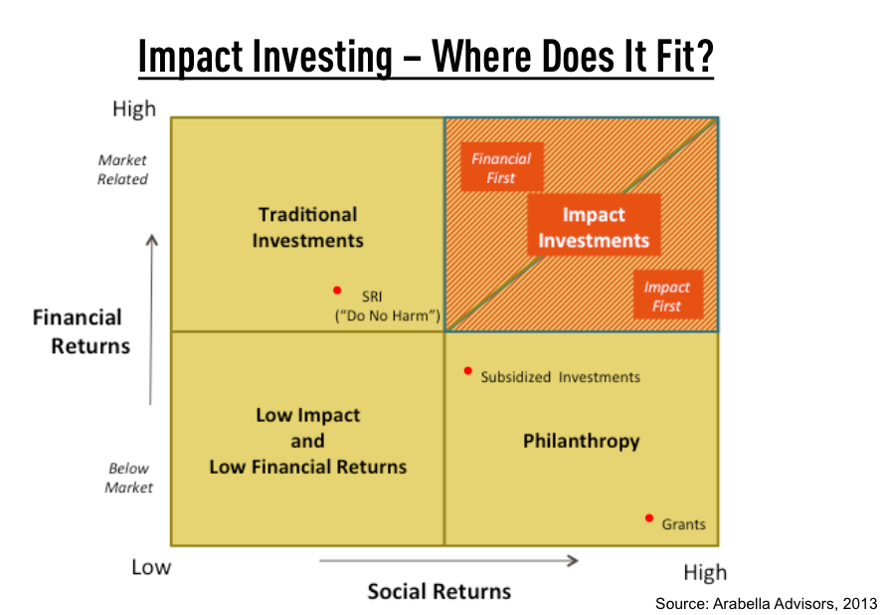
What is Impact Investing

Slide 5
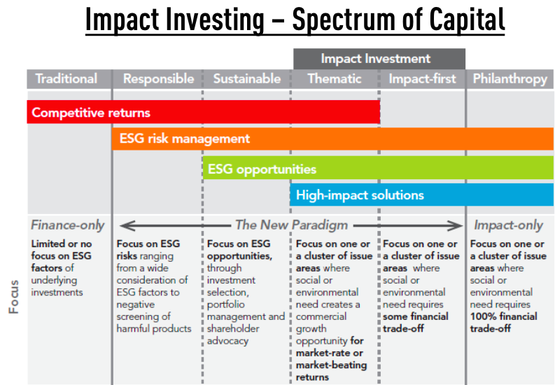
What is Impact Investing
Notes:
Source: Bridges Ventures 2012

Slide 6
Impact Investing in Perspective
US Assets
$40T
6% CAGR
ESG
Assets
$8T
15% CAGR
Philanthropy
$390B
5% CAGR
Impact Invest
$25B
18% CAGR
Social
Impact

Slide 7
What is Impact Investing

Slide 8
Today’s Session
Panelists
Lisa Jones, SV2
David Lynn, SVP San Diego
Tasha Seitz, SVP Chicago
David Smith, SVP Portland
John Thornborrow, Mission Capital
Moderator
Bill Brownell, SV2

Slide 9
Mark your calendars for the next…
Impact Investing
Community of Practice Call
Thursday, June 7th
5 pm Pacific
Look for registration e-mail soon!
STRETCH | CONNECTION | EQUITY | ACCOUNTABILITY

