Slide 1
8-Step Roadmap for Change

Slide 2
Agenda
Vision: How you see the world and/or what you believe/value
What is strategic philanthropy?
What is 8-step ‘roadmap for making strategic philanthropic investments?’

Slide 3
What is strategic philanthropy?
Leverages private resources for greatest public benefit.

Slide 4
Roadmap for Change
Root causes of problems
Upstream solutions
Lasting change

Slide 5
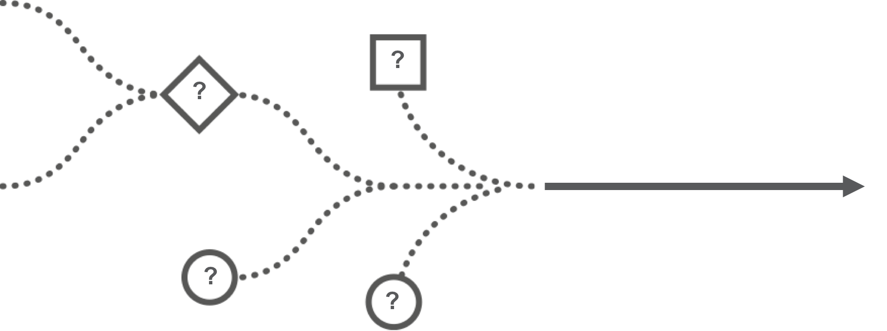
1. Define the Problem. Ask “Why 5x?”

Slide 6
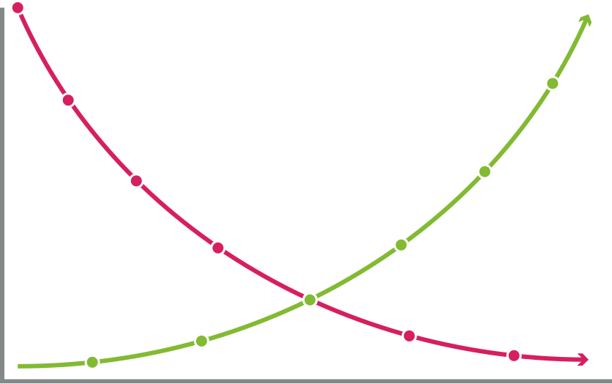
1. A Child’s Life: Possible Trajectories
0 yrs
18 yrs

Slide 7
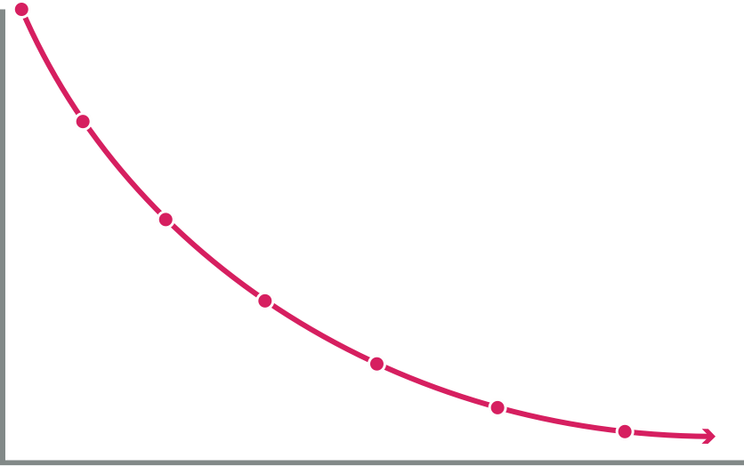
1. A Child’s Life: Downward Trajectory
Unemployed/jail
0 yrs
18 yrs

Slide 8
1. A Child’s Life: Downward Trajectory
High School Dropout
0 yrs
18 yrs

Slide 9
1. A Child’s Life: Downward Trajectory
Teenage Pregnancy
0 yrs
18 yrs

Slide 10
1. A Child’s Life: Downward Trajectory
3rd Grade Can’t Read
0 yrs
18 yrs

Slide 11
1. A Child’s Life: Downward Trajectory
1st Grade, Not Ready To Learn
0 yrs
18 yrs

Slide 12
1. A Child’s Life: Downward Trajectory
No Pre-School Learning
0 yrs
18 yrs

Slide 13
1. A Child’s Life: Downward Trajectory
Quality Pre-School
Unemployed/jail
0 yrs
18 yrs

Slide 14
1. A Child’s Life: Downward Trajectory
1st Grade Ready To Learn
Unemployed/jail
0 yrs
18 yrs

Slide 15
1. A Child’s Life: Downward Trajectory
Reading by 3rd Grade
Unemployed/jail
0 yrs
18 yrs

Slide 16
1. A Child’s Life: Downward Trajectory
Graduates High School
Unemployed/jail
0 yrs
18 yrs

Slide 17
1. A Child’s Life: Downward Trajectory
College or Vo-Tech
Unemployed/jail
0 yrs
18 yrs

Slide 18
1. A Child’s Life: Downward Trajectory
Employed
Unemployed/jail
0 yrs
18 yrs

Slide 19
2. Articulate Vision & Theory of Change
How will the world look if you can achieve change?
What will success look like?

Slide 20
2. Articulate Vision & Theory of Change
What intervention is needed for change?

Slide 21
2. Articulate Vision & Theory of Change
Your hypothesis?

Slide 22
3. Assess Market & Conduct Due Diligence
Who else is working on the problem?
Which organisations and individuals are doing the best work?

Slide 23
4. Identify Levers of Change in “Ecosystem”

Slide 24
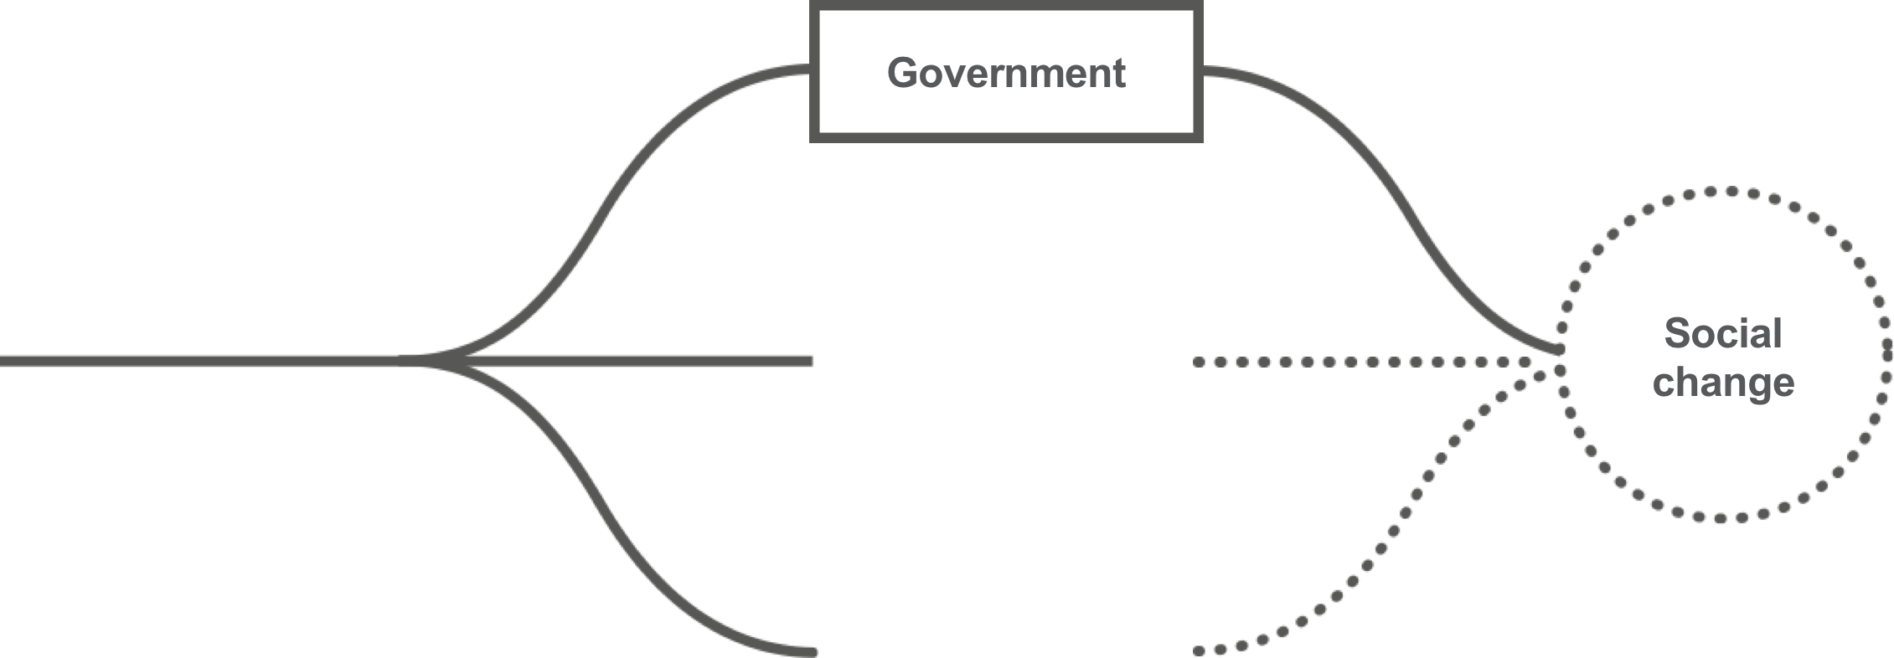
4. Identify Levers of Change in “Ecosystem”

Slide 25
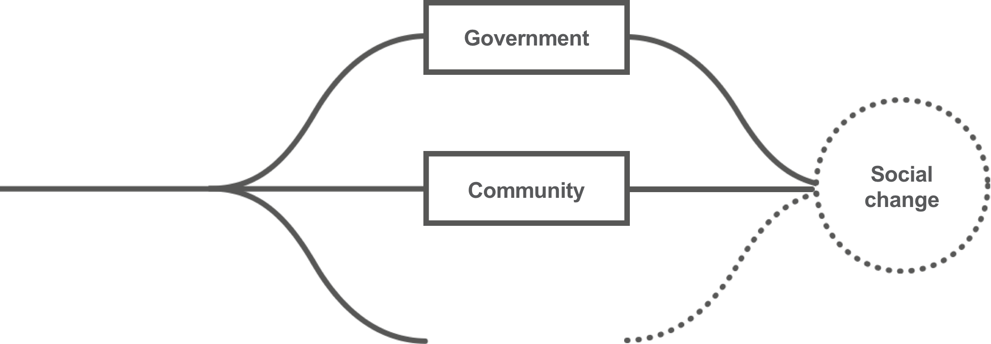
4. Identify Levers of Change in “Ecosystem”

Slide 26
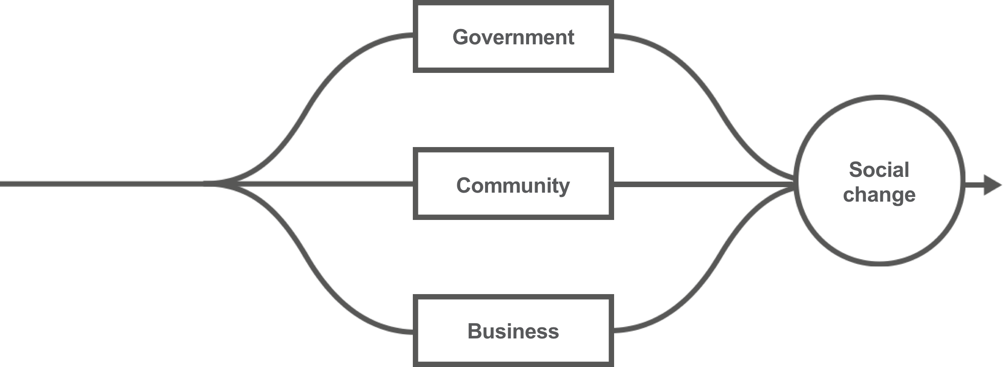
4. Identify Levers of Change in “Ecosystem”

Slide 27
5. Identify Effective Ways & Partners to Advance Solutions

Slide 28
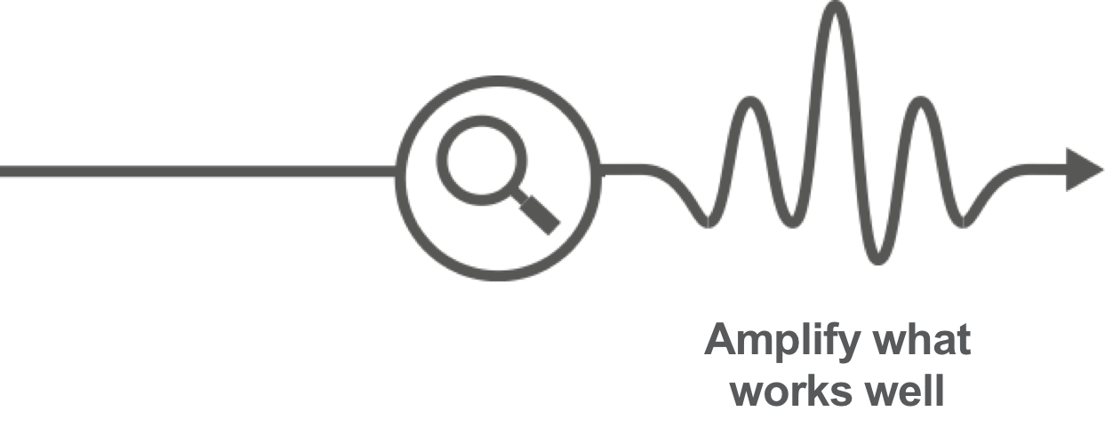
5. Identify Effective Ways & Partners to Advance Solutions

Slide 29
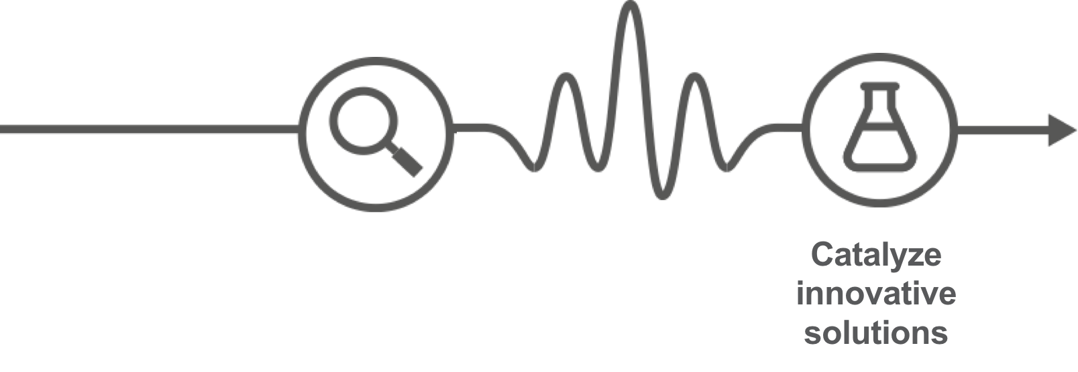
5. Identify Effective Ways & Partners to Advance Solutions

Slide 30
5. Identify Effective Ways & Partners to Advance Solutions

Slide 31
5. Identify Effective Ways & Partners to Advance Solutions

Slide 32
6. Consider your comparative advantage – your value add

Slide 33
6. Consider your comparative advantage – your value add

Slide 34
6. Consider your comparative advantage – your value add

Slide 35
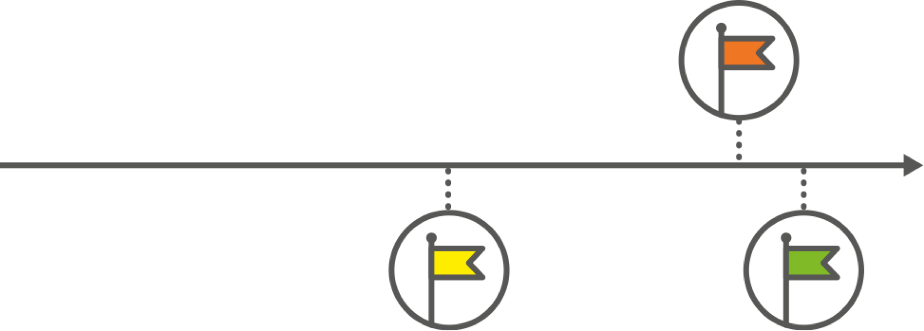
7. Define Performance Measures
What are your short-term and long-term goals?

Slide 36
8. Seek Leverage

Slide 37
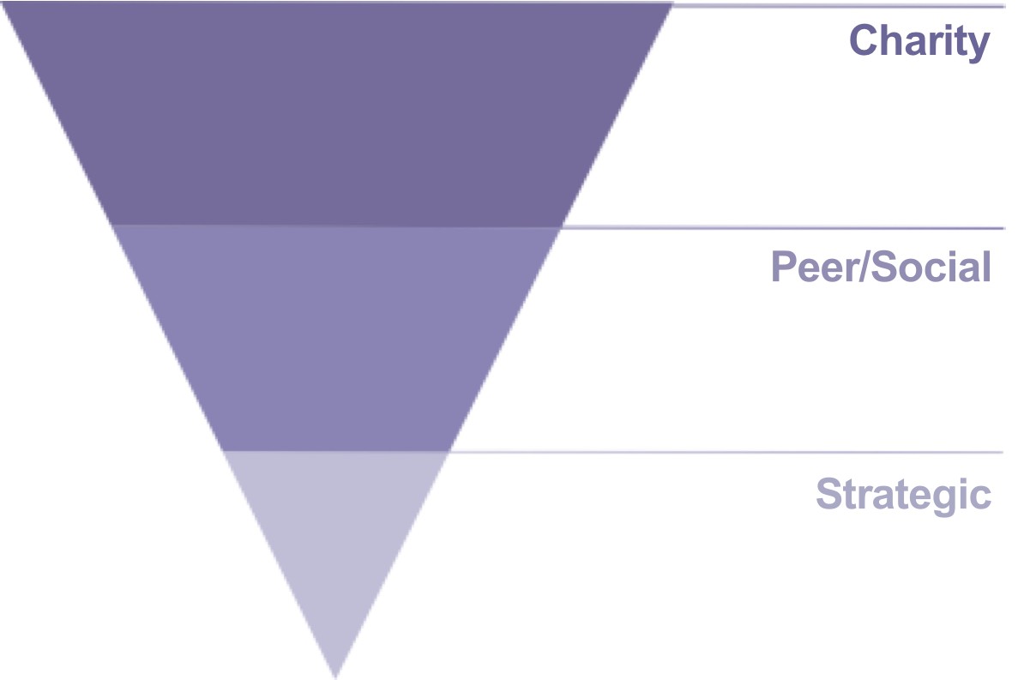
Philanthropic Investment Portfolio Allocation

Slide 38
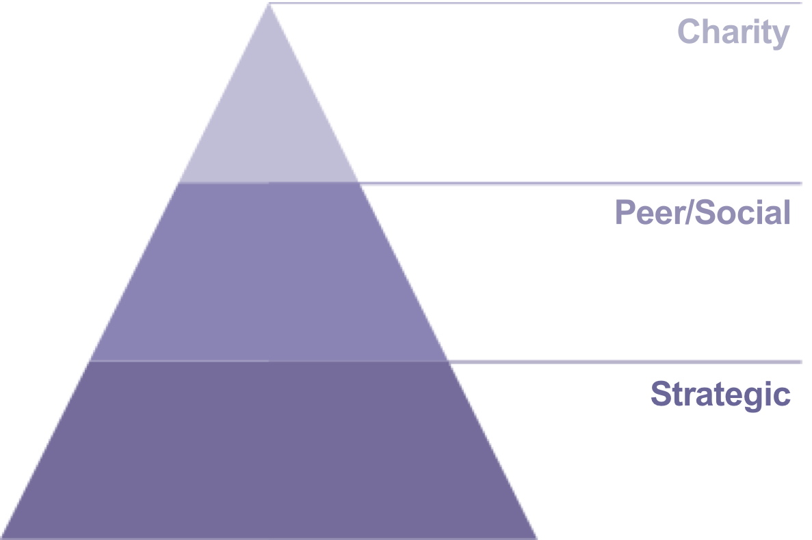
Philanthropic Investment Portfolio Allocation

Slide 39
Contact
Tracy Mack Parker
tracy@tpw.org
www.tpw.org

