Slide 1
The Giving Code & The Giving journey
Insights on New Philanthropy
Presentation for the SVPI Conference
April 27th, 2018 - Chicago
Notes:
Use headers to tell the story: active
Economic growth in SV to Explosive Economic Growth in SV
Just read headers and know what the deck is about
OR if the picture makes the point no header

Slide 2
Agenda
Who is in the room? (SVP members, nonprofits, leaders/staff)
What questions do you have about new donors?
Presentation on Giving Code data & discussion
Presentation on Giving Journey data & discussion
Conversation and report back

Slide 3
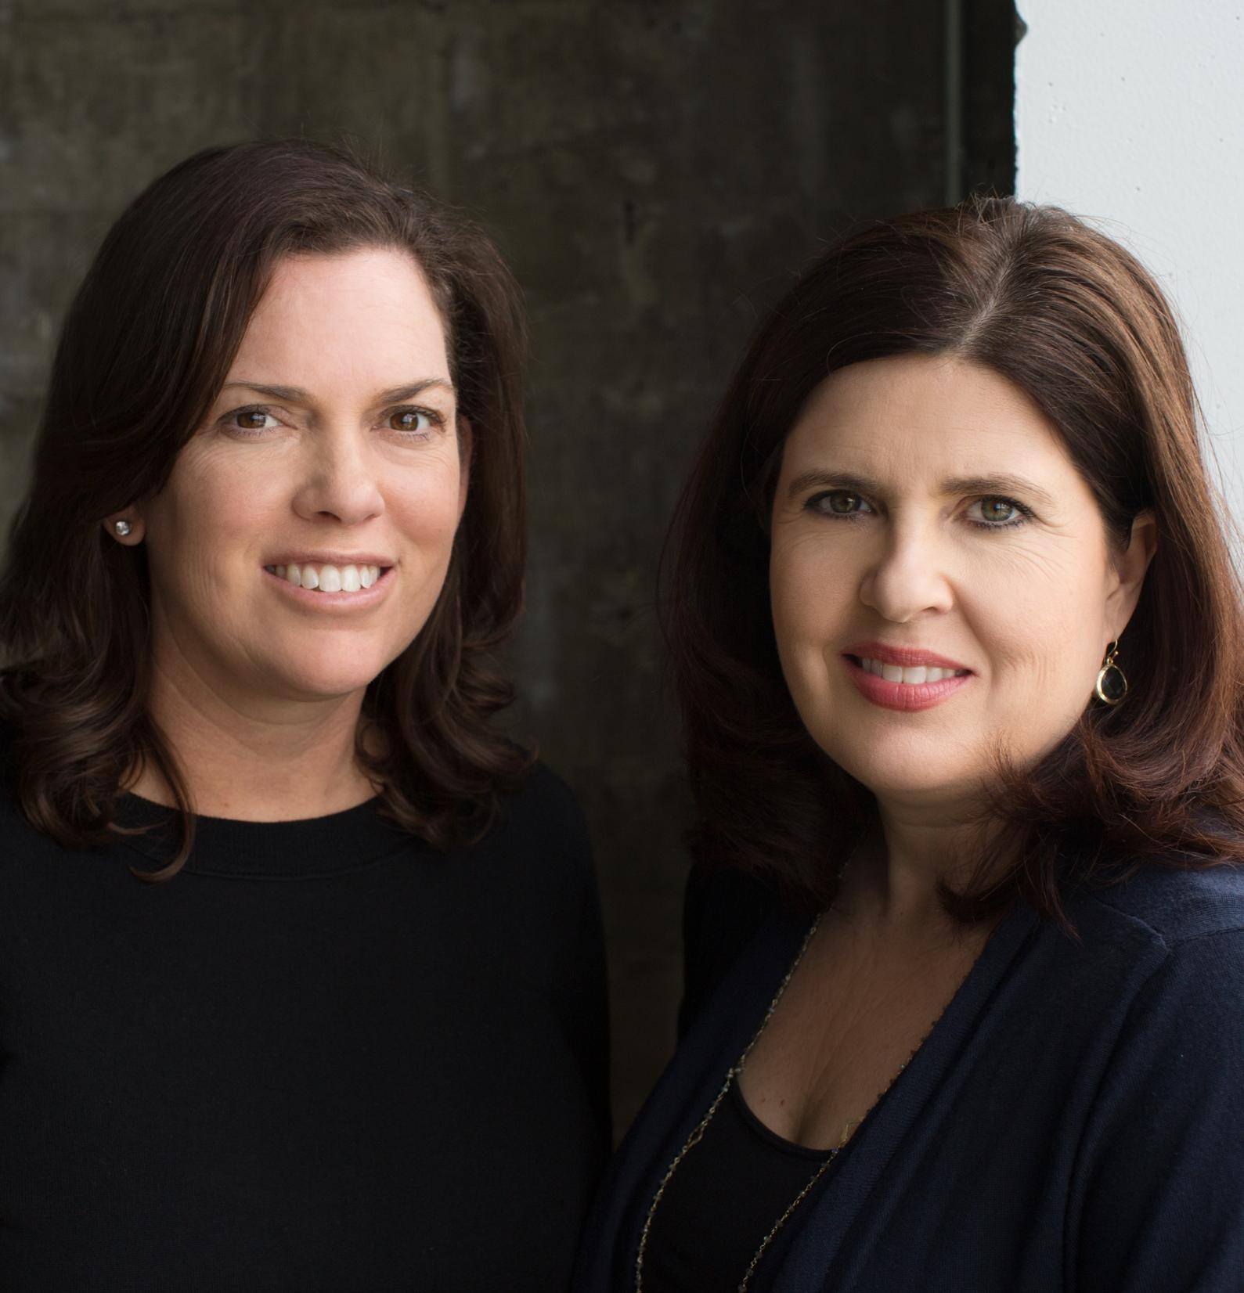
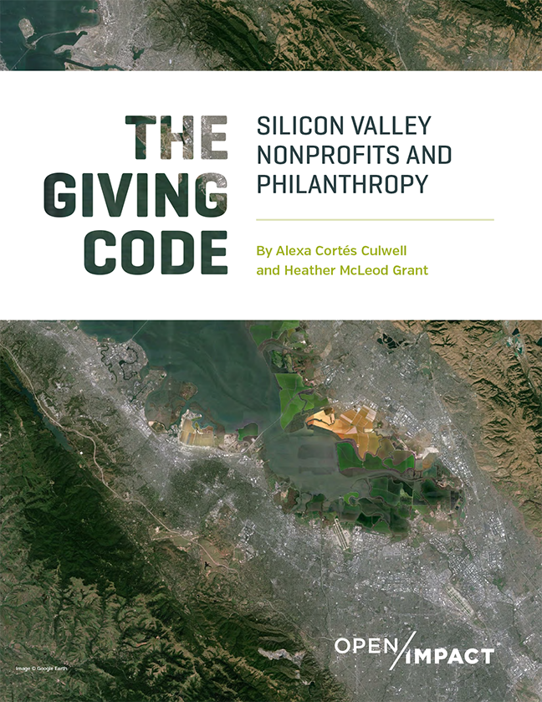
About Us
Co-founders of Open Impact
We partner with exceptional leaders to envision, design, and accelerate the work of social change.
Notes:
We both live and work in Silicon Valley:
Social Impact Advisors
Work with both nonprofits and funders
Raising our kids and families here
Deeply involved in the community as volunteers, donors, etc.

Slide 4
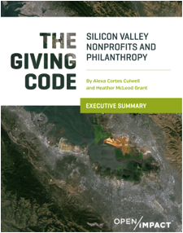
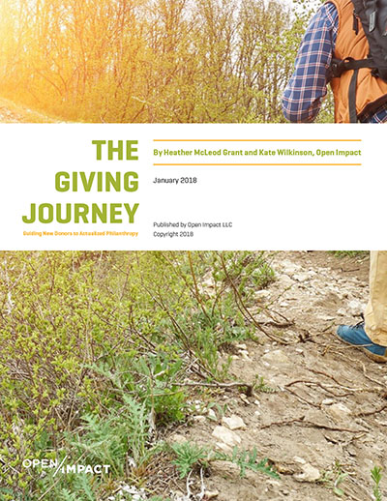
You can Download both Reports online
www.openimpact.io/giving-code

Slide 5
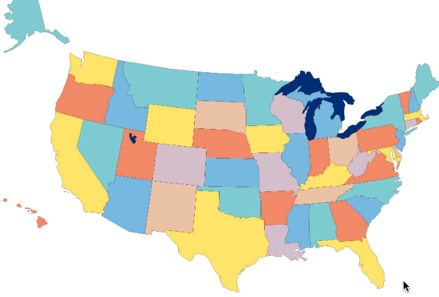
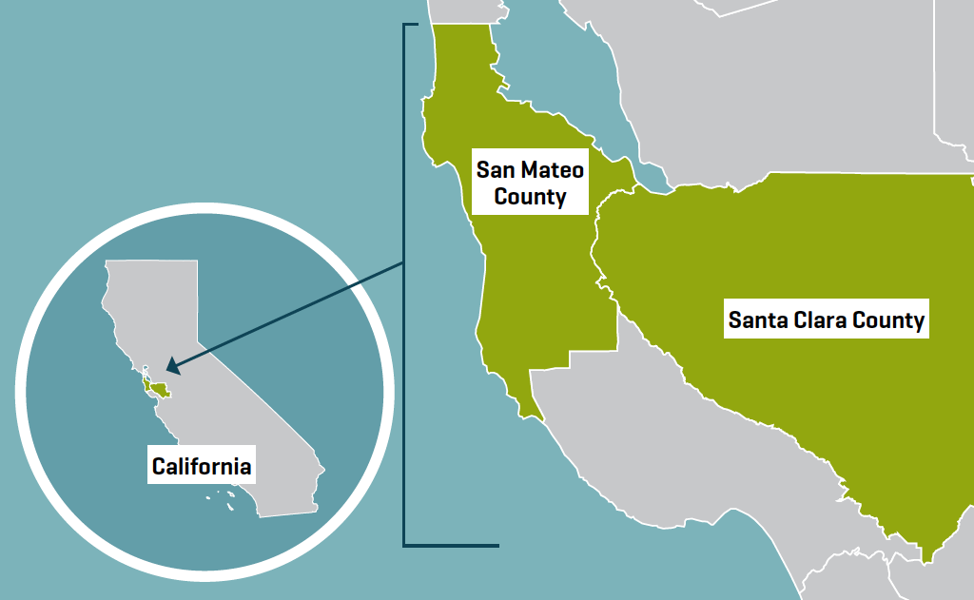
Silicon valley PHILANTHROPY has lessons for others
Our region of study
Notes:
local government ecosystem is highly fragmented;
60 municipalities (towns, cities, unincorporated areas)
55 separate school districts

Slide 6
WHAT IS HAPPENING WITH NEW / Silicon valley PHILANTHROPY?
SUPPLY SIDE (philanthropic funding)
DEMAND SIDE (nonprofits)
How can these two groups leverage their collective strengths to meet community challenges?
How can we help the social capital market work better?
Notes:
How many community-based organizations operating in Silicon Valley, what issues are they addressing and what are their needs?
Are local CBOs struggling to meet demand, and if so why?
How much new wealth is being created and how much is being channeled toward philanthropy?
Within SV philanthropy where is the money going, and how much is being directed to local organizations and issues?
What are the motivations and barriers to giving overall, and specifically to giving locally?
Caveats:
There is no aggregated or streamlined data in our sector – we had to cobble together data from a variety of sources, often with varying timelines, levels of analysis, and was often self-reported.
Some of it was apples to oranges and we had to figure out how to create analogous comparisons across different data sets.
Some organizations were able to provide complete data sets while others could only share aggregated high level numbers.

Slide 7
We gathered lots of data thanks to 13 partners
QUANTITATIVE
EXISTING
Local foundations
Nonprofit Finance Fund
Foundation Center
NEW
Nonprofit survey
Donor Advised Funds
QUALITATIVE
300 stakeholders conversations

Slide 8
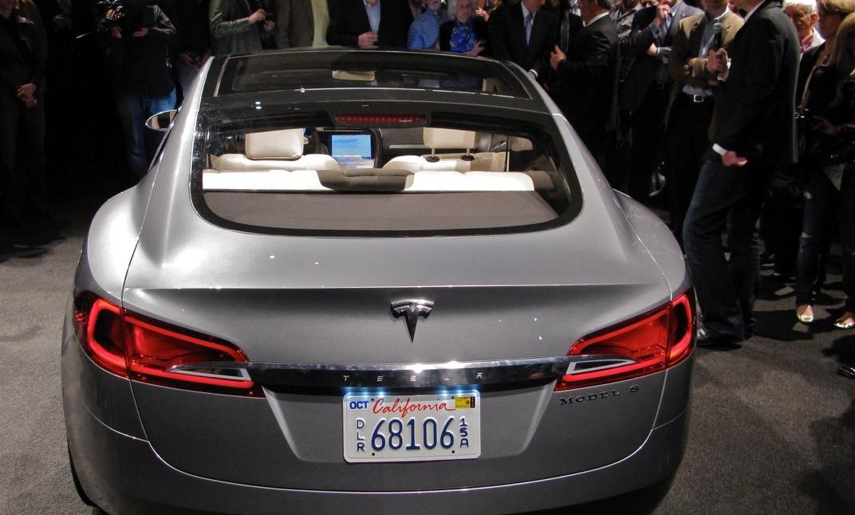
Economic Growth in Silicon Valley
21 Unicorns
$833B in annual sales
76K Millionaires and Billionaires in SV
California global economic status driven by SV
California global economic status driven by SV
Notes:
21 Unicorn companies in last few years
$833B in sales each year from SV companies
CA economy is 6th in world; SV is a significant share of that
76,000 Millionaires and Billionaires in SV

Slide 9
Across All Segments, Philanthropy Is growing
individual
private foundations
donor advised funds
corporate giving

Slide 10
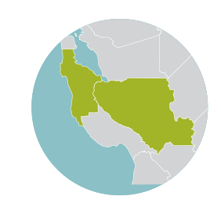
Individual Giving is Increasing CHARITABLE GIVING AS % OF ADJUSTED GROSS INCOME, 2008-2013
SILICON VALLEY
CALIFORNIA
UNITED STATES
Source: IRS Statement of Income Datasets, 2008-2013 Giving USA/Chronicle of Philanthropy “How America Gives” Methodology. [Itemized Contributions as % of AGI. Approximately 80% of donations by individuals in US made by itemizers]

Slide 11
private foundations With > $10M doubled since 2000
NEW FOUNDATIONS $10M+ ADDED EACH TIME PERIOD
Notes:
There are 72% more SV-based private foundations with more than $10M in assets in 2015 than a decade earlier.
Total combined assets of all SV-based private foundations grew 80% in that same period
As of 2015 there are 1,146 private foundations in the two counties with combined assets of $31.6B

Slide 12
SV-Based DAFs: leading national providers GROWTH IN NUMBER AND AVERAGE ASSETS OF SV-BASED DONOR-ADVISED FUNDS, 2005-2015
946%
Growth in assets to 2.2B

Slide 13
Growth in SV Corporate Contributions to locally based nonprofits, 2007-2015
$114M
$117M
$103M
$83M
$79M
$70M
$56M
$57M
$47M

Slide 14
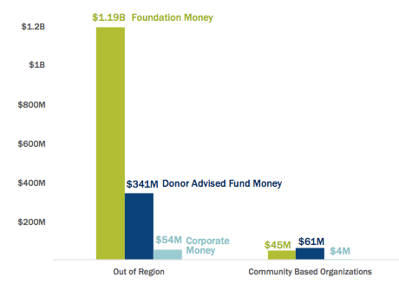
WHERE IS THE MONEY GOING? ~90% IS leaving the region

Slide 15
The Prosperity Paradox
1 in 3 SV kids hungry
Low income families earn less than ‘89
30% residents rely on assistance
17% earn <$35,000/year
Middle class is declining: ~11%

Slide 16
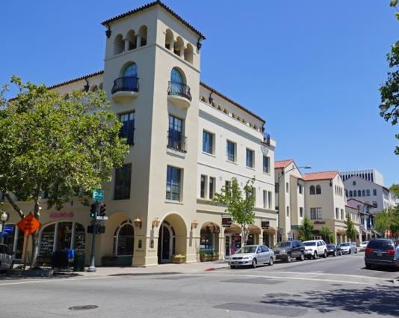
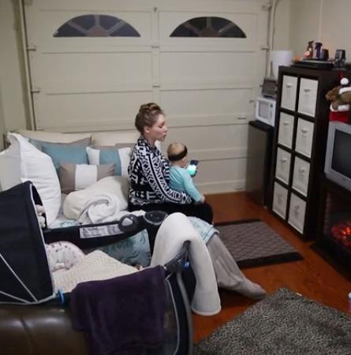
Rising Cost of Living is disrupting quality of life
Median house costs $830,361
94k income required to rent an apartment
Rent is 227% higher than national average
7500 residents moved away in 2015
Only 27% of first-time home buyers in SMC can afford a home
http://www.tulsakids.com/Time-Out/Web-2015/This-working-single-mom-lives-in-a-garage-with-daughter/

Slide 17
Perfect storm for community based organizations
DEMAND IS UP
COSTS ARE RISING =
CBOs STRUGGLING
80%
Reporting increased demand
30%
are running deficits
46%
Report doing business in SV is hard:
Talent,
Wages
Rent
54%
Wait list for services
47%
had less than 3 months cash on hand

Slide 18
Large INSTITUTIONS Capture the Most Resources 3,145 ACTIVE PUBLIC CHARITIES REPORTED REVENUES OF $20.5B

Slide 19
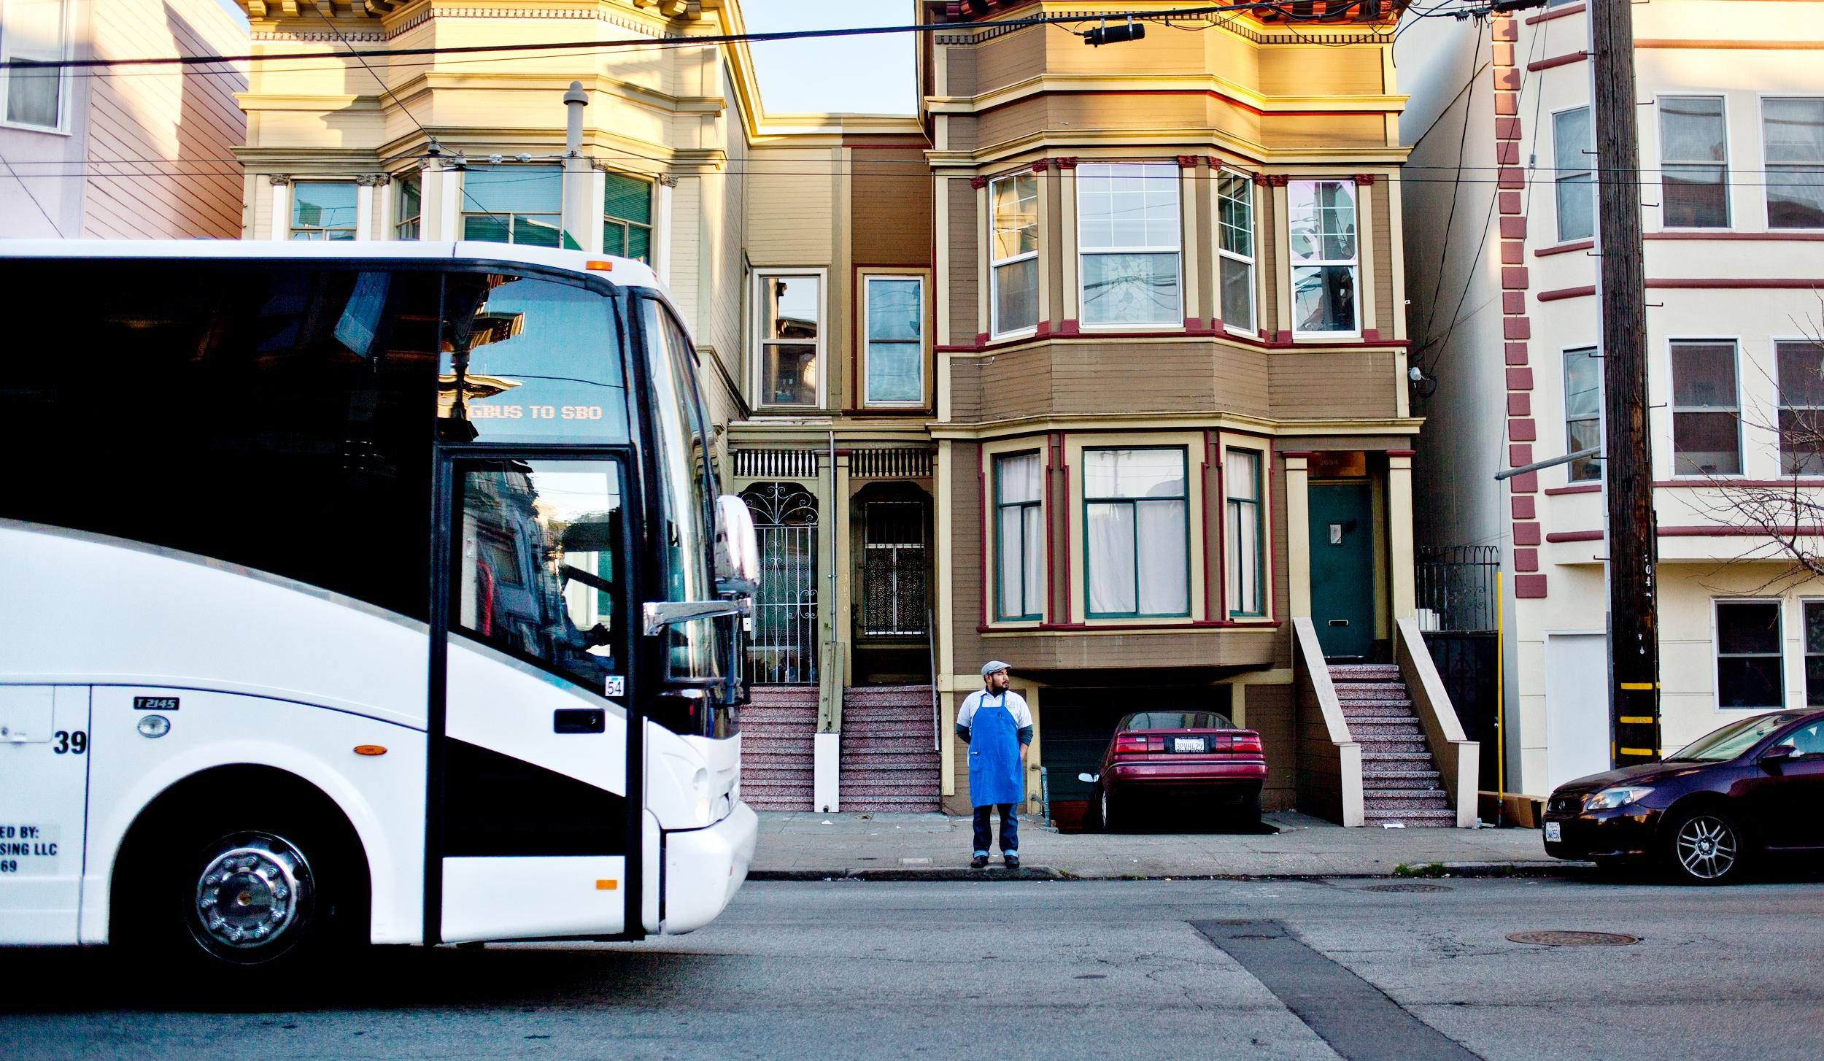
The philanthropic landscape is changing - new intermediaries:
Family offices and wealth advisors are gatekeepers
Hybrid structures for impact investing (LLC)
New giving vehicles, such as DAFs (Donor-Advised Funds)
How does this affect me?
Traffic increases
Lack of Affordable Housing
Our first responders don’t live here
Notes:
Ask your nurse, teacher, police officer, fire fighter where they live – it’s likely not here
More stats:
Transportation: 78 hrs in traffic
30% of workers commute to another county
Education: 50% of 3rd graders in SM county are failing to meet grade-level reading requirements
45% of 8th graders are below proficient on state algebra test
67% of tech workers in SV are born outside US

Slide 20
WHY the gap? Barriers to connection
knowledge & information
NETWORKS & experience
mindset & language
empathy & insight

Slide 21
Q&A/ Discussion (10 min.)
Questions?
How is your local social sector landscape changing?
What do you see happening with philanthropy and CBOs? Are the dynamics similar or different?
What can you take away from this data?

Slide 22
THE GIVING JOURNEY
Formative experiences shape giving
The wealth event and “pause”
Getting unstuck & starting to give
Ramping up - accelerators
Actualized philanthropy

Slide 23
Where are you/ your members on the journey?

Slide 24
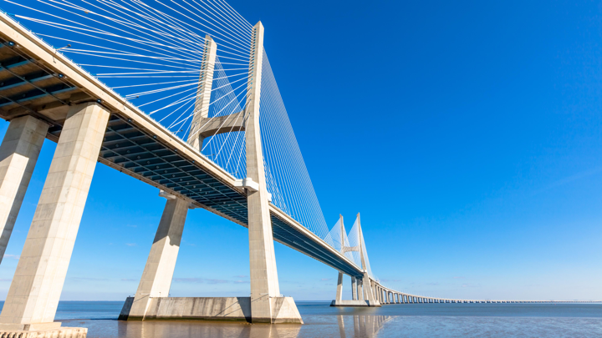
Mindsets and motives for giving
1
2
3
4
5
personal
Connected
High impact
innovative
portfolio

Slide 25
1
Personal/ Values
DONOR behavior
Advice
Shaped by personal experiences
Gratitude, family, faith and work
First the why, then the how
Start with the donor/ member
Understand their journey & stage
Ask them questions about their values/ motives: why?
What has shaped you?
Why do you give?

Slide 26
2
Connected/ Social
DONOR behavior
Advice
Want to build relationships
Learn by doing, experiential
Influenced by peer networks
Cultivate, cultivate, cultivate
Engage them; make giving social
Activate your/ their networks
Which networks matter?
How do you learn?

Slide 27
3
High-Impact
DONOR behavior
Advice
Focus on root causes, strategic
Systems-thinkers, scale
Want to hear about outcomes/ ROI
Lead with impact, donors follow
Emphasize the ecosystem (place)
Appeal to both head and heart
What is your aspiration for local impact?

Slide 28
4
Innovative
DONOR behavior
Advice
Love disruption, innovation
Start with small bets, agile
Build trust through iteration
Emphasize your differentiation
Start small and build
Prove with a prototype, then grow
What are you trying to disrupt or change?

Slide 29
5
Portfolio
DONOR behavior
Advice
Approach giving as “investing”
Use multiple vehicles to give
Diversified across issues, areas, orgs
Understand portfolio approach
Offer multiple options to give
Make the case for how you fit into their portfolio
What does your portfolio look like?

Slide 30
Q&A/ Discussion
How are you innovating your SVP model to stay relevant?
What is your unique value proposition in your community?
Are you making giving social, fun, experiential, and rewarding?
Are you diversifying your network? (millennials, women, families)
Have you thought about your donors’ learning journey?
What else?

Slide 31
THANK YOU!! Download both Reports online
www.openimpact.io/giving-code

