Slide 1
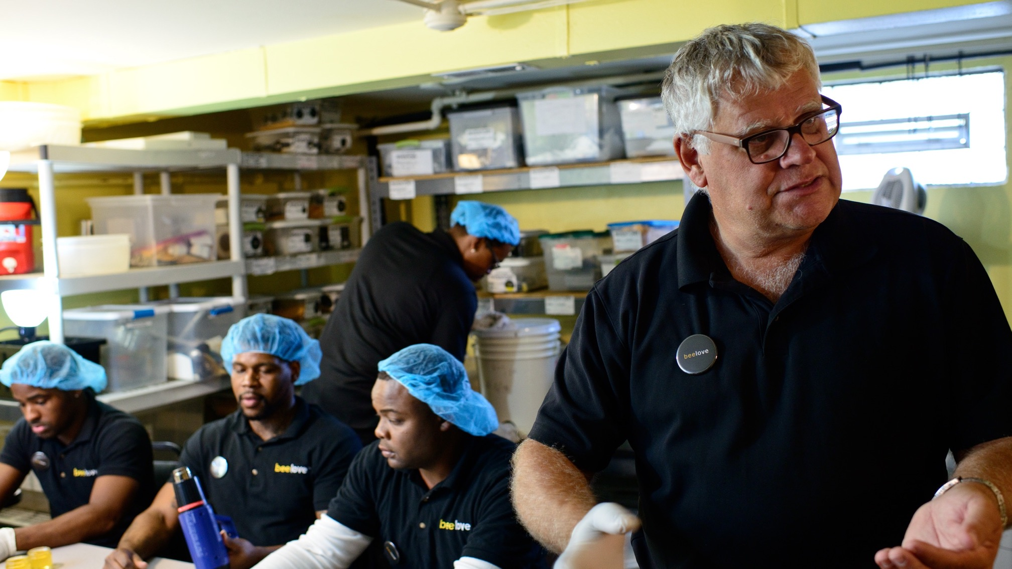
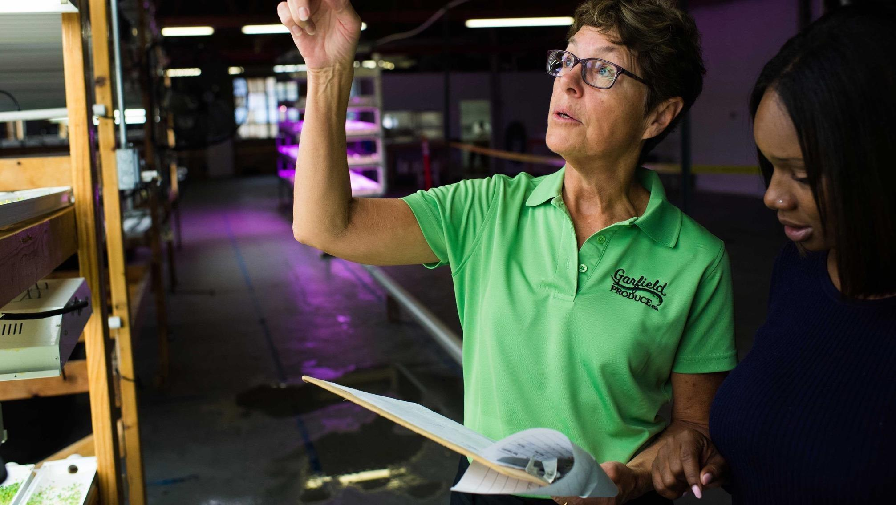
The Challenge of Impact Investing
@BenefitChicago

Slide 2
What is Impact Investing?

Slide 3
Impact investments aim to generate specific beneficial social outcomes in addition to financial gain.

Slide 4
Why now?

Slide 5
The way things change has changed.

Slide 7
Information is everywhere

Slide 8
Notes:
We’re demanding more of the companies we do business with – people are conscious, and are economically motivated by engagement.

Slide 9
It’s a virtual world

Slide 10
Notes:
Communities are less confined to or defined by place
Technology allows us to build relationships and engage others through networking and fluid communication.

Slide 11
Demographics are changing

Slide 12
Notes:
Led by millennials and women – the next generation is not willing to wait for change or in line for their turn.

Slide 13
There is significant lack of capital across the areas that need it most.

Slide 14
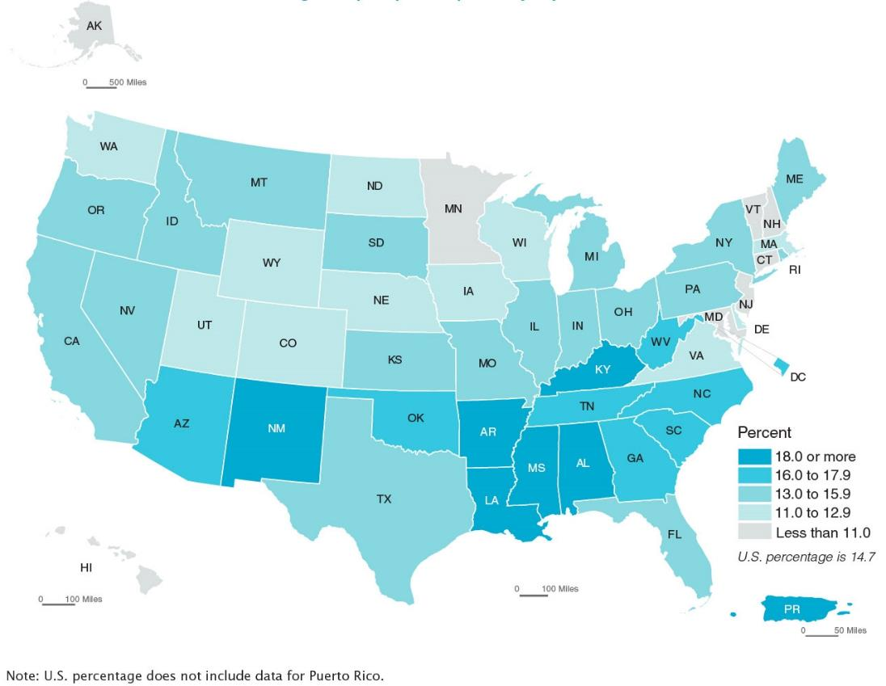
Areas of persistent poverty have a need for capital
More than 14% of the U.S. population has been living in poverty
Source: U.S. Census Bureau, 2015 American Community Survey

Slide 15
Many of these areas are rich with intellectual capital,
social capital, and
investor capacity.

Slide 16
Chicago Capital Landscape
We need to bridge the gap
between the areas of poverty and capital
Source: U.S. Census Bureau, 2015 American Community Survey

Slide 17
Shared Opportunities

Slide 20
Notes:
Led by millennials and women – the next generation is not willing to wait for change or in line for their turn.

Slide 21
@WilliamWTowns @BenefitChicago
info@BenefitChicago.org

Slide 22
Mark your calendars for the next…
Impact Investing
Community of Practice Call
Thursday, June 7th
5 pm Pacific
Look for registration e-mail soon!
STRETCH | CONNECTION | EQUITY | ACCOUNTABILITY

